Slide 1
Kentucky Tobacco Tax Facts 2014
Cigarette Excise Tax: $0.60/pack
Current national rank: 42nd
2014 Cigarette Sales: 391.2 million packs
8.3 million packs bought or smoked by kids
Gross state cigarette excise taxes collected: $234,727,000 (plus $113,451,000 from sales tax)
Approx. $4,980,000 from youth smoking
MSA dollars received: $118,520,588
Source: The Tax Burden on Tobacco, Historical Compilation, Volume 49, 2014.

Slide 2
State Cigarette Tax Rates
Average = $1.61 per pack
As of 4/1/2016

Slide 3
Tobacco Taxes and Tobacco Use
“Federal, state, and local taxes that raise prices on tobacco products improve public health by reducing initiation, prevalence, and intensity of smoking among young people. Comprehensive reviews of the literature on the effect of price on tobacco consumption estimate a 3­-5% reduction in overall cigarettes consumed as a result of a 10% increase in cigarette prices, and youth and young adults have proven to be even more responsive than adults to higher cigarette prices….”
--2012 U.S. Surgeon General’s Report, Preventing Tobacco Use Among Youth and Young Adults, pg. 809-810

Slide 4
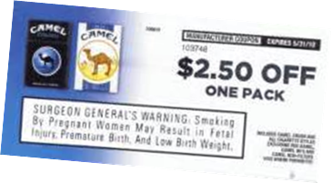
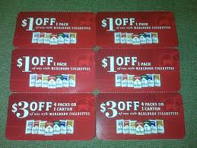
Why at least $1.00?
If the average price of a pack of cigarettes in KY is $4.86, and a 10% price increase will reduce consumption by 3­-5%, why push for at least a $1.00 when $0.50 will do the trick?
“…it is possible that the observed reductions in smoking among youth would have been even larger had the price increases from state and federal taxes not been offset at least partially by discounting and other price-related promotions by cigarette companies.”
--2012 SGR, pg. 526

Slide 5
The Cost of Tobacco in KY
Annual health care costs from smoking: $1.92 billion
Medicaid costs: $589.8 million
Residents’ state & federal tax burden from smoking-caused government expenditures: $1,185 per household
Productivity losses: $2.79 billion
Source: Campaign for Tobacco Free Kids

Slide 6
Tax Reform
In the Kentucky’s movement for tax reform, where does increasing the tobacco tax fit?
Opportunities?
Threats?

