Slide 1
Local Smoke-free Ready or Not
Amanda Bucher
Program Coordinator
Kentucky Center for Smoke-free Policy
Elizabeth Burrows
Health Educator
Oldham County Health Department

Slide 2
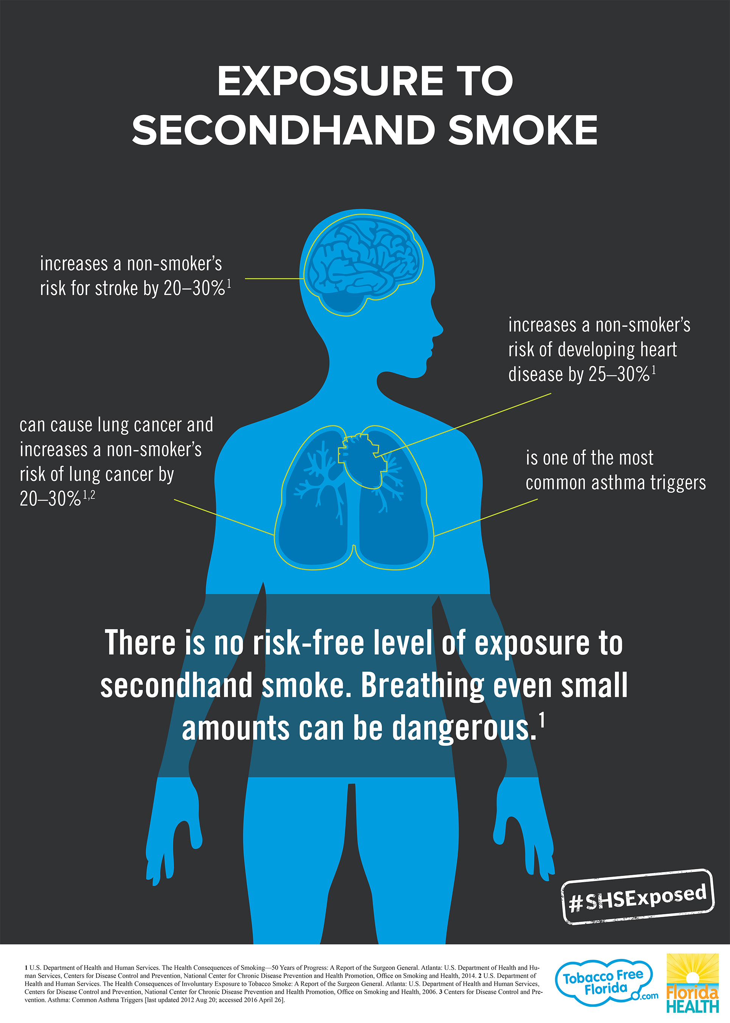

Slide 3
Why focus on a smoke-free workplace law?

Slide 4
“Tobacco Control Vaccine”
100% Smoke-Free Policies
Cessation
Access
Tobacco Price Increases
Hard Hitting Media Campaigns
Source: Centers for Disease Control and Prevention. Best Practices for Comprehensive Tobacco Control Programs. 2014.
Notes:
Smoke-free laws with no exceptions are like a vaccine to prevent heart disease and cancer. A lower ‘dose’ for KY will not improve population health, nor save healthcare dollars.

Slide 5
Smoke-free Indoor Workplace Policies are Only Effective if they are Comprehensive, or 100%
Reduced exposure to secondhand smoke
Employees at work
Patrons in indoor public places
Air quality improves
Reduced tobacco use
More smokers quit
Fewer youth start to smoke
Reduced hospitalizations and healthcare costs

Slide 6
Types of Smoke-free Workplace Laws
COMPREHENSIVE
Covers all workplaces and enclosed public places
Protects all workers from exposure to secondhand smoke. No one is left out.
PARTIAL
Covers only some enclosed public places
Exempts certain businesses and specific communities
Leaves workers and patrons unprotected from exposure to secondhand smoke
Creates an uneven playing field for businesses and the potential for legal challenges
Effective; biggest gains in health and economics

Slide 7
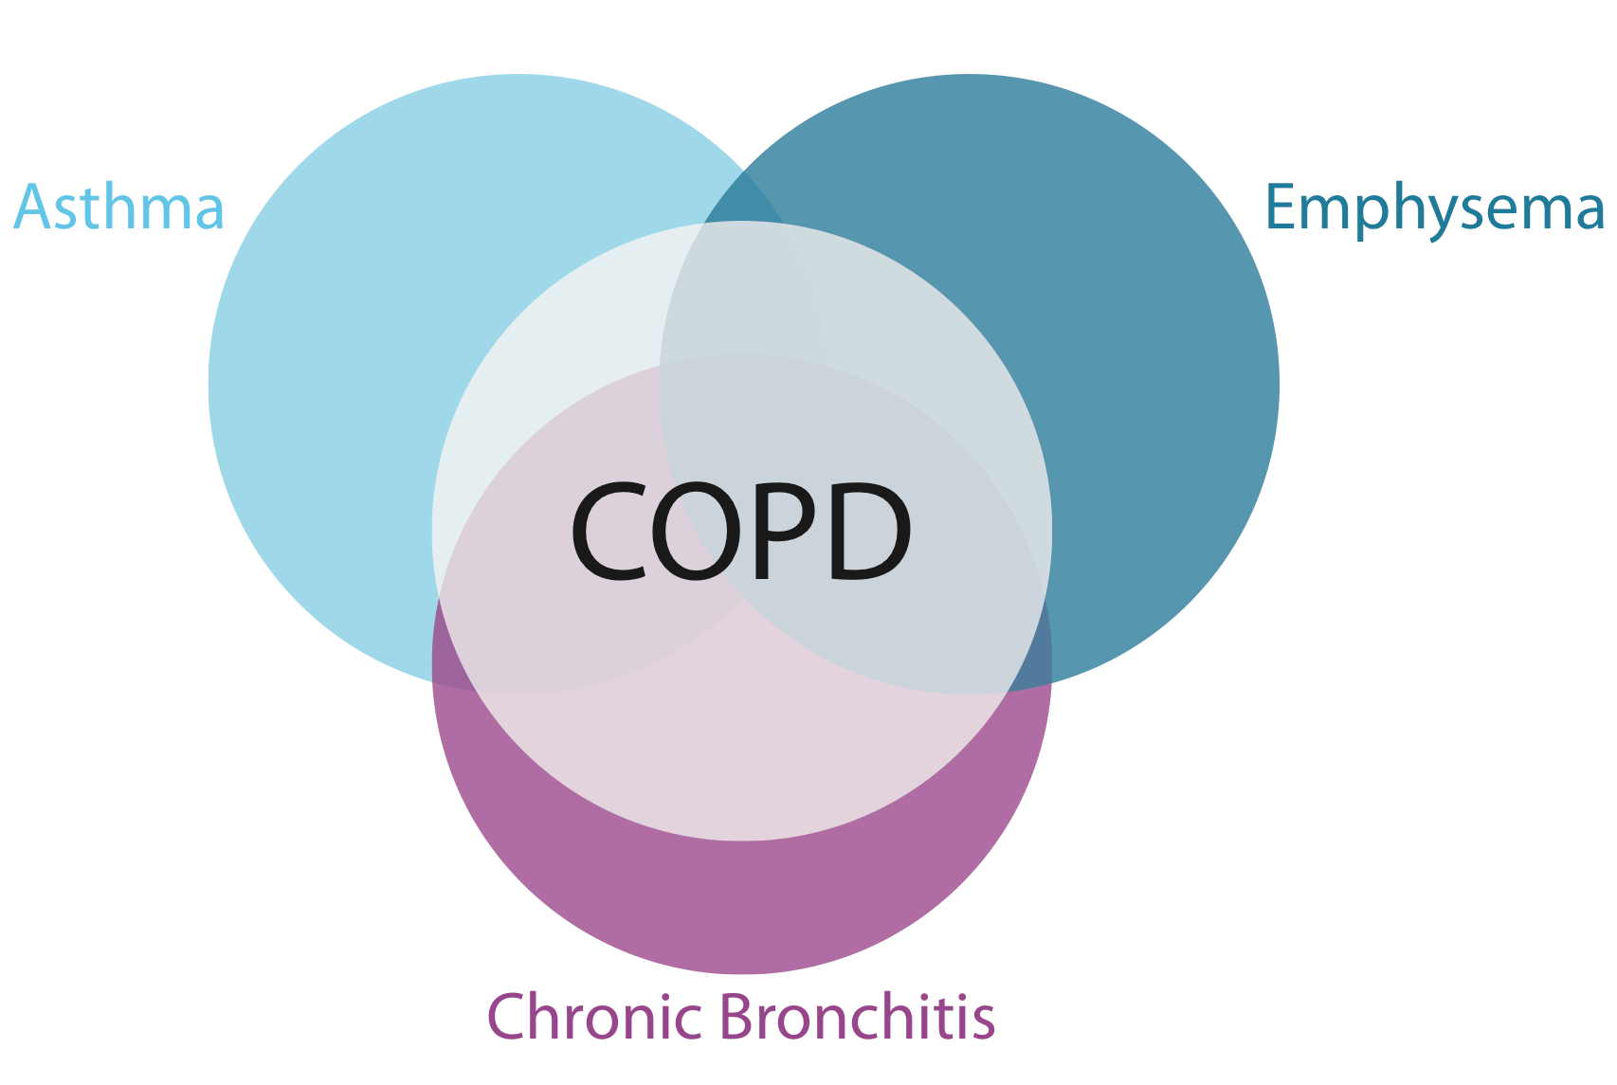
Fewer Hospital Visits for COPD
People with COPD living in Kentucky communities with comprehensive smoke-free workplace laws are 22% less likely to be admitted to the hospital compared to those in communities with moderate-weak or no smoke-free laws.
Hahn, E.J., et al. American Journal of Public Health, 2014.
Notes:
Fewer hospital visits for serious heart problems and asthma

Slide 8
Notes:
Conclusion: Fewer new cases of lung cancer in KY communities with COMPREHENSIVE smoke-free workplace laws. Moderate and partial laws do not confer the same benefit.
Lung cancer incidence was 8% lower in KY communities with comprehensive smoke-free workplace laws, compared with communities that do not have laws. This effect was not seen in communities that have partial laws. There are 4000 new cases of lung cancer diagnosed every year in KY. Comprehensive smoke-free laws across the state could prevent 325 of them.

Slide 9
Smoke-free Laws Save Money
32% reduction in adult smoking since Lexington’s law took effect (16,500 fewer smokers)
Impact: $21 million per YEAR in healthcare cost savings
Notes:
The smoking rate in Fayette county declined nearly 32% (from 25.7% before the smoke-free law to 17.5% after), while smoking rates remained stable in other similar Kentucky counties without smoke-free ordinances. Lexington’s law resulted in 16,500 fewer smokers for an estimated annual healthcare cost savings of $21 million.

Slide 10
Businesses thrive in Smoke-Free Communities!
Studies in Kentucky and worldwide show no economic harm in smoke-free communities (even in our rural communities).
Lexington restaurant employment increased 3% after the smoke-free law took effect, while bar employment remained stable. Downtown is thriving!
87% of tourists prefer a smoke-free hospitality environment
“Smoking is not only killing us, it is bankrupting us – both in terms of costs to business and costs to government.”
Dave Adkisson, President and CEO
Kentucky Chamber of Commerce, 2013.
Notes:
You’ll hear scare stories about losing money! Opposition tried to tell Georgetown businesses that a Lexington bowling alley closed after Lexington’s law took effect (not true).
Where will customers go? They will still go to their favorite restaurants and social gathering places. They will simply step outside to smoke.
92% of the Chamber of Commerce members are supportive of smoke-free laws.
In Lexington, employment in bars remained stable after the smoke-free law took effect. Restaurant employment increased by 3%, resulting in 400 more employees per month. The study analyzed data 5 years prior to and 14 months after the law took effect in April 2004.
Source: Pyles MK, Mullineaux DJ, Okoi CTC, Hahn EJ. Economic impact of a smoke-free law in a tobacco-growing community. Tobacco Control. 2007;16:66-68.

Slide 11
How to advocate for a local smoke-free policy

Slide 12
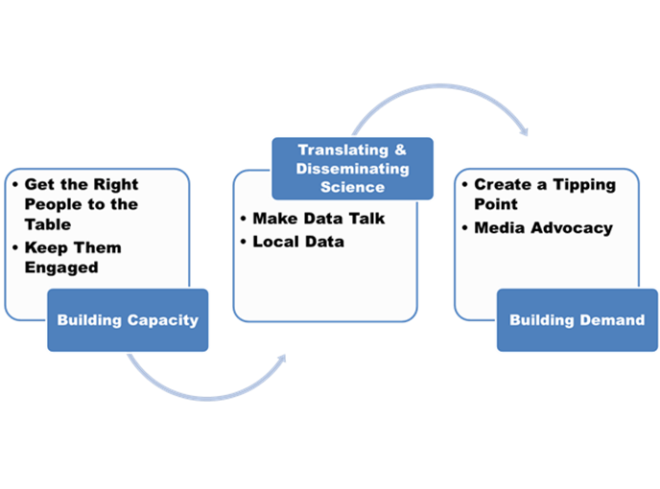
How to Advocate for a Smoke-free Workplace Ordinance
Our model works! Nearly one-third of the 22 rural counties that received outreach and technical assistance adopted smoke-free laws covering restaurants, bars, and all workplaces compared to 0 comparison counties.
Hahn EJ, et al. J Rural Health. 2014

Slide 13
Oldham County Smoke Free Timeline
Oldham County Tobacco Awareness Coalition founded
Oldham Passes Comprehensive Ordinance*
Process to strengthen ordinance begins
Opposition requests amendments . . .
2003
2006
2007
2017
2018
2005
2018
Smoke Free Oldham Coalition started
Oldham passes amendment weakening comprehensive ordinance
Comprehensive ordinance passed and enacted!

Slide 14
Building Capacity
Recruit non-traditional partners and credible local leaders to your coalition.
Brand your campaign
Leverage funds
Notes:
*Mayfield’s highest dimension on the SF CAT was resources.
Traditional partners: network with health partners (health care providers, educators, police and fire department personnel, government officials, media, business/economic leaders, recreation personnel, youth organizations)
Non-traditional partners: artistic organizations, church/faith groups, service groups, support groups, sports groups, social cause groups, interest groups, ethnic associations
Credible Leaders: business community, educators, medical community, parents, grandparents

Slide 15
Building Capacity
The right people – 2006 OCTAC
Local hospital, physicians, grassroots advocates, ACS, Breathe, local government champions, Campaign for Tobacco Free Kids, youth, business owners, health departments, local drug free community groups, ASAP groups, local university faculty, faith community
Engagement Funding
Regular emails and texts Local ASAP groups
Media ads Drug Free Communities
In person meetings
Volunteer appreciation
Community events
Notes:
If you are a part of any of these groups in a community, you can be involved!
Careful of Social Media – we did not have any in 2006, but it has been helpful in 2018 to monitor opposition – not necessarily connect with supporters

Slide 16
Translating & Disseminating Science about Secondhand Smoke and Smoke-free Laws
There is no safe level of secondhand smoke.
Most people know smoking is harmful, but do they know that secondhand smoke is more than just a nuisance?
Use data to show that there is a problem in the community.
Indoor air quality results
Adult smoking rates, leading causes of death
Economic toll of tobacco use for the state of Kentucky and individual businesses.
Use data to show that a comprehensive smoke-free ordinance is the solution.
Reduced hospitalizations
Reduced smoking rate
Reduced healthcare costs
Notes:
Sharing the science of secondhand smoke and smoke-free policy in user friendly formats
Fact sheets:
Economic impact of smoke-free policy
Secondhand smoke and health
E-cigarettes and hookah smoking
Summary of research
County data:
Heart attack reduction projections
Leading causes of death
Tobacco use rates
Summary of local smoke-free laws in KY
Map by strength of law and percent covered

Slide 17
Translating and Disseminating Science in Oldham County
Oldham 2006
Air Quality Studies
Community telephone survey
Data on secondhand smoke
Oldham 2017
Information on electronic cigarettes
Data on secondhand smoke
New secondhand smoke data from other communities

Slide 18
Community Telephone Survey

Slide 19
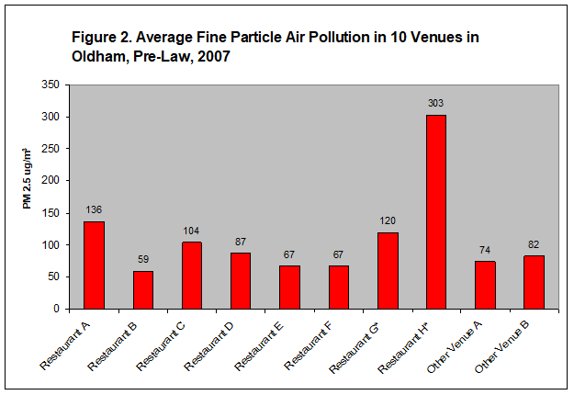

Slide 21
Building Demand: Media Resources
Paid Media
Evidence based messages available in various media formats (billboards, postcards, newspaper ads)
Examples from other communities of radio, video, and print PSA’s
Messaging strategies
Earned Media
Templates and guidance on letters to the editor, editorials, periodic health columns in the paper
Notes:
Sample letters to the editor on worker health, secondhand smoke, ventilation, call to action (from someone who can lobby) etc.
It is important to develop a relationship with the media and to use that relationship to disseminate information to the community (using both paid and earned media). Become the “go-to” person on SHS and SF
Low-cost ways: Posters, newspaper ads, direct mail, church bulletins, radio/cable TV shows (many hospitals have marketing dollars they need to spend)

Slide 22
Building Demand
Smoke Free Dining Guide
Letters to the Editor
Paid Ads
Email lists
Signatures/
postcards

Slide 23
Building a Case for Legislative Action
Create a tipping point
Assess policymaker support and educate
Identifying legislative champions
Demonstrate community support with resolutions, petitions, and public opinion polls
Draft an ordinance
Notes:
*Mayfield’s second lowest dimension was leadership.
Resolution: used for groups/organizations to sign on in favor of a smoke-free community – will help provide political cover for policymakers – no group is too small
Petition: signed by individuals. Coalition members get signatures at other meetings/groups/community events. Can build an “action alert” list from the petitions to use when an action is needed from supporters (a person who can lobby sends out the action alerts)
Building on existing local infrastructure: stakeholders; influential people
Lobby: a direct call to action about specific legislation to legislators or the public asking them to vote a certain way
Advocacy: educate and inform – there’s a lot that can be done within these parameters including helping legislators imagine someone they know who works in a smoky environment and what risks they face
*Tips for conducting a public forum or avoiding lobbying (difference between forums and hearings)
Continue to educate and build demand throughout the legislative phase (use of fact sheets, presentations, public opinion polls, air quality data)

Slide 26
Celebrate Success!

Slide 27
Air Pollution in Oldham County by Workplace, Post Law 2008

Slide 29
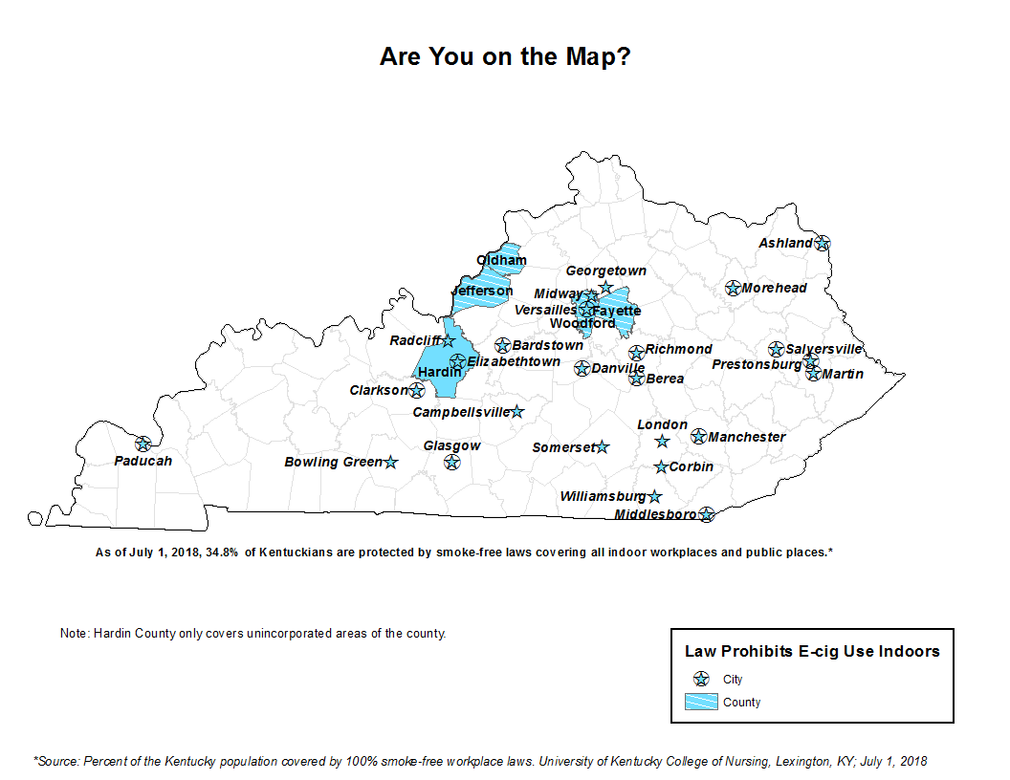
Notes:
If you work in one of the blue communities, it is appropriate to work on TF parks and other outdoor spaces
If you work in one of the pink or yellow communities, strengthen the ordinance to comprehensive.
If there is no ordinance, work on a smoke-free workplace ordinance campaign

Slide 30
Local Smoke- and Tobacco-free Policy Targets
Comprehensive smoke-free workplace laws that cover all workplaces and indoor public places
Biggest gains in health and economics
We recommend workplaces policies as the best starting point for public policy to restrict smoking
Strengthen your community’s partial policy or add e-cigs
100% tobacco-free campus K-12 and university policies

Slide 31
Kentucky Center for Smoke-free Policy www.breathe.uky.edu Get our Partner e-Newsletter: kcsp00@lsv.uky.edu amanda.bucher@uky.edu (859) 323-9958 @kysmokefree
Oldham County Health Department
www.oldhamcountyhealthdepartment.org/
ElizabethF.Burrows@ky.gov
(502) 222-3516

