Slide 1
Reducing Barriers to Tobacco Treatment Workgroups: Health Professionals and Consumers
Jennifer R. Knight, DrPH Kentucky Cancer Consortium

Slide 2
Health Professionals
No need to re-create new materials (written)
Organize and strategize how to get existing resources to health professionals
Better identify the needs
Which professionals?
Which geographic areas of KY?
Strategize on how to reach those that have the greatest needs
Through Insurance companies?
Provider networks and associations?

Slide 4
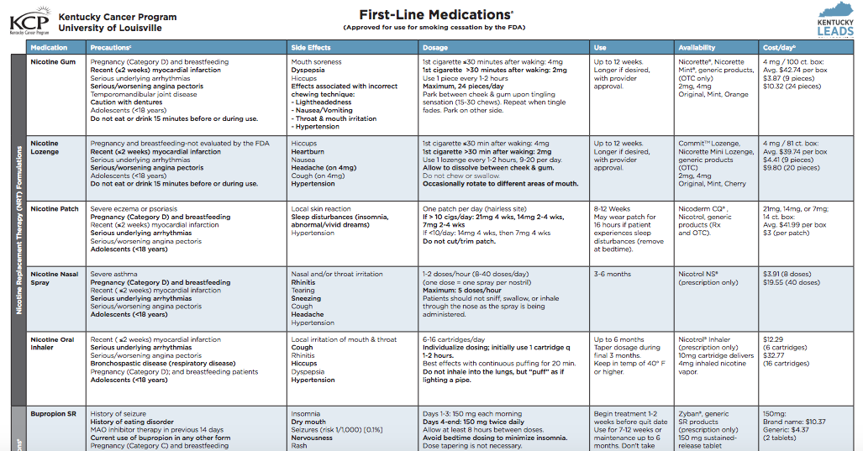

Slide 5
Consumers
So many resources available, it’s difficult to know what to recommend or how to organize it in a way that is most helpful to consumers
Coalition for a Smoke-free Tomorrow
KCP Plan to Be Tobacco Free
Kick it Kentucky! (September 25-30th)
Need to develop and/or collect stories in KY from people who have successfully quit
Particularly video
KET Videos/Documentary
Need to evaluate the success of the cessation bill
KY Voices for Health is tracking data, but not a full scale evaluation
May need to look at qualitative interviews, continuing barriers, etc.

Slide 6
KET and Profiles of Former Smokers
Ken Kurtz, https://www.ket.org/smoking/ken-kurtz-quit-smoking/
Paige Bentley, https://www.ket.org/smoking/paige-bentley-quit-smoking/
Selena Coomer, https://www.ket.org/smoking/selena-coomer-quit-smoking/

Slide 7
Discussion and Next Steps
KET- Teresa Day
Additional Videos
Documentary
Tobacco Treatment Health Professionals Workgroup
Tobacco Treatment Consumers Workgroup

