Slide 1
Patient Advocate Foundation: An Overview
Presented by :
Shonta Chambers, MSW
KCP Statewide Meeting
June 7, 2017

Slide 2
Objectives
Provide an overview of Patient Advocate Foundation Services and Resources
Educate attendees on how to access PAF services, tools and resources
Describe the connection between PAF and SelfMade Health Network

Slide 3
Our Mission & Our Impact
Our Mission
Our Impact
Since our inception in 1996, PAF has touched the lives of millions of Americans. From 1996 – 2016, PAF has served 928,078 individual patients through case management and/or financial assistance programs.
Patient Advocate Foundation seeks to safeguard patients through effective mediation assuring access to care, maintenance of employment and preservation of their financial stability relative to their diagnosis of life threatening or debilitating diseases.

Slide 4
PAF works with patients to navigate today’s healthcare puzzle
Who is PAF?
PAF employs professional case managers with experience in coding and billing, public health and disability systems, insurance, nursing and much more.
Highly-rated national 501 c(3) charity nonprofit earing 6 consecutive 4-star Charity Navigator designations and numerous Case Management awards.
Provides case management services to patients facing chronic, life threatening and debilitating diseases at no cost.
PAF celebrated its 20th year serving patients in April 2016.

Slide 5
PAF Impacting Lives
105,792 patients received direct, sustained assistance from PAF at the conclusion of 2016.
1,405,906 contacts were made by PAF professional staff on behalf of patients to relevant stakeholders in order to bring resolution to healthcare access issues.
PAF case managers obtained debt relief valued at $31.7 million dollars for PAF patients through negotiated write offs, charity care access and coding/billing error resolutions.
Since inception, PAF’s Co-Pay Relief Program has served more than 158,294 patients and allocated more than $300 million in patience assistance.
$0.94 of every dollar donated supports a direct patient service program offered by PAF.

Slide 6
Analysis of PAF Patients
Ethnicity
Gender
Male 34.5%
Female 65.5%

Slide 7
Household Income
Income | Percentage
Less than $11,000 | 17.48
$12,000-$23,000 | 30.39
$24,000-$35,000 | 22.55
$36,000-$47,000 | 12.84
$48,000-$59,000 | 7.04
$60,000-$71,000 | 4.21
$72,000-$83,000 | 1.82
$84,000-$95,000 | 1.22
$96,000-$107,000 | .83
$108,000-$119,000 | .45
$120,000 or More | 1.20
70.42%

Slide 8
PAF Mission Analysis
Mission Analysis
Medical Debt Crisis Issue Analysis

Slide 9
How we do it
Case Management
College Scholarships
Co-Pay Relief
Partnership Programs
Specialty Programs
Educational Materials
Financial Aid Funds
20+ more programs!

Slide 10
What Does PAF Do?
Patient Advocate Foundation seeks to safeguard patients through effective mediation assuring access to care, maintenance of employment and preservation of their financial stability.
Provide real-time help for TODAY’s needs.
Personalized assistance
Assigned Case Manager
Short and Long term case duration
“Active liaisons” that work on behalf of patient
Phone-based interaction
Free assistance to patients, caregivers, or their POC
Confidential and Security-aware
Engagement within 48 hours
Issues are focused in 3 areas:
Insurance | Financial Stability
& Medical Debt | Employment
Related

Slide 11
Whom Does PAF Serve?
?
ELIGIBLE FOR CASE MANAGMENT SERVICES
Patients may have any INSURANCE status
Patients or caregivers of any AGE
Any GENDER
Any ETHNICITY or cultural heritage
Any EMPLOYMENT status
Any STATE in the U.S. or U.S. Territory
Patients and households with any INCOME range
Patients with a broad range of disease and diagnosis
IILLNESS DEFINED AS:
Or “Debilitating” Illness
Patient must have an official Diagnosis (or in the midst of screening) based on
“Chronic”
“Life Threatening”

Slide 12
Service areas of Concentrations
Screening and enrollment services
Insurance navigation services
Financial Aid
Appropriate insurance coverage options
(Exchange/market- place products, Medicaid, Medicare Parts A, B, D & F, COBRA)
Social Security Disability Income (SSDI)
Social Security Income (SSI)
Securing pre-authorizations for prescribed care
Facilitating the insurance appeals processes
Resolving coding and billing issues
Coordinating benefits
Job retention services
Negotiating free or reduced drug or treatment access
Navigating patients to appropriate resources for required copayment, coinsurance, deductible and premium assistance
Administering small grant program (if included in CareLine)
Education on employer sponsored benefits (STD, LTD, COBRA)
Education on employee protections (FMLA, ADA)

Slide 13
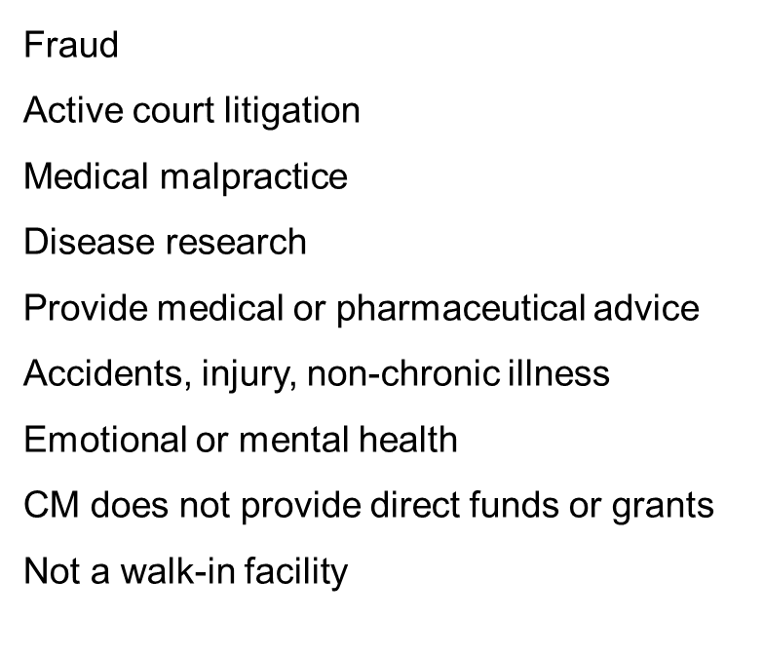
What is NOT Included
in PAF Services

Slide 14
PAF’s Other Services
Case Management
College Scholarships
Co-Pay Relief
Partnership Programs
Specialty Programs
Educational Materials
Financial Aid Funds
20+ more programs!

Slide 15
The PAF Co-Pay Relief Program (CPR) exists to provide direct financial assistance to insured patients who cannot afford the co-payments and co-insurance required to access prescribed pharmaceutical therapies.

Slide 16
Program Eligibility Criteria
Connect patients in need with PAF through
www.copays.org
Must be insured and have some level of coverage for needed medication. Commercial insurance, Military Tricare or Medicare coverage are eligible.
Must have diagnosis matching fund with medication for treatment related to that diagnosis.
1-866-512-3861
http://www.copays.org
Must have household income < 400%
of Federal Poverty Guidelines
Must currently reside and receive treatment
in the U.S.

Slide 17
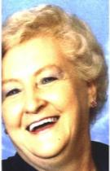
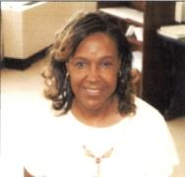
Disease Funds
Bladder Cancer (open)*
Breast Cancer (open)*
Cervical Cancer (open)*
Chronic Pain
Electrolyte Imbalance (open)*
Hepatitis B (open)*
Hepatitis C (open)*
HIV, AIDS and Prevention (open)*
Inherited or Acquired Lipodystrophy (open)*
Metastatic Breast Cancer
Metastatic Colorectal Cancer
Metastatic Gastric Cancer (open)*
Metastatic Prostate Cancer
Multiple Myeloma (open)*
Myelodysplastic Syndrome (open)*
Non-Small Cell Lung Cancers
Osteoporosis
Ovarian Cancer
Periodic Paralysis
Renal Cell Carcinoma
*as of date of presentation, please view website for changes

Slide 18
How to Access CPR
Four (4) Program Entry Points
Toll Free by phone
866-512-3861
8:30 am-5:00 pm EST
Patient Online Portal
Provider Online Portal
Pharmacy Online Portal
http://www.copays.org
24 hours a day, 7 days a week

Slide 19
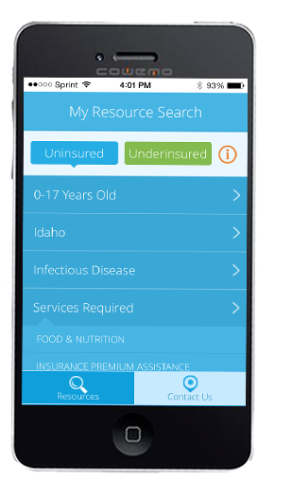
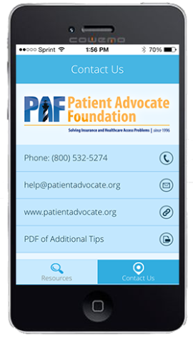
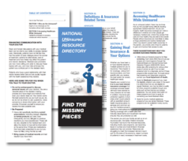
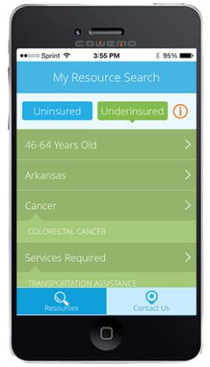
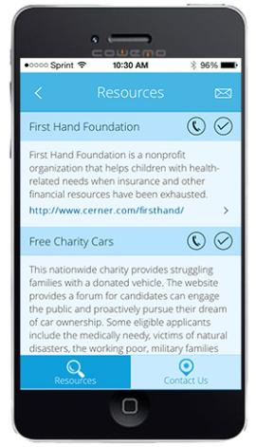
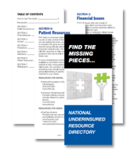
My Resource Search Mobile Phone App
www.patientadvocate.org/myresources Or from APP STORE directly from your phone
My Resources

Slide 20
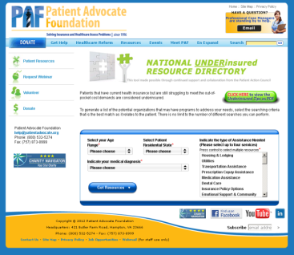
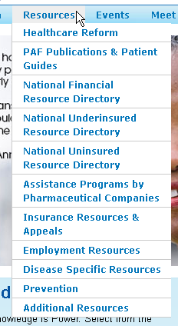
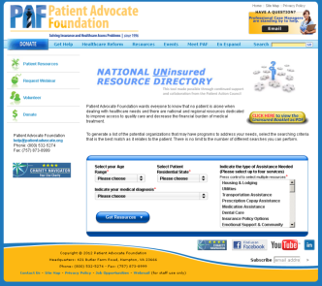
National Uninsured and Underinsured
Resource Directory Tools
www.patientadvocate.org/uninsured
www.patientadvocate.org/underinsured
www.patientadvocate.org/facebook

Slide 21
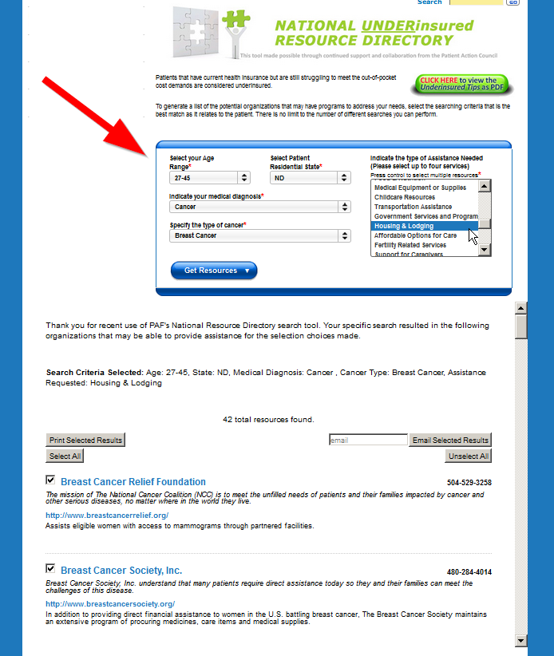
The NURD in ACTION
Example Search
27 – 45 Age Range
Breast Cancer
North Dakota
Needs Housing & Lodging
Pink Fund 877-234-7465
http://www.thepinkfund.org
Distributes short-term financial aid in the form of direct bill payment of expenses for breast cancer patients (male and female) during active treatment or recovery for breast cancer. This support can come in many forms: a car payment, house or rent payment, payments for medical or car insurance and utility payments are the most common.

Slide 22
Educate and Empower
Metastatic Breast Cancer Insert
Paired alongside our Managed Care Guide
Disability eligibility & Compassionate Allowance
Medication tiers and drug reimbursement within plan language
Clinical Trial options
Importance of Prior Authorization in costs and access
Understanding vocabulary in MBC treatment
Options for palliative and hospice care
Personalized treatment
Genetic screening and biomarker testing
Re-entering the workforce
Negotiating medical bills and seeking alternate funding
Resources specific to mBC patients
And more!
English & Spanish
Available in Print format & Electronic delivery

Slide 23
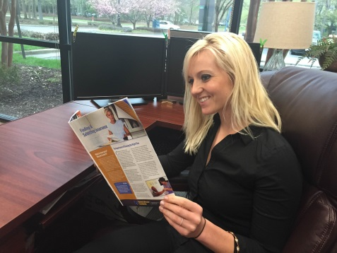
Educate and Empower
Managed Care Answer Guide (refreshed & updated Spring 2015)
Health insurance eligibility
Enrollment process, timelines and materials
Choosing the right plan for your medical needs
Essential Health Benefits
Understanding and navigating you plan structure
Vocabulary and terminology
Understanding your out-of-pocket costs, co-payments, drug tiers and more
Insurance Denials and Appeals
Protections under Affordable Care Act
And more!

Slide 24
Educate and Empower
Personalized for Metastatic Breast Cancer Patients
Insert distributed along side the Managed Care Guide to patients and caregivers dealing with Metastatic Breast Cancer
“Wrap” joins two publications and ensures delivery as a single comprehensive unit
Granting organization acknowledged prominently on wrap
Available in Spanish and English
www.patientadvocate.org/metastaticbreastguide
Back of Wrap

Slide 25
Contact Us
421 Butler Farm Road
Hampton, VA 23666
Phone: (800) 532-5274
Fax: (757) 873-8999
Internet: www.patientadvocate.org
E-Mail: info@patientadvocate.org
421 Butler Farm Road
Hampton, VA 23666
Phone: (866) 512-3861
Fax: (757) 952-0118
Internet: www.copays.org
E-Mail: cpr@patientadvocate.org

Slide 26
PAF’s Focus on Health Equity
The Intentional Shift: A Focus on Health Equity

Slide 27
What does it mean for PAF?
Mark Abraham on Twitter. Equality vs Equity vs USA Reality. February 2016.
Retrieved May 5, 2017-https://twitter.com/urbandata/status/695261718344290304

Slide 28
Goal
Expand the level at which current and existing PAF programs effectively reach and serve patients facing inequities in the health care system in a way that produces data and patient stories that empowers advocacy and policy activities in this area.

Slide 29
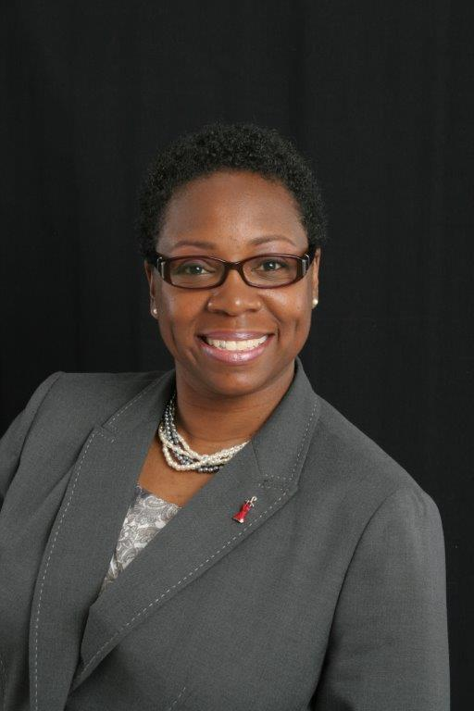
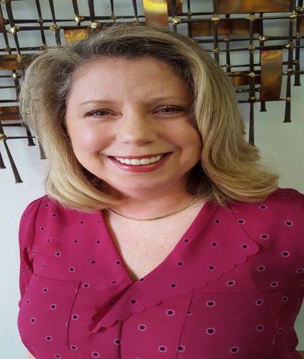
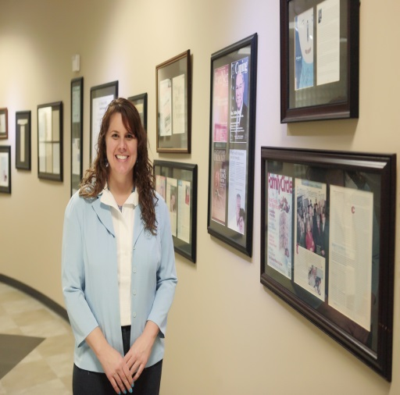
Embracing our nation's populations with low socioeconomic status (SES) characteristics
Principal Investigator-Shonta Chambers, MSW
Communications-
Rebecca Duckett
Director-Network
Dwana “Dee” Calhoun, MS
Evaluator Consultant-Cynthia Lewis, MPH
Communications-
Kelly Alvord
Health Network (SMHN) Team
Member of the Consortium of National Networks to Impact Populations Experiencing
Tobacco-Related and Cancer Health Disparities

Slide 30
Goal: To establish a national network to reduce cancer and tobacco related disparities among low-SES populations.

Slide 31
Shonta Chambers, MSW
EVP Health Equity Initiatives and Community Engagement
Principal Investigator-SelfMade Health Network
Direct Dial: (757) 952-2533
Shonta.Chambers@patientadvocate.org
s.chambers@selfmadehealth.org

