Slide 2
What to expect today?
Acquaint you with the Kentucky Cancer Consortium
Discuss lessons learned from colon cancer prevention and early detection efforts
Discuss idea for lung cancer

Slide 3
Who is the Kentucky Cancer Consortium?
Kentucky’s comprehensive cancer control coalition funded by the CDC
University of Kentucky is bona fide by Kentucky Department for Public Health
More than 55 organizations working together
One of 67 state, tribe and territorial programs participating in the National Comprehensive Cancer Control Program

Slide 4
Comprehensive Cancer Control in KY…
Kentucky Cancer Action Plan
Kentucky Cancer Consortium
(State level)
Kentucky Cancer Program
(Regional)
Kentucky Department for Public Health
(Breast & Cervical Cancer Program; KCCSP; both act as liaison to local HDs)

Slide 5
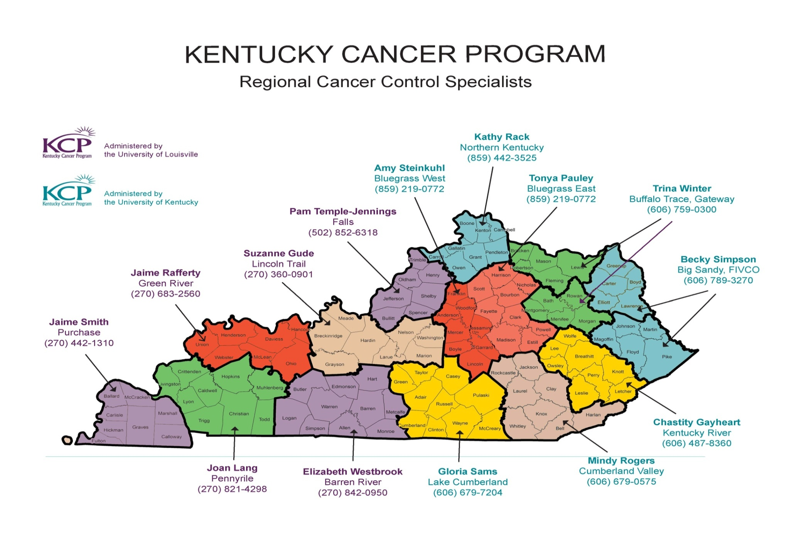
Notes:
The KCP Structure consists of Rgeional Cancer Control Specialists who work with District Cancer Councils in each of KY’s 15 Area Development Districts to identify and address cancer problems in the community. Cancer Control Specialists work out of regional offices – they live in the communities where they work. District Cancer Councils consist of representatives from a broad range of organizaions and gorups in the community.

Slide 6
What does KCC “do”?
KCC focuses on issues related to cancer that are shared by multiple regions and/or the entire state.
Utilize cancer control data and KCC “best process” to:
Identify and prioritize statewide needs for cancer prevention and control.
Identify evidence-based interventions and resources to meet those needs.
Provide neutral forum for cancer control partners to network, coordinate and collaborate.
Increase efficiency and reduce duplication of effort by coordinating activities with major partners in cancer prevention and control.

Slide 7
What does KCC “do”?
Participate in influencing policy and environmental systems changes
Maintain and update the Kentucky Cancer Action Plan (CAP) priority goals, objectives and strategies
Prevention, Screening/Early Detection, Treatment and Care, Quality of Life
Maintain and update Resource Plan
Defines the resources needed to fund priority areas of the CAP
Lung, colon, breast and cervical cancer prevention/early detection
Evaluate efforts
Support efforts to reduce the burden of cancer inequities faced by underserved populations.

Slide 8
How?
Teams focused on interest/expertise:
Resource Plan
Becoming ACA and cancer team…
Environmental Carcinogens
Survivorship/Patient Navigation
Evaluation
Shared Use Agreements
Obesity stakeholder group
KCC staff provide leadership in other statewide teams
Kentucky Colon Cancer Screening Program Advisory Committee
Smoke-free Kentucky Leadership Team
Kentucky Worksite Wellness Council
Changing this Generation through Unbridled Health

Slide 9
Who is KCC Staff?
Katie Bathje, MA, LPCC
Program Director
Consortium management, KCP liaison, cancer control news & resources, patient navigation, survivorship, worksite wellness, colon cancer
Jennifer Redmond, DrPH
Co-Investigator
Lung Cancer Prevention and Control, Resource Plan, ACA and cancer
Kristian Wagner, MS, RD, LD
Health Policy Director
Policy, systems and environmental (PSE) change: smoke-free, shared use, obesity, nutrition and physical activity, environmental carcinogens
Jessica Jones, MSW, DrPH (c)
Evaluation and Research Coordinator
Evaluation, data & epidemiology, smoking cessation, dissemination of best practices

Slide 10
Lessons learned
How did we contribute to a 22% reduction in colon cancer incidence and mortality from 2001 – 2010?

Slide 11
Colon cancer lessons learned
Supplemental funding from CDC
Statewide summit/gathering around this issue
public, provider, policy
Close partnership with regional partners
Kentucky Cancer Program District Cancer Councils

Slide 12
Colon cancer lessons learned
Data guided our decisions and focused our efforts
Clear action plans for each subgroup
Clear roles and responsibilities for committee members
Consistent communication

Slide 13
Why lung cancer?

Slide 14
Kentucky Cancer Burden
2005-2009, U.S. Cancer Statistics
Type of Cancer | Where Kentucky ranks in the U.S. for rate of new cases | Where Kentucky ranks in the U.S. for rate of deaths | Difference between Kentucky and the U.S. death rate
Lung | 1 | 1 | 46% ↑
Colon | 1 | 4 | 19% ↑
Breast | 31 | 21 | 2% ↑
Cervical | 9 | 6 | 21% ↑*
* Note: Rates are very small, so any change in the number can appear significant. The difference in KY and the U.S. is not as large as it appears.
Notes:
Kentucky has a higher death rate from lung, colon and cervical cancer than the U.S.
Kentucky’s lung cancer death rate is almost 50% higher than the U.S. rate
Kentucky is first in the nation for new cases and deaths from lung cancer
Cigarette smoking is the number one risk factor for lung cancer. In the United States, cigarette smoking causes about 90% of lung cancers

Slide 15
Average % of Kentuckians Diagnosed at Early vs. Late Stage
Lung cancer
Almost all late stage
Colon and cervical cancer
Have similar numbers, both have higher late stage
Breast cancer
More early stage than late stage

Slide 16
The Impact of Prevention
Thousands of Kentuckians die each year from cancers that could have been prevented or found early through screening.
Notes:
Many lung cancers can be prevented through not smoking or being exposed to second-hand smoke
Low dose CT scanning is a recent addition to detecting early stage lung cancer that can reduce the risk of death of lung cancer for those who are between ages 55-74 and have been heavy smokers.
9,554 of the 16,886 lung cancer deaths occurred in Kentuckians who were 55-74
Most cervical and colorectal cancers can be caught before they become life threatening.
– 239 cervical cancer deaths occurred in women ages 20-64
– 2,108 colon cancer deaths occurred in men and women ages 50-74
Breast cancer can be detected early enough to be treated through screening.
– 1,529 breast cancer deaths occurred in women ages 50-74

