Slide 1
Kentucky Cancer Consortium Lung Cancer Network October 24, 2017

Slide 2
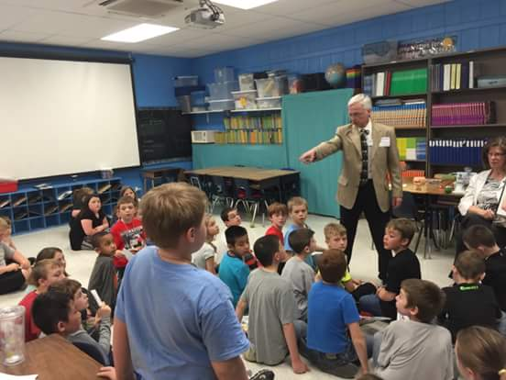
Smoke Free Kentucky

Slide 3
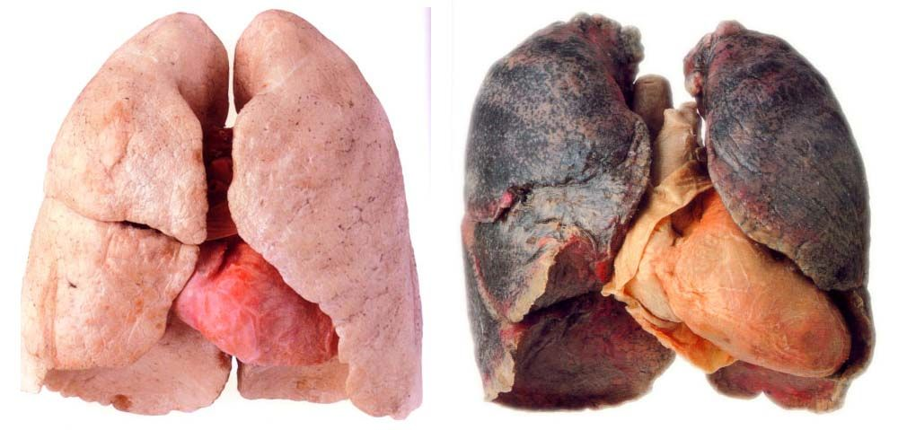
Lungs & Heart
Non-Smoker Smoker

Slide 4
Local Smoke Free Ordinances
Grayson County News Gazette
Fiscal Court kills smoke-free ordinance
KY Forward
Despite student lobbying efforts, move to ban smoking fails to generate support in Grayson County

Slide 5
Smoke Free Ordinances
Kentucky Health News
Leitchfield passes smoking ban to take effect Jan. 1
Grayson County News Gazette | Clarkson passes smoking ban
Kentucky Health News
Second town in tobacco-loving Grayson County goes smoke-free

Slide 6
From Failure to Success

Slide 7
Why a Smoke Free Initiative
Kentucky Cancer Consortium Vision:
We believe in protecting all Kentuckians from secondhand smoke.
Twin Lakes Regional Medical Center Mission:
To heal the sick, relieve pain and suffering and improve the quality of life for the people we serve.

Slide 8
Why a Smoke Free Initiative
Affordable Care Act
Community Health Needs Assessment
Population Health Committee

Slide 9
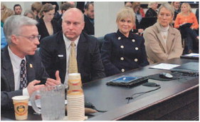
State or Local

Slide 10
Public Support
Local Smoking Survey
Social Media
Letters to Editor/Print Ads
Medical Staff/Local Endorsements
School System Involvement
Elected Official Champion
Booklet of Facts/Statistics
Calling/Email Campaign
Kentucky Center for Smoke Free Policy

Slide 11
Local County/City Gov’t
Grayson County Fiscal Court
Leitchfield City Council
Clarkson City Commission
Caneyville City Council

