Slide 1
Kentucky Regional Resource Lead Organization & Partners
Dwana “Dee” Calhoun, MS
SelfMade Health Network (SMHN) Director
June 7, 2017
Notes:
I’m Dwana Calhoun, Director of the National SelfMade Health Network. Thanks for inviting us.
In hopes of providing you all with a slightly modified Twitter version about me..I transitioned from state government to assume the Director position at here SMHN last year in February 2015. My Bachelor’s degree: Pre-Medicine: Biology with minor in Chemistry (UL-Louisiana). And acquired Graduate degree education in Maryland then Virginia. With a background in: Public Health along with Healthcare Quality Improvement and Medical Compliance.
Over the next few minutes, I’m glad to provide everyone with a brief overview about our fairly new national network.

Slide 2
“SelfMade Health” Philosophy
In the presence of affordable, supportive and resource-friendly environments; individuals, families and subsequently populations can accrue greater awareness, knowledge, understanding, and self-efficacy as well as increased control of their decisions about health risks and overall health.
In the presence of sustained local & regional infrastructures with evidence-based resources, decisions among vulnerable populations would be consistently applied throughout the entire continuum of health.
Notes:
The “SelfMade Health” philosophy originates from the “SelfMade” concept & understanding that:
1-In the presence of affordable, supportive and resource-friendly environments;…. individuals, families and subsequently populations
2-In the presence of sustained local & regional infrastructures with evidence-based resources…
3-Although this concept has been modernized, it is based on a historical perspective and belief that “a man, woman or teen can become the captain of his destiny.”

Slide 3
Overview: Priority Populations
Annual Income
Level of Education
Geography
By Employment Status
Health Insurance
Notes:
In an effort to break the cycle of cancer burden and tobacco use among underserved, vulnerable and low-resourced populations residing in rural, urban and frontier communities & regions.
We at…SelfMade Health Network strive to more specifically improve the health of populations with lower SES characteristics by:
By income (including populations at or near the Federal Poverty Level)
By geography (including medically underserved areas-lack of PCP, high infant mortality, levels of poverty or elderly populations)…
By levels of education, as well as
By health insurance coverage status (including uninsured the underinsured) and
By employment status (including F/T, part-time, contractual, self employed and Unemployed)

Slide 4
SMHN Leadership Council
American Health Quality Association (AHQA) | National Health Care for the Homeless Council, Inc. | National Area Health Education Center (AHEC) Organization
Louisiana Primary Care Association | Ohio State University Comprehensive Cancer Center, The James Cancer Hospital Division of Gastroenterology, Hepatology & Nutrition | West Virginia University (WVU)-Cancer Institute
Academy of Oncology Nurse and Patient Navigators (AONN) | Louisiana Public Health Institute (LPHI) | University of Wisconsin School of Medicine and Public Health-Center for Tobacco Research and Intervention
Catholic Health Association of the United States | West Virginia Division of Tobacco Prevention | Ohio Commission on Minority Health
Meharry Medical College | Georgia Council on Aging | Altarum Institute
Louisiana Public Health Institute, Louisiana Cancer Research Center | National Federation of Licensed Practical Nurses (LPNs), Inc. | Food Bank Association (Vacant)
Reference:
http://www.selfmadehealth.org/about/network-leadership-council/
Notes:
Component 1 - Administer a national network to impact tobacco-related and cancer health disparities for populations with low socioeconomic status (SES) characteristics.
SMHN Leadership Council (Advisory Council)
Further supported by-
SMHN Core Members
SMHN Dissemination Partners
SMHN Peer-to-Peer Learning Network Partners:
Featured above are member organizations from our Leadership Council, established last year-September 2015. In addition, we recently began inviting organizations to become SMHN Core Member Organizations. Additional information is posted on the SMHN website.
Optional: We recently established a partnership with the National Rural Health Association (NRHA).

Slide 5
Snapshot of Overarching Priorities
Convene and establish partnerships with an array of diverse sectors to ensure that priority setting and delivery are relevant to their underserved and vulnerable populations and that recommendations are adopted and implemented effectively.
Continue to build capacity and a sustainable infrastructure addressing cancer and tobacco-related disparities within high disease burden/underserved regions.
Promote the development, and adoption “promising practices” as well as evidence-based(EB) strategies and initiatives among organizations that provide services to populations with low socioeconomic status (SES) characteristics (including those residing within high disease burden state or regions).
Expand dissemination and access to evidence-based (EB) cancer and tobacco-related resources and services among a.) vulnerable members of society (regardless of their race/ethnicity, socioeconomic status, health insurance status and literacy level) and b.) service providers, policy makers and other major stakeholders.
Identify, evaluate, integrate and disseminate relevant data to address disparities among members of low SES populations, as it bears on identifying “best practices.”
Notes:
Via Infrastructure and expertise…One of our network’s priorities include:
Build support for public health service and practice strategies to improve community-clinical linkages that benefit the target population…this is accomplished by: capacity building & Promising –RRLO as well as states, TA (TA-to CDC and non-CDC funding organizations) and identifying/disseminating proven and promising practices.
Intermediate: Increased infrastructure and capacity (RRLO, CDC programs, non-CDC programs, low sES service providers) to impact tobacco-related and cancer health disparities among low SES populations via combination of or via these multi-level approaches.
Long-term_Decreased exposure to secondhand smoke among the target populations, Decreased tobacco use among the target populations AND
Increased support for cancer control selfmanagement among cancer survivors in target populations for increased quality and duration of life.

Slide 6
General Overview: Framework
SMHN Regional Resource Lead Organizations-”Communities of Promise” Resource Hubs
Breast Cancer Disparities –Tennessee (Winter 2015)
Meharry Medical College
Lung Cancer Disparities with Tobacco Cessation-Kentucky (2016)
University of Kentucky-College of Public Health
National SMHN Tobacco Cessation Marketplace Project (Partnership with the American Lung Association-National Office)
9 sites in 7 states (West Virginia, North Carolina, Michigan, Pennsylvania, Iowa, Illinois and Mississippi)
3 Poster Presentations featured at the CDC’s 2017 National Conference on Tobacco or Health (NCTOH)
Notes:
Our national network also consists of projects (including the National SMHN Tobacco Cessation Marketplace Project (launched last year in July 2015) involving a partnership with the American Lung Association and focuses primarily on increasing tobacco cessation & cancer resource awareness among Marketplace organizations and corresponding cessation service utilization among their clients.
-Partner sites range from health departments such as: Johnson County Public Health (in Iowa) as well as Macoupin County Public Health Department in partnership with Maple Street Medical Clinic (in Illinois) to other types of organizations (including: non-profit and healthcare).
Our network’s infrastructure also includes SMHN Regional Resource Lead Organizations or SMHN Community Resource hubs or organizations . They are in Tennessee and Kentucky are: Meharry Medical College (established last year-October 2015) and most recently (confirmed last week) University of Kentucky-College of Public Health with support from UK-College of Medicine & Nursing.

Slide 7
SMHN National Tobacco Cessation Marketplace Project
Organization Type | *Priority State or Region | State Status: Medicaid or Non-Medicaid Expansion
Alcohol / Drug Council of North Carolina | *North Carolina | Not at this time
American Lung Association | *West Virginia | ⌂
ACCESS Community Health & Research Center | Michigan | ⌂
Johnson County Public Health | Iowa | ⌂
Harrisburg Area YMCA - Northern Dauphin County Branch | Pennsylvania | ⌂
Health Promotion Council of Southeastern Pennsylvania | Pennsylvania | ⌂
Macoupin County Public Health Department (in partnership with Maple Street Medical Clinic) | *Illinois | ⌂
Mississippi Primary Health Care Association | *Mississippi | Not at this time
Oak Hill Baptist Church Ministries, Inc. Navigator Office | *Mississippi | Not at this time
Notes:
Component 3 - Convene partners and promote implementation of health system interventions that benefit the target population.
Crozer-Pennysylvania-Downsized after 1 ½ years into project.
The National SMHN Tobacco Cessation Marketplace Project was launched and involves the piloting of the American Lung Association’s Assistors Toolkit. Grantees are representative of diverse organizations in 7 states.
3 Abstracts were selected as Poster Presentations at 2017 CDC National Conference on Tobacco or Health (NCTOH). Pennsylvania, Iowa and Michigan.
TA examples:
Tobacco Cessation Coverage and Medicaid Workgroup offered to include SMHN Resources as part of their Resource Library for use among all of its members.
ASTHO/Tobacco Control network, Health Equity & Tobacco-Nebraska, Virginia (most recent-Cancer), South Carolina Tobacco-Free Collaborative, Massachusetts, Texas, Illinois, CADCA’s 15th Mid-Year Training Institute in Nevada.

Slide 8
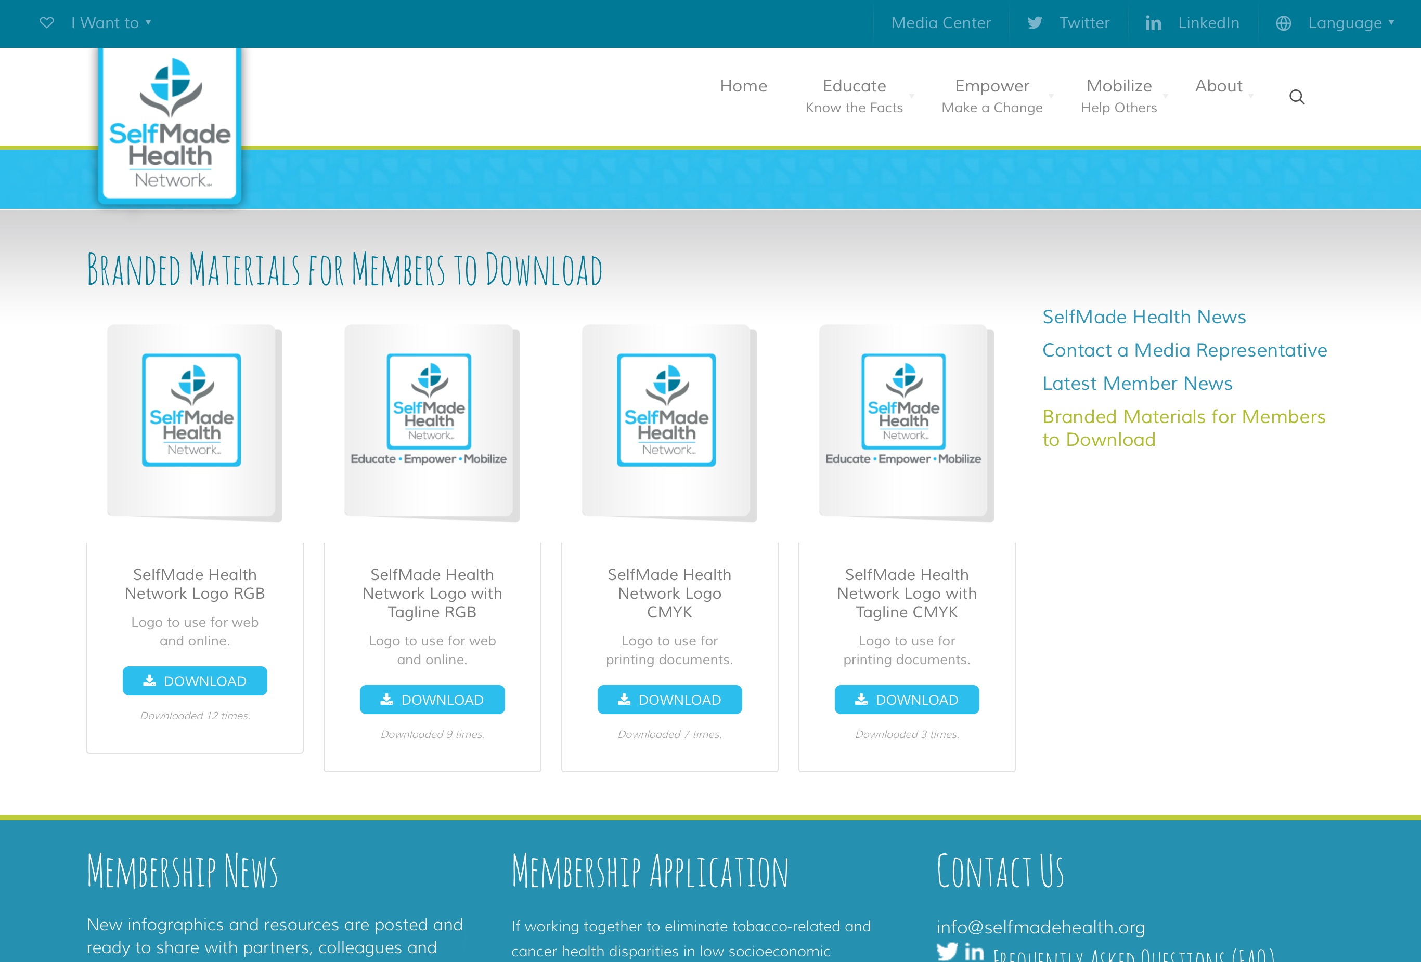
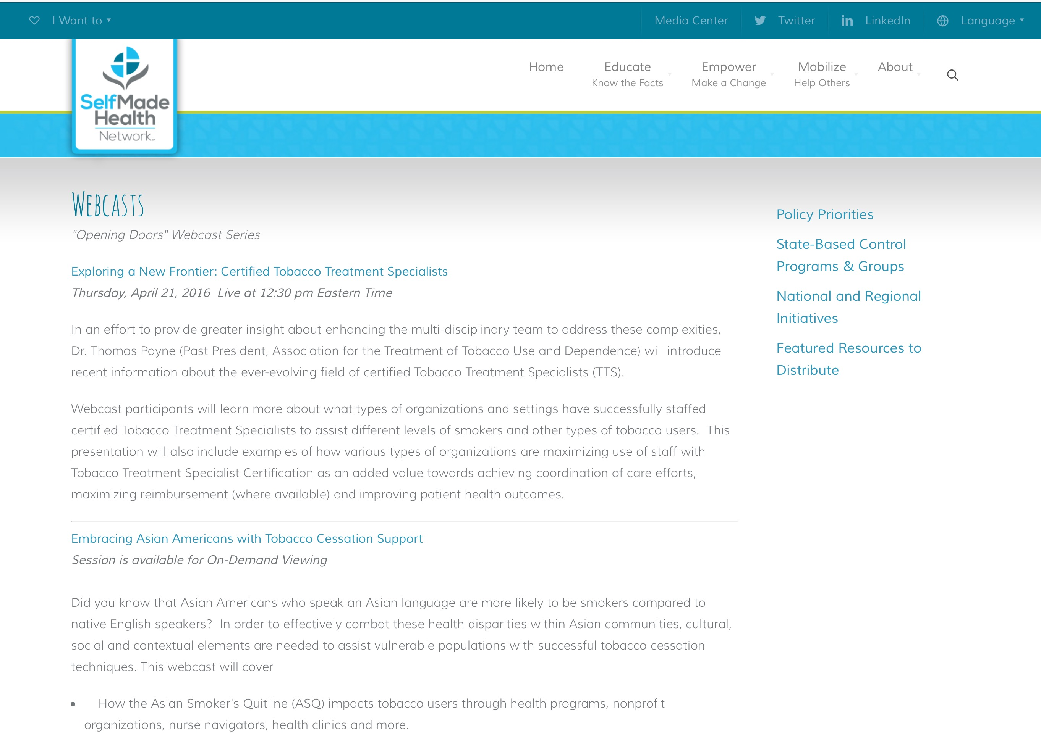
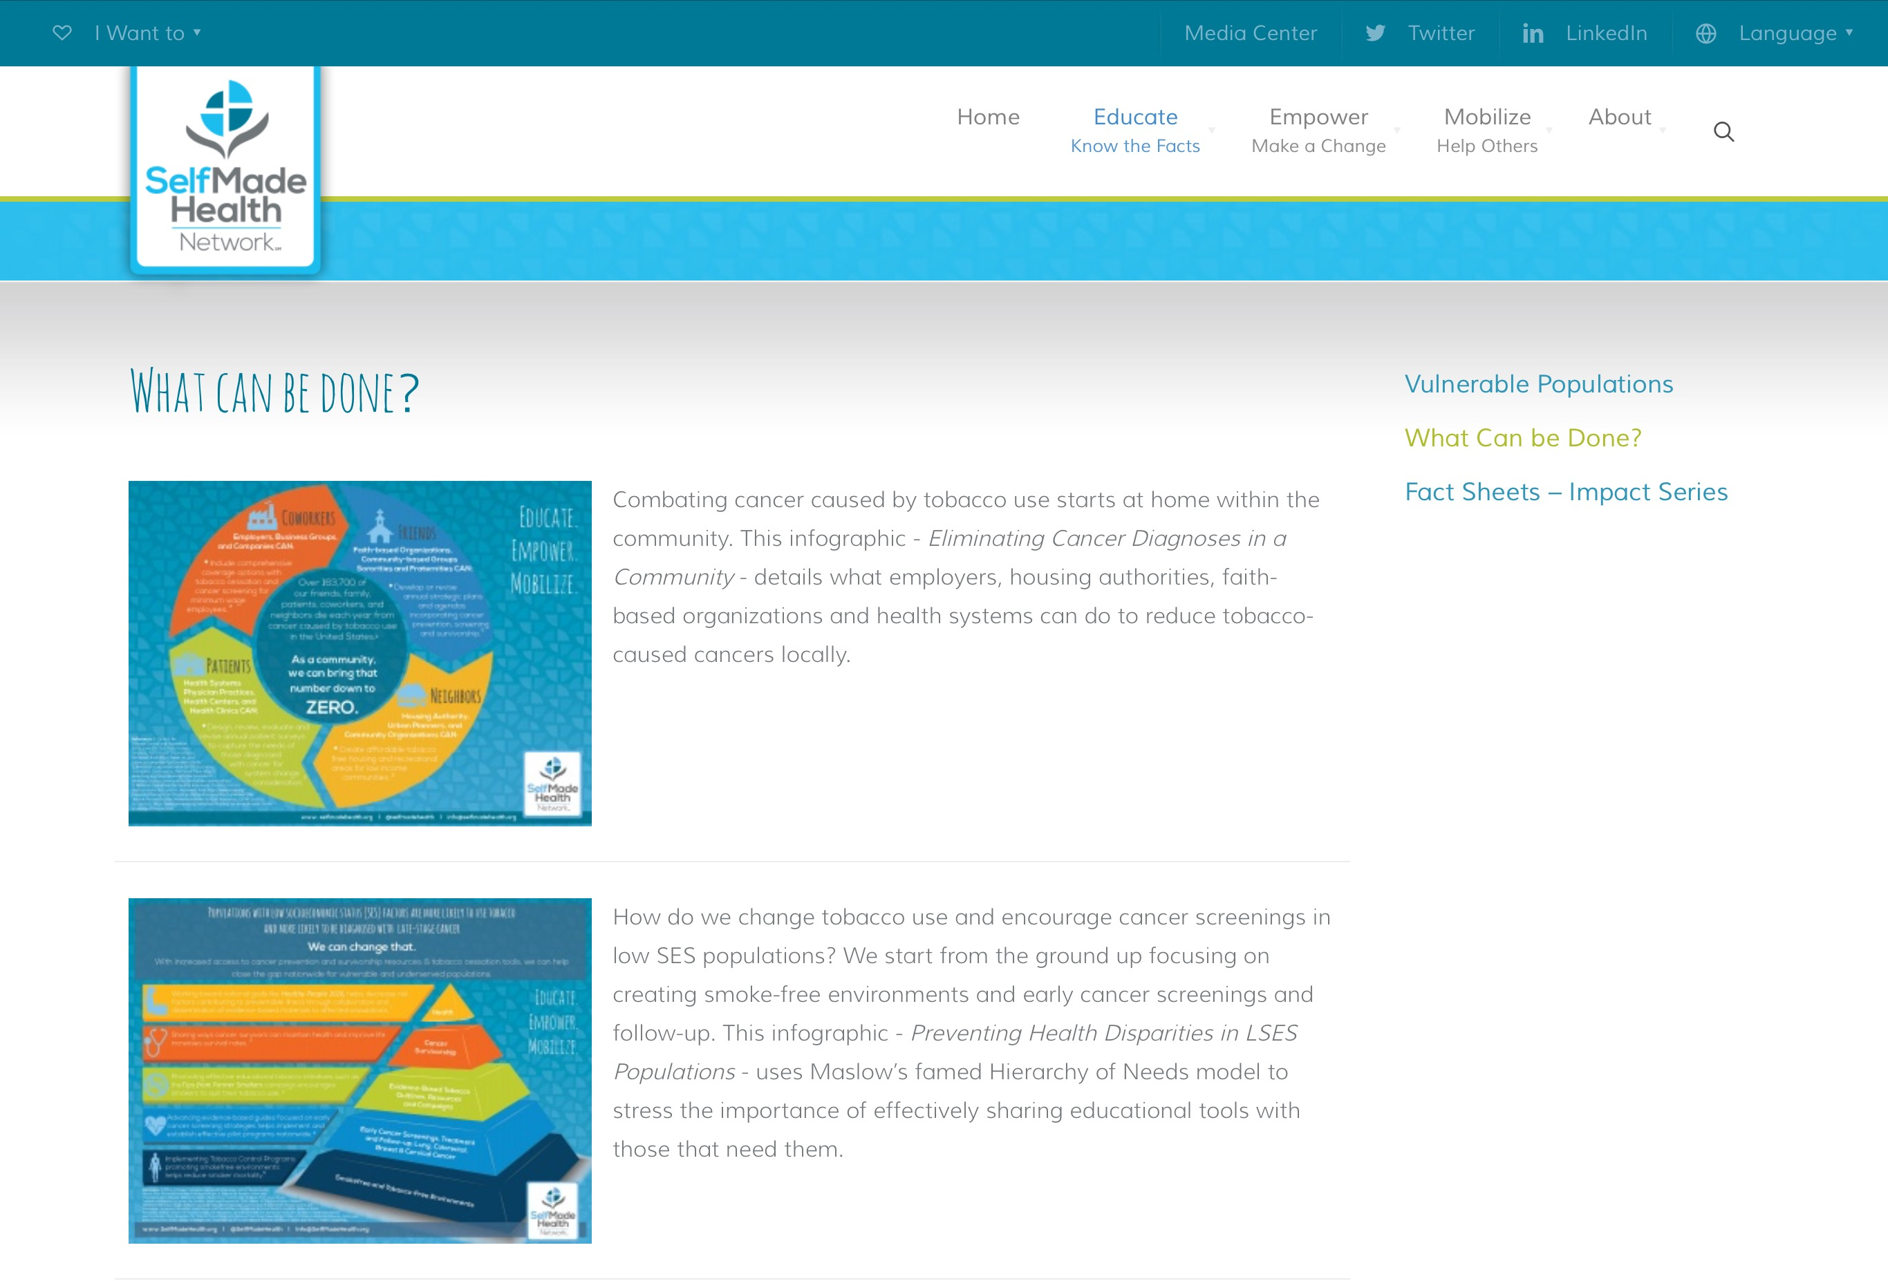
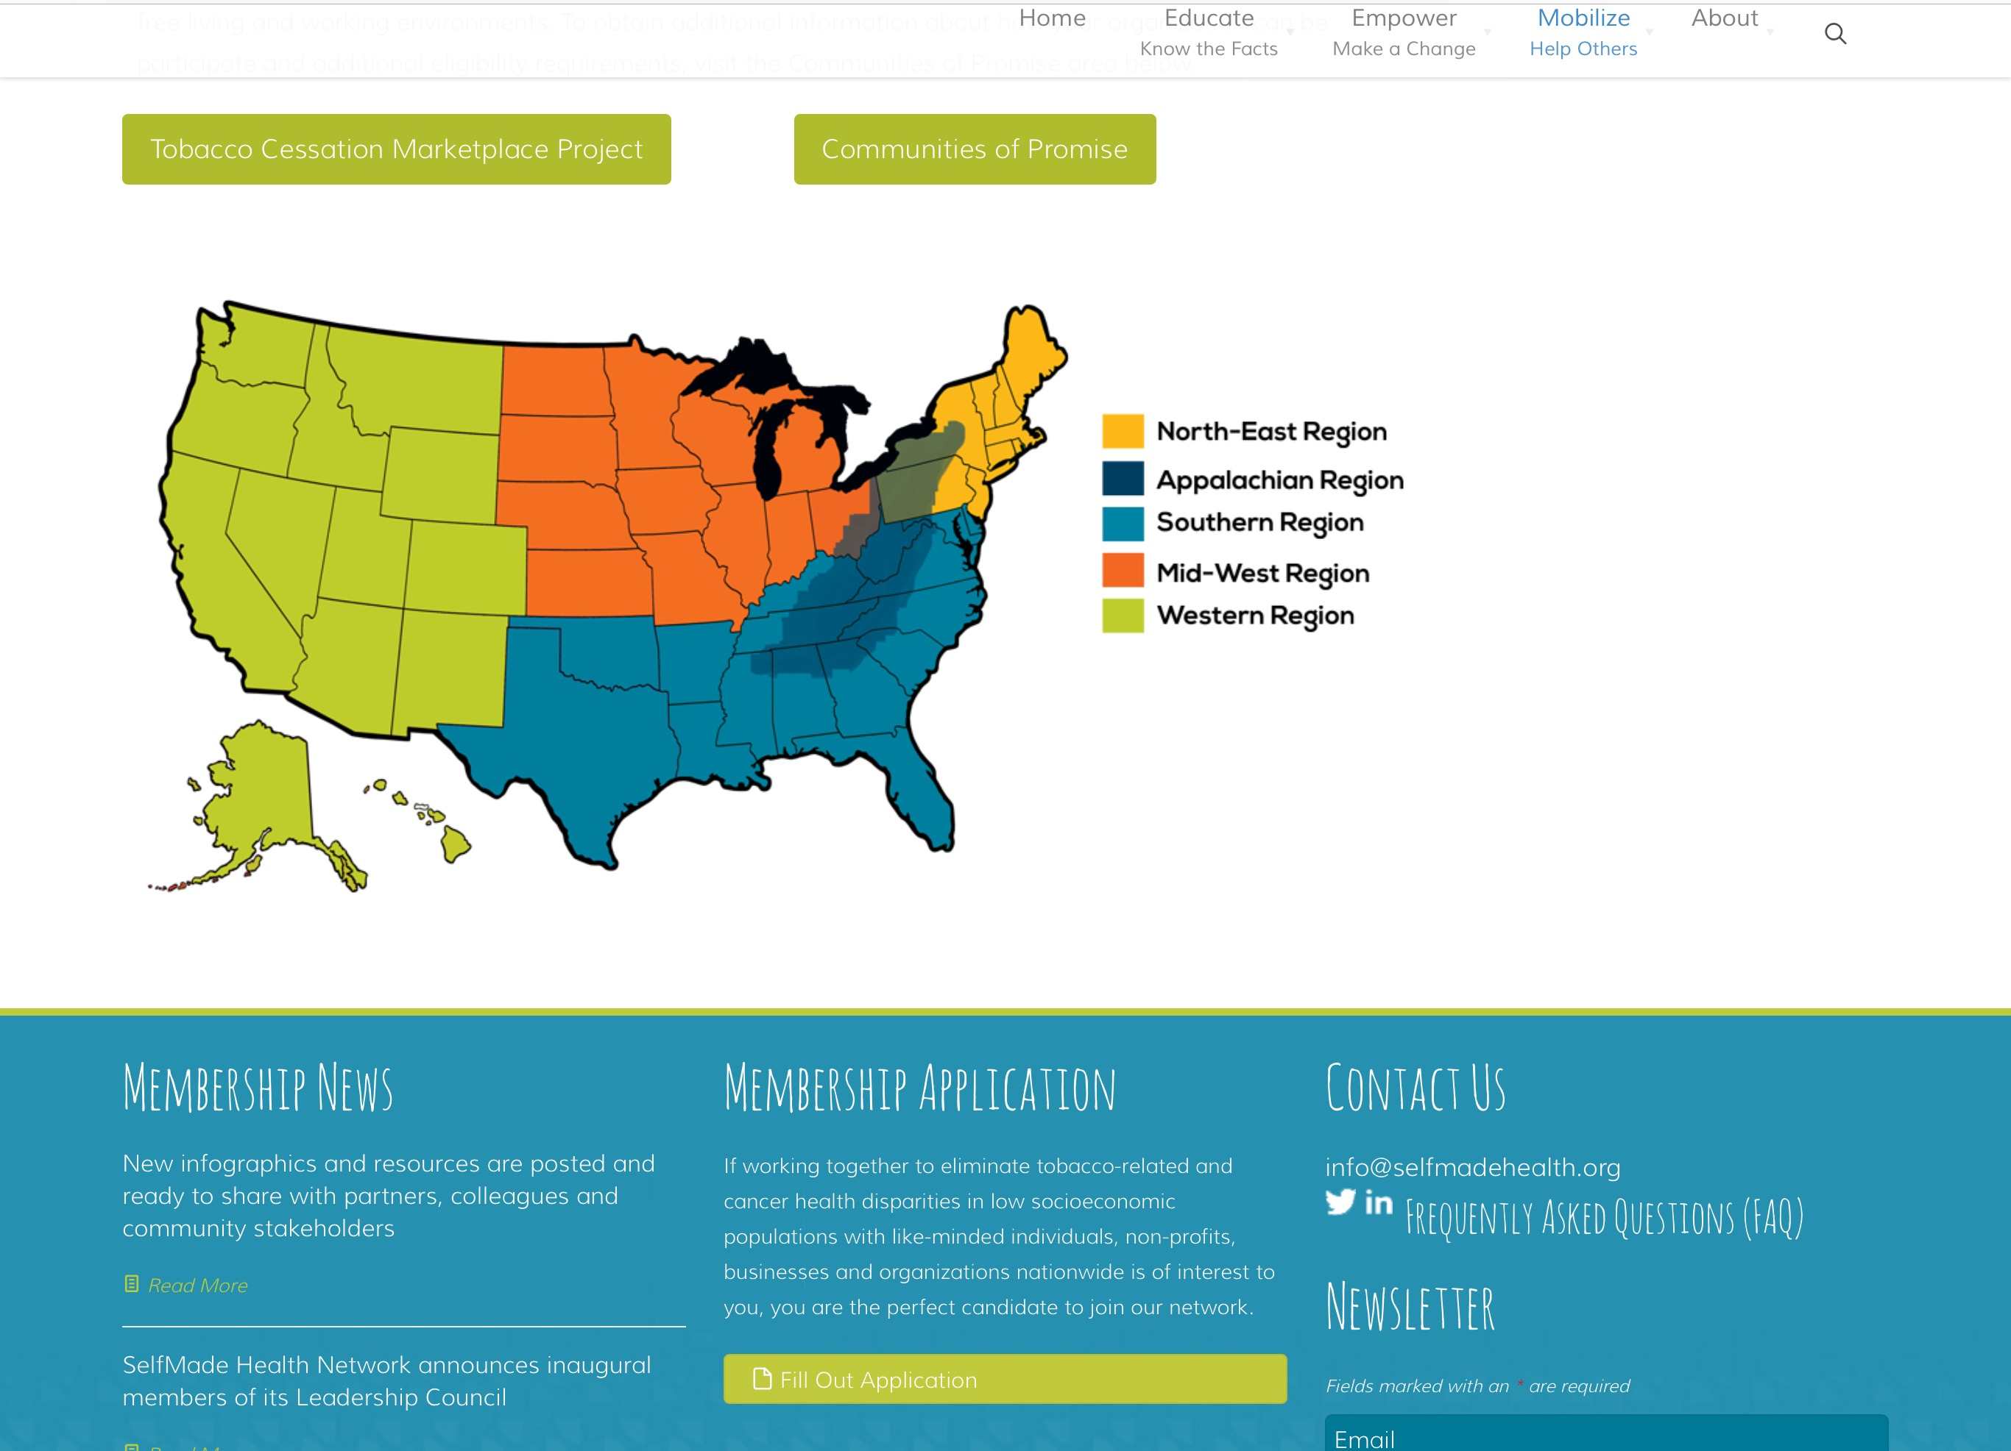
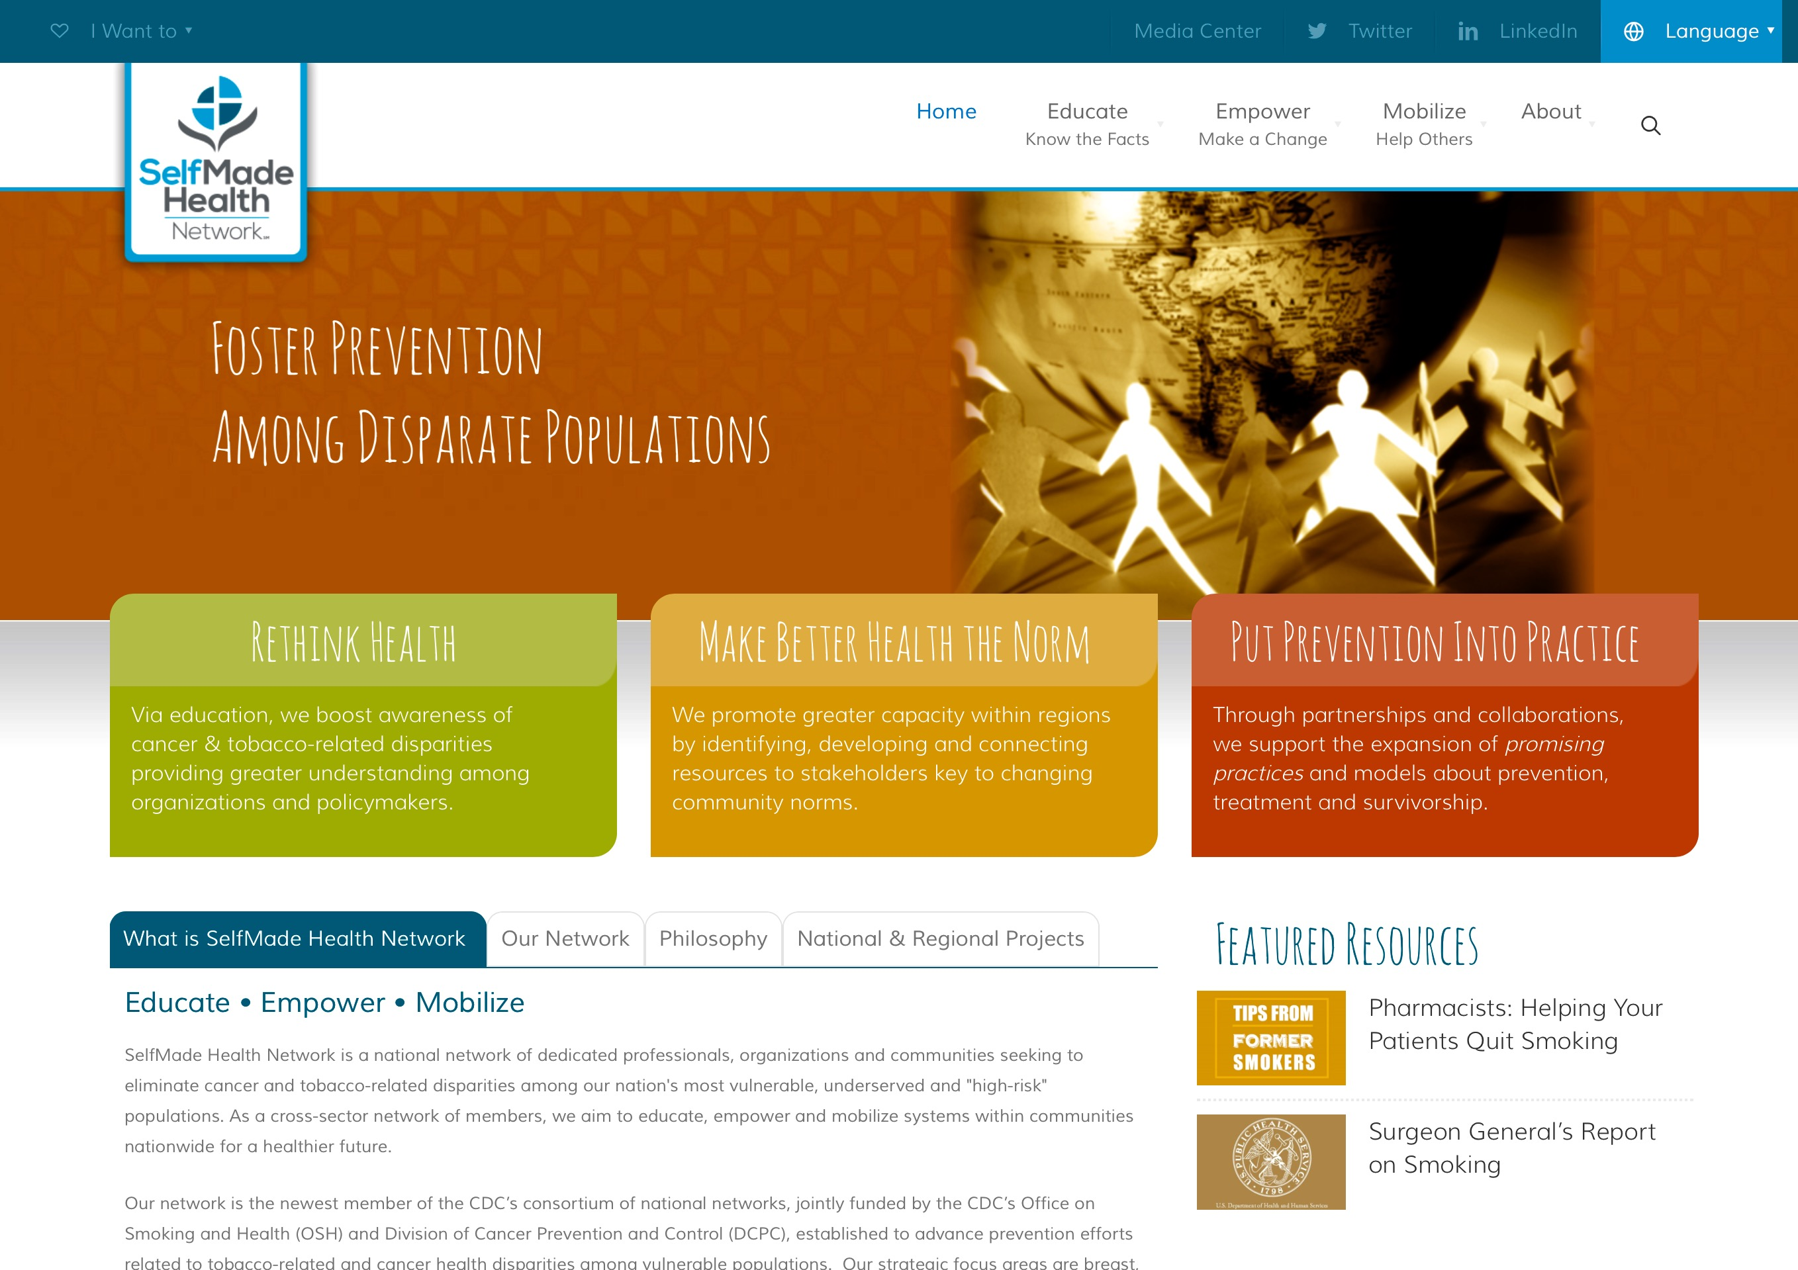
SelfMade Health Network Website
Notes:
Launched January 2016…depicted above is one example of how this priority area is addressed.
Educate and communicate support for evidence-based commercial tobacco use prevention and cancer prevention environmental approaches which support healthful behaviors among populations with low SES characteristics.
Related Program Outcomes:
Increased use of tobacco cessation services
Increase use of primary prevention strategies to reduce cancer risks among target population
Increased use of clinical preventive services among target population
Increased dissemination and diffusion of culturally appropriate population-specific strategies to impact tobacco-related and cancer health disparities.
*Everyone is welcome to visit website to learn more about our network, join as a member and/or sign up to receive newsletters.

Slide 9
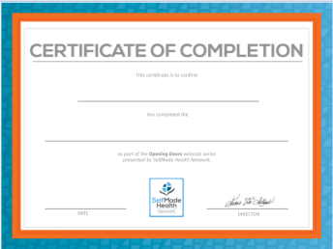
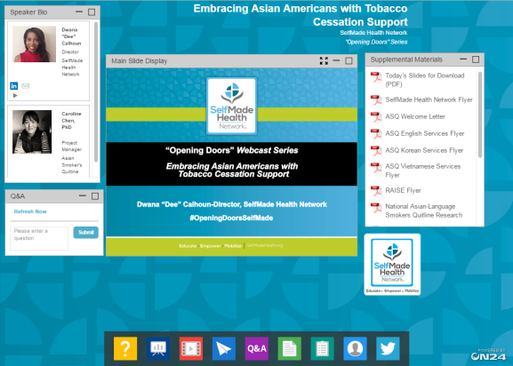
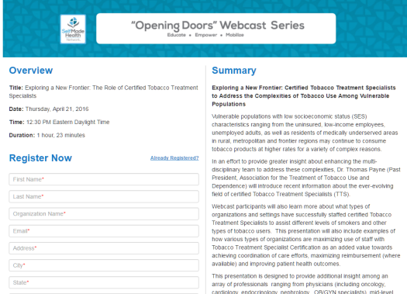
SMHN Webcasts
SelfMade Health Network
Webcast Events
When: Live webcast events focused on topics of relevance to member organizations and practitioners who are working to reduce cancer and encourage smoking cessation. Each session is free to attend and available on-demand viewing following the live event. Includes SelfMade Health Network's "Opening Doors" Series. Certificate of Completions are included for most sessions.
Where: Website -> Empower-> Webcasts
Notes:
As part of the SMHN “Opening Doors” Webcast Series:
“Closing the Gap” in Lung Cancer Disparities (Harvard School of Medicine)-Medical Oncologist in the Lowe Center for Thoracic Oncology at Dana Farber Cancer Institute and Assistant Professor of Medicine at Harvard Medical School
From Coverage To Care: Potential Opportunities to Impact Vulnerable Populations, Patients & Clients-Presenter: Centers for Medicare and Medicaid (CMS)
Embracing Asian Americans with Tobacco Cessation Support-University of California/Administrator-Asian Tobacco Quitline
Exploring a New Frontier: Certified Tobacco Treatment Specialists-Past President…Thomas Payne, PhD (Past President, Association for the Treatment of Tobacco Use and Dependence and current Director of the ACT Center for Tobacco Treatment, Education and Research-University of Mississippi Medical Center).
Men’s Health-Examining Community Engagement to Address Colorectal Cancer Disparities and Survivorship (featured Dr. Darrell Gray II, MD)-Dec. 2016

Slide 10
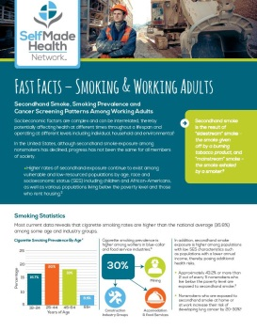
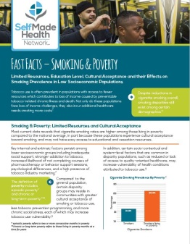
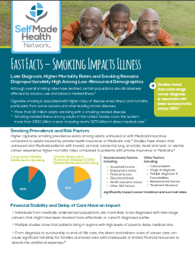
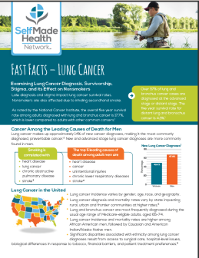
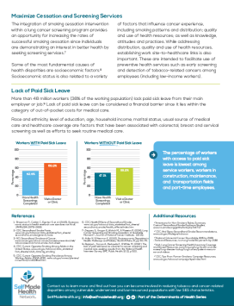
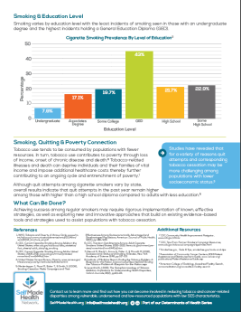
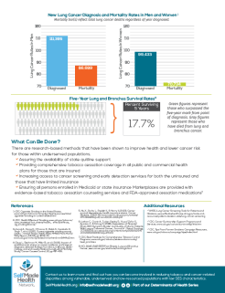
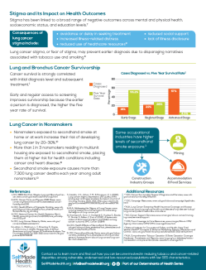
SMHN Fact Sheets
SelfMade Health Network
Determinants of Health Fact Sheets
When: Custom Fact Sheets created by SelfMade Health Network help Members learn about topics specific to helping cancer prevention and understand the correlation between tobacco usage and communities of low socioeconomic populations. Data is gathered from expert sources and curated specifically for Member use in mind.
Where: Website -> Educate -> Determinants of Health Fact Sheets
Notes:
SMHN Products include: Twitter Images, Press Releases, SMHN Website, SMHN Fact Sheets

Slide 11
SMHN Determinants of Health Fact Sheets
Fact Sheets | Downloads
Primary Focus Area: Tobacco-Related
Smoking & Working Adults | 333
Smoking Impacts Illness | 328
Smoking & Poverty | 321
*Lung Cancer: Diagnosis, Survivorship, Stigma and Effect on Non-Smokers | 183
Primary Focus Area: Cancer Disparities and Survivorship
Cancer Survivorship | 243
Cancer Survivorship Challenges | 243
*Men’s Cancer Health Disparities | 110
*Breast Cancer Disparities-Financial Barriers | 63
Notes:
Denotes most recent Fact Sheets
Organizations are encouraged to feature any or all of these Fact Sheets on their website (link to webpage), in newsletters and other forms of communication. Can also be used while meeting with stakeholders or developing policies, etc.

Slide 12
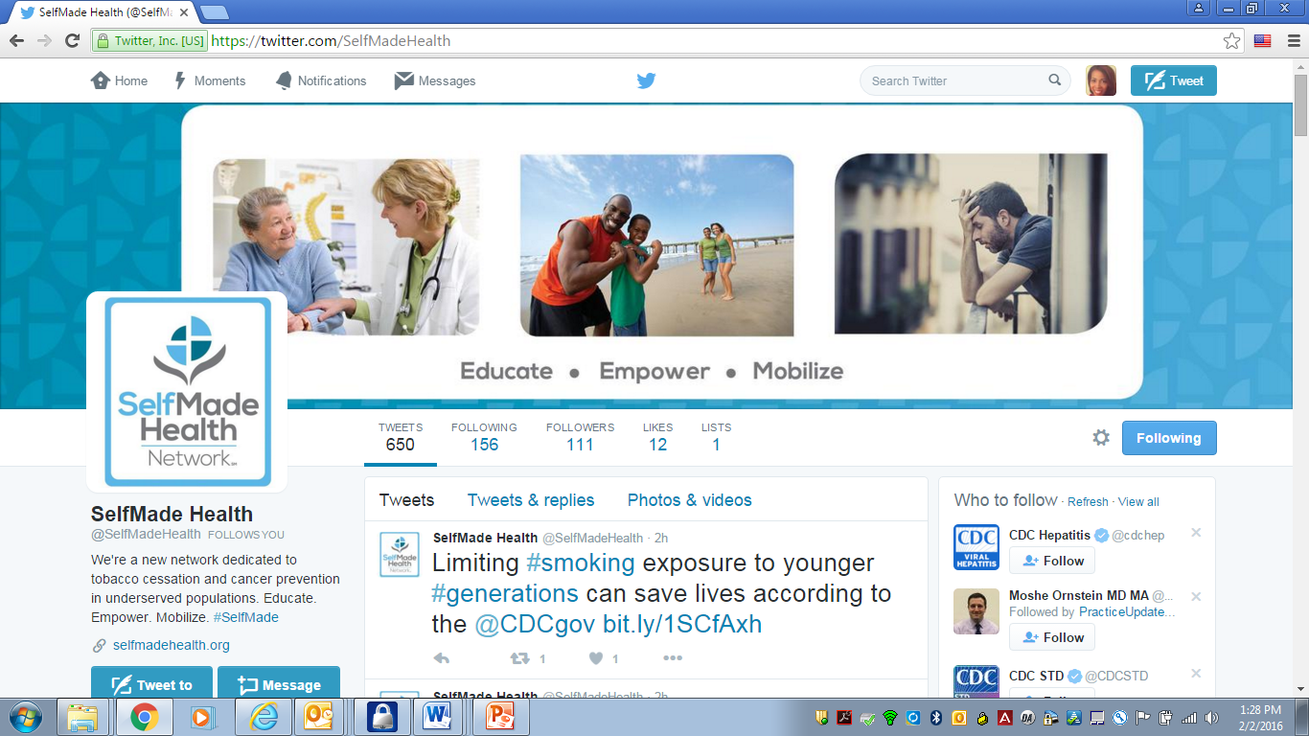
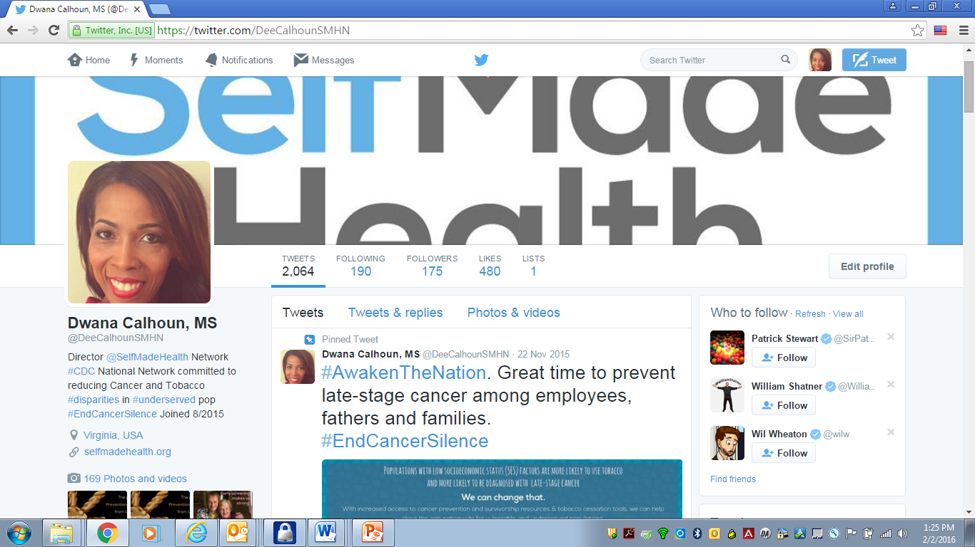
SMHN Social Media: Twitter
Twitter: @SelfMadeHealth and @DeeCalhounSMHN
Notes:
-Organizations are also invited to join us via any of our 2 Twitter handles: @SelfMade Health and @DeeCalhounSMHN and on LinkedIn OR share with your partners. Humble beginnings..
Dee’s Twitter followers:

Slide 13
SMHN Social Media: Twitter Followers (1)
National Quality Forum (NQF) American Academy of Family Physicians (AAFP) American Journal of Preventive Medicine (AJPM) Association of Community Cancer Centers (ACCC) America’s Essential Hospitals *Catholic Health Association of the United States National Hispanic Medical Association Association of Community Cancer Centers (ACCC) American College of Chest Physicians (CHEST) | Mayo Clinic Cancer Center Community Preventive Services Task Force (CPSTF) Patient-Centered Primary Care Collaboration (PCPCC) National Medical Association (NMA) CDC’s MMWR (Morbidity Mortality Weekly Report) American Family Physician (AFP) Podcast Vanderbilt University Medical Center-Children’s Academy of Oncology Nurses and Patient Navigators (AONN) *American Health Quality Association (AHQA) | Population Health Equity at Harvard T.H. Chan School of Public Health University of Minnesota Rural Health Research Center Kentucky Coalition of Nurse Practitioners & Nurse Midwives (Dissemination Partner) *National Health Care for the Homeless Council, Inc. Visiting Nurse Associations of America (VNAA) Fred Hutch Health Disparities Research Center Missouri Health Equity Collaborative (MOHEC) CounterTobacco.Org Policies For Action (Robert Wood Johnson Foundation & Urban Institute)
Twitter reference: @DeeCalhounSMHN
Notes:
*Leadership Council Member Organization

Slide 14
SMHN Social Media: Twitter Followers (2)
National Cancer Institute (NCI) National Minority Quality Forum (NMQF) Oncology Nursing Society (ONS)-South Carolina American Pharmacy Purchasing Alliance (APPA) Community Oncology Alliance (COA) Visiting Nurse Associations of America (VNAA) North Carolina Hospital Association Oklahoma State University-Center for Rural Health American Cancer Society (ACS): Cancer Journal for Clinicians Foundation for a Healthy Kentucky Annals of Family Medicine and other medical peer-reviewed journals . | Public Health Law Center at Mitchell Hamline School of Law (Home of the Tobacco Control Legal Consortium) Big Cities Health Coalition Cleveland Clinic-Florida Federal Practitioner (clinical journal- serving those in Department of Veterans Affairs, Department of Defense, and Public Health Service-PHS) MacColl Center (creators of the Chronic Care Modell-CCM) COPD Foundation Salvation Army-New Orleans George Washington (GW) Cancer Institute Advocacy Action Network(Kentucky) American Cancer Society (ACS)-Illinois | Rural Health Research Gateway (funded by the Federal Office of Rural Health Policy) South Carolina Tobacco-Free Collaborative University of Kansas Hospital Journal of Public Health Management & Practice (JPHMP) United Nurses Association of California (Union) Hospitals-Virginia AJMC (American Journal of Managed Care)-Oncology Blue Cross/Blue Shield Federal Employee Program Men’s Health Network Tulane University Prevention Research Center (PRC) North Carolina -Society for Public Health Education (SOPHE)
Twitter reference: @DeeCalhounSMHN
Notes:
JAMA (Ed)-Journal of the American Medical Association and

Slide 15
SMHN Social Media: Twitter Followers (3)
Oregon Office of Rural Health President-United Food & Commercial Workers International Union National Association of Health Underwriters (NAHU) National Community Oncology Dispensing Association (NCODA) Community Oncology Annals of Surgical Oncology National Ovarian Cancer Coalition American Society for Radiation Oncology CDC Tips From Former Smokers Campaign-Spokesperson Brian Hayden Americans for Nonsmokers’ Rights (ANR) Community Commons Hidalgo County Tobacco Prevention & Control Coalition | Network for Regional Healthcare Improvement (NRHI) Directors of Health Promotion and Education (DHPE) National Institute for Children’s Health Quality (NICHQ) The National Center for Health and Aging [supported by the U.S. Department of Health and Human Services, Health Resources and Services Administration (HRSA)] Washington University School of Medicine-Division of Public Health Sciences along with additional academic institutions Louisiana Food Banks American Cancer Society (ACS)- Cancer Action Network-Tennessee University of Kansas Medical Center-Rural Health and Education Services | Johnson County Public Health-Iowa American Public Health Association (APHA) National Network of Public Health Institutes (NNPHI) Oncology Nursing Society (ONS)-Public Policy Arm Oncology Nursing Society (ONS) Foundation UC Davis Center for Poverty Research Kentucky LEADS Collaborative Texas' Society of Clinical Oncology Missouri Oncology Society Blue Cross/Blue Shield Federal Employee Program Louisiana Navigators Tarrant County Cancer Disparities Coalition Salvation Army-New Orleans
Twitter reference: @DeeCalhounSMHN
Notes:
In addition..recent core members include: Cancer Disparities Coalitions, Physicians (including oncology, radiology specialty areas) and Nurse Practitioners, etc.

Slide 16
SMHN Featured: 2016 8th Biennial Cancer Survivorship Research Conference
Notes:
2016 8th Biennial Cancer Survivorship Research Conference (SMHN Director tweets featured during lunchtime) sponsored by American Cancer Society, the National Cancer Institute of the National Institutes of Health, Centers for Disease Control and Prevention (CDC), and the LIVESTRONG Foundation.

Slide 17
SMHN Featured: 2016 8th Biennial Cancer Survivorship Research Conference
Notes:
Performance Measurement Question: What sources of best and promising practices have you disseminated and/or promoted to your network in the reporting period? Dwana via Twitter and on webcasts (SMHN sponsored and externally sponsored webcasts when Dwana presenter)
Options: Guidelines/Recommendations, Systematic Reviews and Evidence-Informed Program/Program Evaluation/Practice-based Evidence

Slide 18
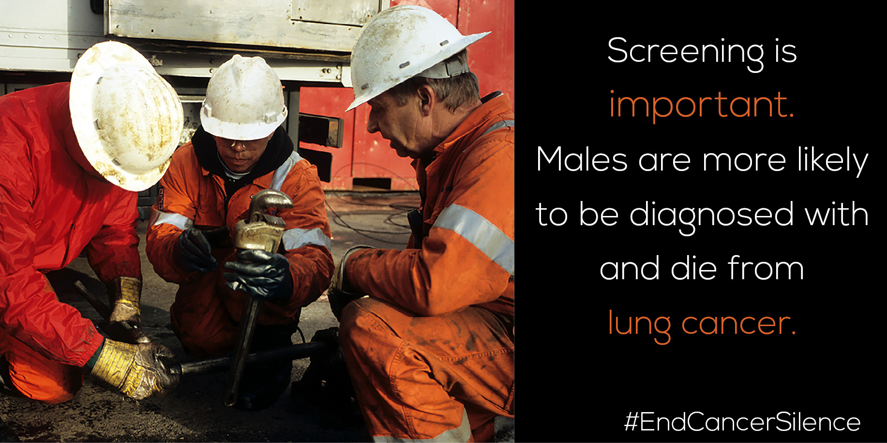
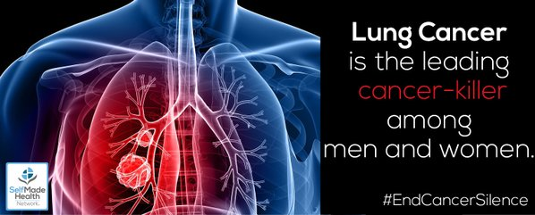
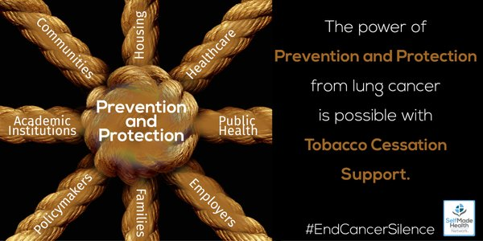
Social Media Images (1)

Slide 19
Contact Information
Dwana “Dee” Calhoun, MS
Director, SelfMade Health Network (SMHN)
Patient Advocate Foundation (PAF)-Parent Organization
421 Butler Farm Road
Hampton, Virginia 23666
Telephone # 757-509-0227
E-mail address: d.calhoun@selfmadehealth.org
Twitter: @SelfMadeHealth and @DeeCalhounSMHN
Website: http://www.selfmadehealth.org/
Send questions or contact us at anytime via shared SMHN mailbox: info@selfmadehealth.org
Notes:
Our contact information is shown above.
Additional partners with National Quality Forum (NQF) and National Rural Health Association (NRHA)..

