Slide 1
The Burden of Cancer in Kentucky (2000 – 2013)
Presented by:
Thomas C. Tucker, PhD, MPH
Director KCR
Jaclyn Nee, DrPH
Epidemiologist and Research Coordinator KCR
Madison Ries
Graduate Student KCR
Kentucky Cancer Consortium (KCC)
Kentucky Cancer Burden Webinar
July 26, 2016
Notes:
Cer Center

Slide 2
Topic to be Covered
The major types of cancer for which there are evidence based interventions
Important Population Characteristics of Kentucky
Vulnerable populations in Kentucky
The impact of poverty and educational attainment on the cancer burden
Break for questions
Trends in lung cancer incidence and mortality by gender, race and place
An index of the lung cancer burden by area development district
Break for questions
Trends in breast cancer incidence and mortality by gender, race and place
An index of the breast cancer burden by area development district
Break for questions
Trends in colorectal cancer incidence and mortality by gender, race and place
An index of the colorectal cancer burden by area development district
Break for questions
Trends in cervical cancer incidence and mortality by gender, race and place
An index of the cervical cancer burden by area development district
Summary, questions and discussion

Slide 3
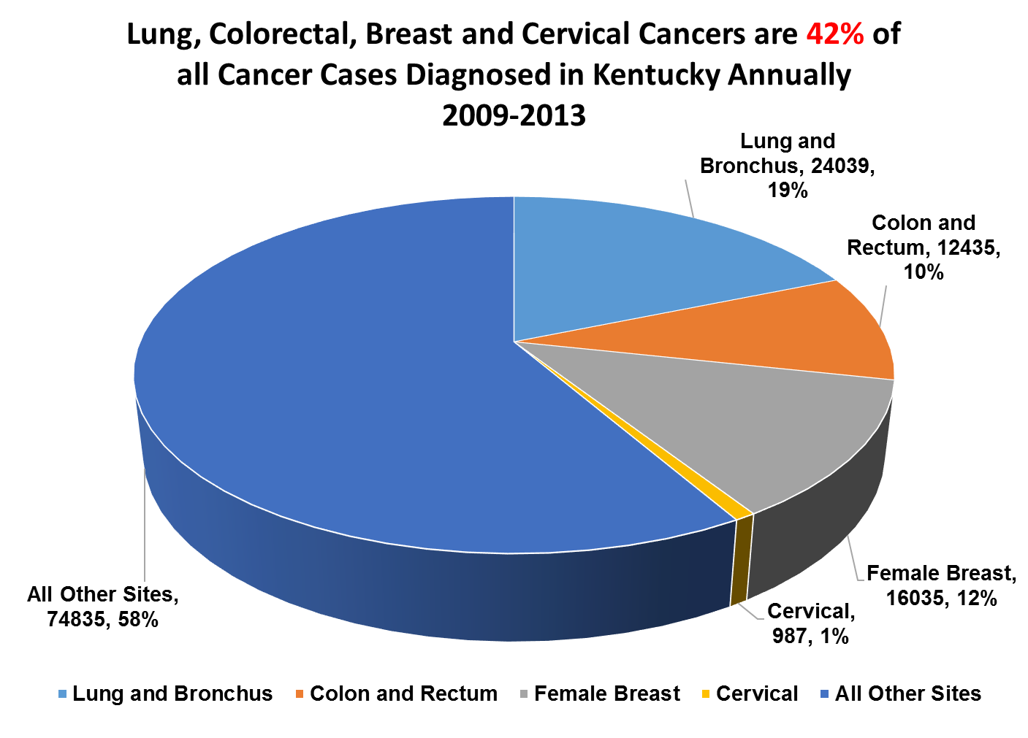

Slide 5
Characteristics of the Kentucky Population
Characteristic | Kentucky | United States
Population* | 4,425,092 | 321,418,820
% White** | 88.3 | 77.4
% African American** | 8.2 | 13.2
% all Other Races** | 3.2 | 9.4
% Below Poverty*** | 19.1 | 14.8
% Bachelor’s Degree*** | 21.8 | 29.3
* = U.S. Census QuickFacts 2015 ** = U.S.Census QuickFacts 2014 *** = U.S.Census QuickFacts 2010-2014

Slide 6
Other Characteristics of the Kentucky Population
Characteristic | Kentucky
% Living in Appalachia | 26.7
% Living in Rural Areas | 41.0
# of New Primary Cancers 2013 | 29,232
Source: Kentucky Cancer Registry Website accessed July 14, 2016

Slide 7
Age-Adjusted Incidence and Mortality Rates 2009-2013
Incidence: U.S., Kentucky and KY African Americans
 | All Cancers | Lung | Colorectal | Cervical | Breast
U.S. | 456.7 | 62.5 | 40.6 | 7.6 | 123.4
Kentucky | 520.9 | 96.4 | 50.8 | 8.7 | 122.2
KY African Americans | 520.3 | *98.8 | *57.1 | 7.4 | *127.2
Source: CDC/USCS Database (SEER & NPCR Combined) and Kentucky Cancer Registry (KCR). * = p<.05 vs Kentucky as a whole and the U.S.
Mortality: U.S., Kentucky and KY African Americans
 | All Cancers | Lung | Colorectal | Cervical | Breast
U.S. | 168.5 | 46.0 | 15.1 | 2.3 | 21.5
Kentucky | 201.0 | 69.5 | 17.6 | 3.0 | 22.2
KY African Americans | *222.8 | 70.2 | *21.5 | *3.5 | *30.1
Source: National Center for Health Statistics (NCHS) and KCR. * = p<.05 vs Kentucky as a whole and the U.S.

Slide 8
Age-Adjusted Incidence and Mortality Rates 2008-2012
Incidence: U.S., Kentucky and Appalachian Kentucky
 | All Cancers | Lung | Colorectal | Cervical | Breast
U.S. | 456.7 | 62.5 | 40.6 | 7.6 | 123.4
Kentucky | 520.9 | 96.4 | 50.8 | 8.7 | 122.2
Appalachian Kentucky | * 534.5 | * 109.2 | * 54.6 | * 9.6 | * 113.3
Source: CDC/USCS Database (SEER & NPCR Combined) and Kentucky Cancer Registry (KCR). * = p<.05 vs Kentucky as a whole and the U.S.
Mortality: U.S., Kentucky and Appalachian Kentucky
 | All Cancers | Lung | Colorectal | Cervical | Breast
U.S. | 168.5 | 46.0 | 15.1 | 2.3 | 21.5
Kentucky | 201.0 | 69.5 | 17.6 | 3.0 | 22.2
Appalachian Kentucky | * 226.6 | * 82.1 | * 20.3 | * 3.6 | * 24.1
Source: National Center for Health Statistics (NCHS) and KCR. * = p<.05 vs Kentucky as a whole and the U.S.

Slide 9
The impact of poverty and educational attainment on the cancer burden and risk behaviors

Slide 10
% Current Smokers by Level of Income
U.S. Compared to Kentucky (2014)
Income Level | % Smokers U.S. | % Smokers Kentucky
Less than $15,000 | 32.7 | 47.7
$15,000- 24,999 | 27.3 | 37.7
$25,000- 34,999 | 23.1 | 31.0
$35,000- 49,999 | 20.1 | 23.1
$50,000+ | 12.9 | 18.4
cdc.gov/brfss website. Prevalence and Trends Data, Accessed July 12, 2016

Slide 11
% Current Smokers by Level of education
U.S. Compared to Kentucky (2014)
Education Level | % Smokers U.S. | % Smokers Kentucky
Less than H.S. | 33.0 | 45.1
H.S. or G.E.D. | 24.0 | 31.1
Some post-H.S. | 19.6 | 25.3
College graduate | 8.2 | 12.3
cdc.gov/brfss website. Prevalence and Trends Data, Accessed July 14, 2016

Slide 12
% Age 50 or Older Ever Screened for CRC
by Level of Income
U.S. Compared to Kentucky (2014)
Income Level | % Screened U.S. | % Screened Kentucky
Less than $15,000 | 53.8 | 54.2
$15,000- 24,999 | 60.7 | 62.0
$25,000- 34,999 | 66.0 | 66.4
$35,000- 49,999 | 69.6 | 72.2
$50,000+ | 72.4 | 70.1
cdc.gov/brfss website. Prevalence and Trends Data, Accessed July 14, 2016

Slide 13
% Age 50 or Older Ever Screened for CRC
by Level of Education
U.S. Compared to Kentucky (2014)
Education Level | % Screened U.S. | % Screened Kentucky
Less than H.S. | 55.7 | 55.2
H.S. or G.E.D. | 64.8 | 65.9
Some post-H.S. | 69.6 | 69.7
College graduate | 74.7 | 73.5
cdc.gov/brfss website. Prevalence and Trends Data, Accessed July 14, 2016

Slide 14
% Women Age 50+ Mammogram for Breast Cancer in the Past 2 Years
by Level of Income In Kentucky (2014)
Income Level | % Screened Kentucky
Less than $15,000 | 66.9
$15,000- 24,999 | 74.6
$25,000- 34,999 | 75.5
$35,000- 49,999 | 77.5
$50,000+ | 85.2
cdc.gov/brfss website. Prevalence and Trends Data, Accessed July 14, 2016

Slide 15
% Women Age 50+ Mammogram for Breast Cancer in the past 2 Years
by Level of Education in Kentucky (2014)
Education Level | % Screened Kentucky
Less than H.S. | 66.4
H.S. or G.E.D. | 79.2
Some post-H.S. | 78.7
College graduate | 82.2
cdc.gov/brfss website. Prevalence and Trends Data, Accessed July 14, 2016

Slide 16
% Women Age 18+ PAP Test for Cervical Cancer in the Past 2 Years
by Level of Income In Kentucky (2014)
Income Level | % Screened Kentucky
Less than $15,000 | 68.7
$15,000- 24,999 | 70.8
$25,000- 34,999 | 72.1
$35,000- 49,999 | 78.2
$50,000+ | 83.2
cdc.gov/brfss website. Prevalence and Trends Data, Accessed July 14, 2016

Slide 17
% Women Age 18+ PAP Test for Cervical Cancer in the past 3 Years
by Level of Education in Kentucky (2014)
Education Level | % Screened Kentucky
Less than H.S. | 63.3
H.S. or G.E.D. | 71.2
Some post-H.S. | 73.4
College graduate | 88.5
cdc.gov/brfss website. Prevalence and Trends Data, Accessed July 14, 2016

Slide 18
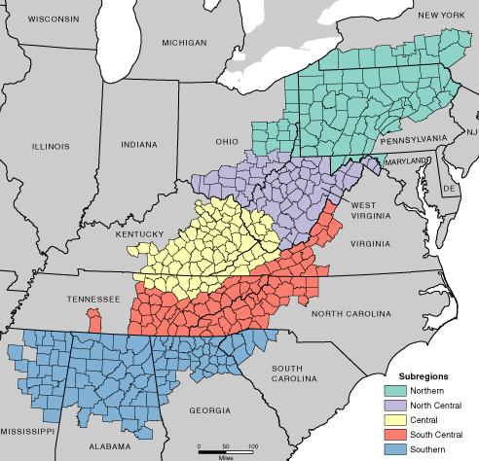
Appalachian Sub-Regions
Notes:
Appalachia is subdivided into five regions. However, Appalachia is not a homogeneous area. The central Appalachian region (Click) has among the highest levels of poverty and low literacy in the country.

Slide 19
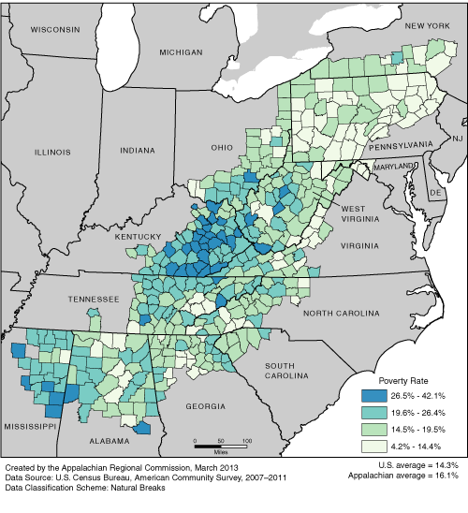
% of People in Living Below the Federal Poverty Level

Slide 20
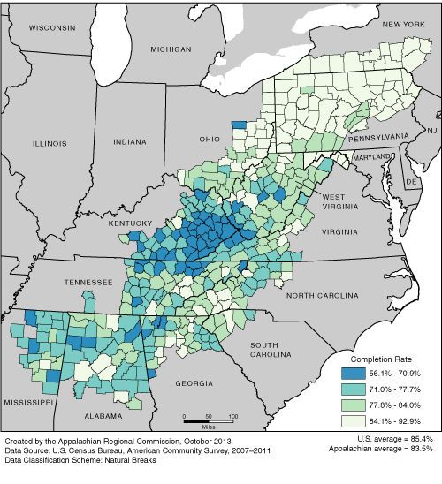
% of People with a High School Degree

Slide 21
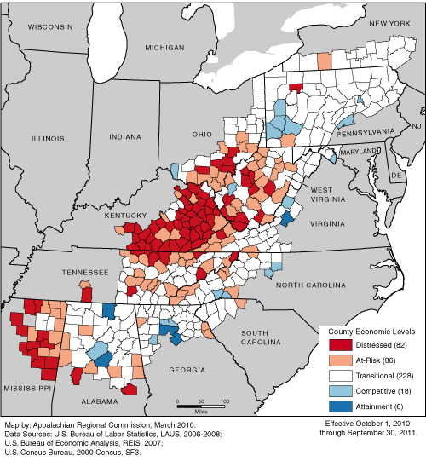
Distressed Counties in Appalachia

Slide 22
Questions?

Slide 23
Lung Cancer Incidence in Kentucky

Slide 24
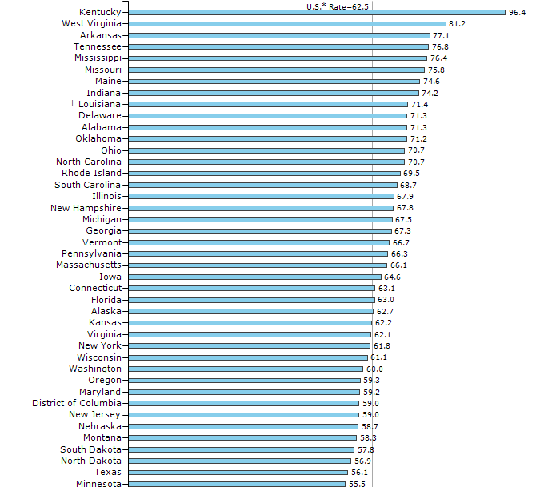
Both Genders, Lung Cancer Incidence Rates Ranked by State (2009 – 2013)
Source: CDC/USCS Website
Accessed July 20, 2016

Slide 25
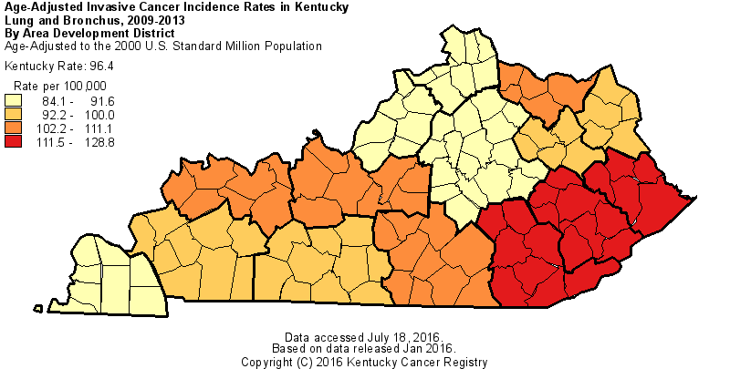

Slide 37
Lung Cancer Mortality in Kentucky

Slide 38
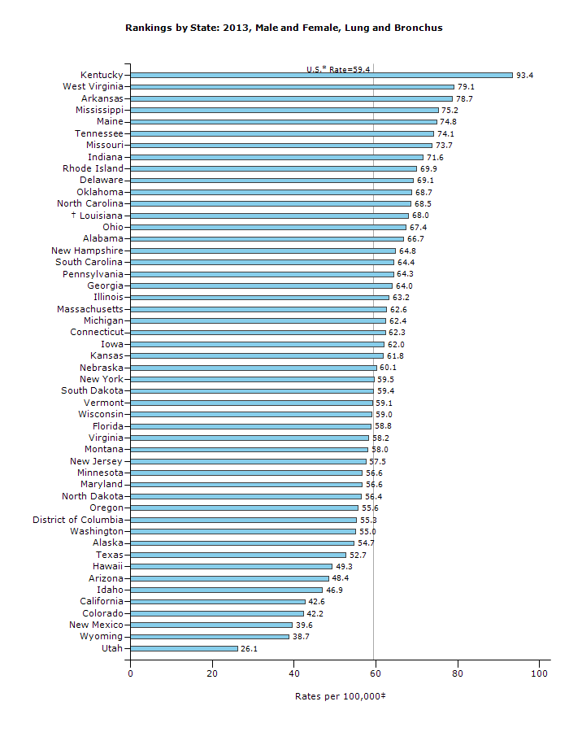
Both Genders, Lung Cancer Mortality Rates Ranked by State (2009 – 2013)
Source: CDC/USCS Website
Accessed July 20, 2016

Slide 39
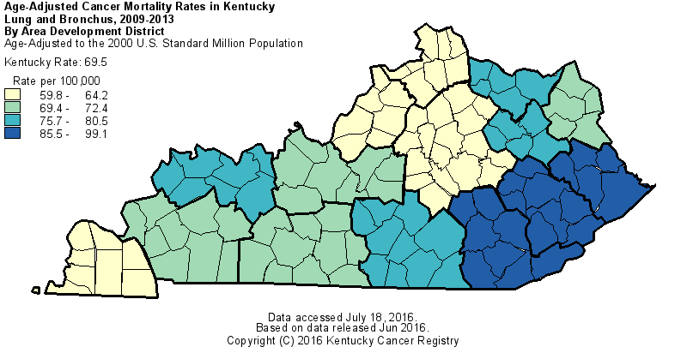

Slide 51
An Index of the Lung Cancer Burden In Kentucky By Area Development District

Slide 52
Combining Data from Multiple Sources
of Data to Define the Burden of Cancer
Demographic Characteristics Contribute to
Risk Factors Contribute to
Incidence and Late Stage DX Contribute to
Cancer Mortality
Logic Model

Slide 56
Lung Cancer by Area Development District in KY, 2009-2013
Area Development District | High School Education 2009-2013 |  | Current Smoker |  | Age-Adjusted Incidence |  | Age-Adjusted Mortality |  | Overall Rank
 |  |  | 2001-2005
 | Percent | Rank | Percent | Rank | Rate | Rank | Rate | Rank
Kentucky River | 66.72 | 1 | 35.7 | 1 | 126.1 | 2 | 99.1 | 1 | 5
Big Sandy | 70.03 | 3 | 35.5 | 2 | 129 | 1 | 89.8 | 2 | 8
Cumberland Valley | 68.8 | 2 | 35.5 | 2 | 111.6 | 3 | 85.5 | 3 | 10
Buffalo Trace | 74.88 | 6 | 33 | 4 | 111.1 | 4 | 80.5 | 4 | 18
Lake Cumberland | 72.48 | 4 | 31.1 | 9 | 102.3 | 7 | 79.9 | 5 | 25
Gateway | 74.28 | 5 | 32 | 6 | 99.5 | 9 | 75.7 | 7 | 27
Fivco | 79.18 | 7 | 32.5 | 5 | 100.2 | 8 | 69.4 | 11 | 31
Barren River | 79.19 | 8 | 31.8 | 7 | 98.4 | 10 | 72.4 | 8 | 33
Lincoln Trail | 83.24 | 10 | 31.1 | 9 | 102.4 | 6 | 71.9 | 9 | 34
Green River | 83.78 | 12 | 30.3 | 11 | 107.2 | 5 | 76.2 | 6 | 34
Pennyrile | 80.8 | 9 | 31.3 | 8 | 92.3 | 11 | 69.9 | 10 | 38
Northern Kentucky | 87.14 | 15 | 29 | 12 | 91.9 | 12 | 64.2 | 12 | 51
Purchase | 83.67 | 11 | 28.5 | 14 | 84.3 | 15 | 61.8 | 14 | 54
Kipda | 87.01 | 14 | 28.6 | 13 | 89.3 | 13 | 59.8 | 15 | 55
Bluegrass | 84.93 | 13 | 28.2 | 15 | 86.9 | 14 | 63.4 | 13 | 55

Slide 57
Lung Cancer Summary
Kentucky has the highest lung cancer incidence and mortality rates compared to all other states.
The lung cancer incidence and mortality is declining among males,
But, the lung cancer incidence is increasing among females.
The lung cancer incidence rate declined significantly in the last 6 years among African American men, but not for African American women.
The highest lung cancer incidence and mortality rates are in the Appalachian region of the state, specifically in the Kentucky River, Big Sandy and Cumberland Valley ADD’s.
The index for the burden of lung cancer also shows Kentucky River, Big Sandy and Cumberland Valley ADD’s to have the greatest need.

Slide 58
Questions?

Slide 59
Female Breast Cancer Incidence in Kentucky

Slide 60
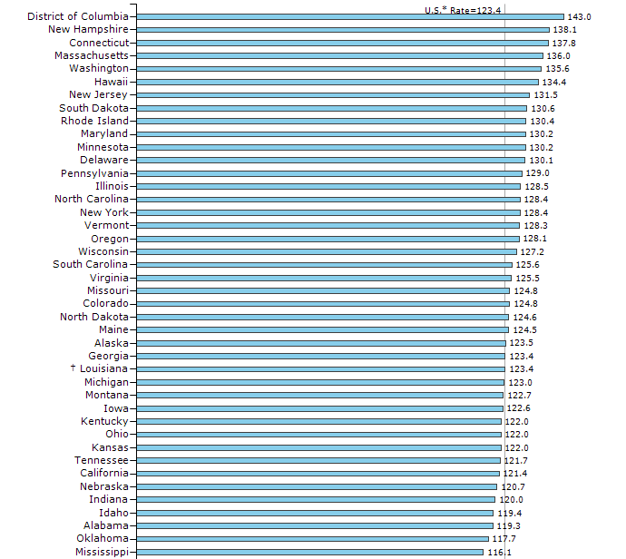
Female Breast Cancer Incidence Rates Ranked by State (2009 – 2013)
32nd
Source: CDC/USCS Website
Accessed July 20, 2016

Slide 61
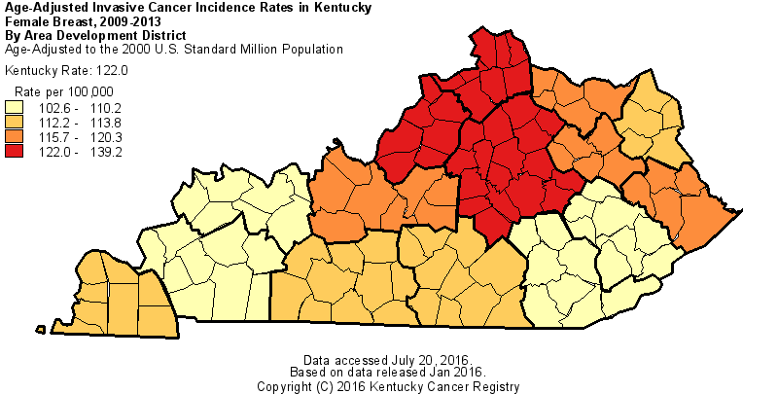

Slide 66
Late-Stage Female Breast Cancer Incidence

Slide 71
Female Breast Cancer Mortality

Slide 72
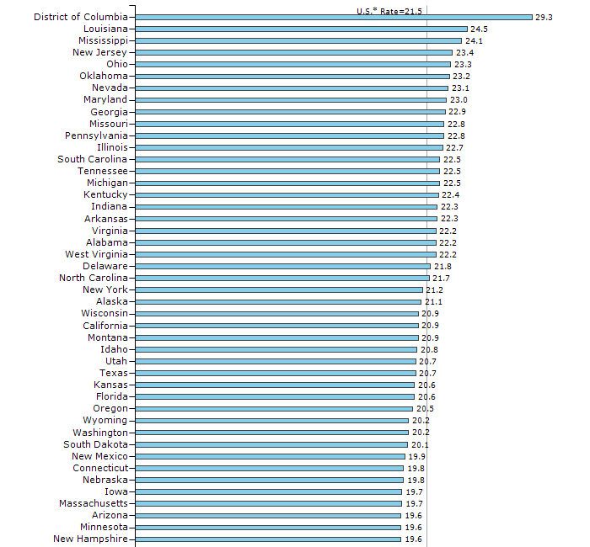
Female Breast Cancer Mortality Rates Ranked by State (2009 – 2013)
16th
Source: CDC/USCS Website
Accessed July 20, 2016

Slide 73
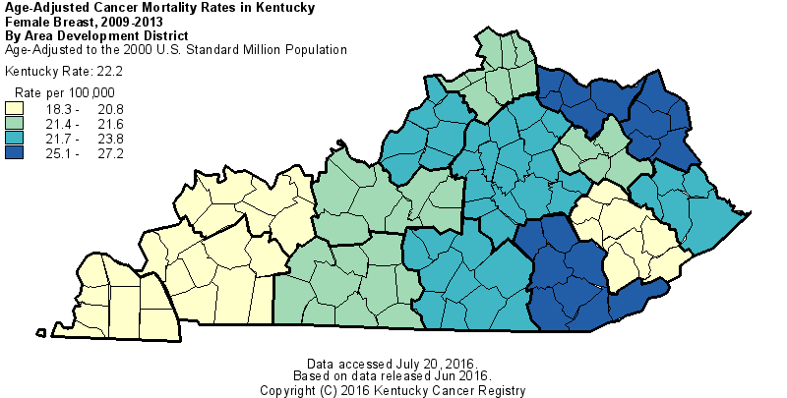

Slide 78
An Index of the Female Breast Cancer Burden In Kentucky By Area Development District

Slide 82
Female Breast Cancer by Area Development District in KY, 2009-2013
Area Development District | High School Education, 2009-2013 |  | Mammography Rate(%) 2012 |  | Age-Adjusted Incidence |  | Late Stage Incidence (%) |  | Overall Rank
 | Percent | Rank | Percent | Rank | Rate | Rank | Percent | Rank
Kentucky River | 66.7 | 1 | 64.3 | 1 | 128.1 | 3 | 36.0 | 1 | 6
Cumberland Valley | 68.8 | 2 | 68.0 | 4 | 116.3 | 1 | 34.0 | 2 | 9
Big Sandy | 70.0 | 3 | 72.3 | 9 | 133.2 | 4 | 31.3 | 4 | 20
Fivco | 79.2 | 7 | 68.5 | 5 | 133.9 | 6 | 31.6 | 3 | 21
Lake Cumberland | 72.5 | 4 | 71.7 | 8 | 133.8 | 5 | 30.6 | 5 | 22
Pennyrile | 80.8 | 9 | 70.4 | 6 | 120.5 | 2 | 29.8 | 7 | 24
Gateway | 74.3 | 5 | 66.6 | 3 | 142.4 | 11 | 30.1 | 6 | 25
Barren River | 79.2 | 8 | 70.5 | 7 | 138.1 | 9 | 29.4 | 9 | 33
Northern Kentucky | 87.1 | 15 | 66.3 | 2 | 148.0 | 13 | 29.8 | 8 | 38
Buffalo Trace | 74.9 | 6 | 77.1 | 11 | 142.0 | 10 | 25.5 | 14 | 41
Green River | 83.8 | 12 | 78.6 | 13 | 134.6 | 7 | 27.7 | 10 | 42
Lincoln Trail | 83.2 | 10 | 75.0 | 10 | 143.8 | 12 | 26.8 | 11 | 43
Purchase | 83.7 | 11 | 84.8 | 15 | 137.0 | 8 | 24.2 | 15 | 49
Bluegrass | 84.9 | 13 | 80.4 | 14 | 158.0 | 14 | 26.7 | 12 | 53
Kipda | 87.0 | 14 | 77.7 | 12 | 172.7 | 15 | 26.5 | 13 | 54

Slide 83
Breast Cancer Summary
Screening for breast cancer increases the breast incidence rate.
Neither the breast cancer incidence rate or late stage disease rate have changed significantly in the past 13 years. However, the mortality rate has declined significantly suggesting improvements in treatment.
African American women have significantly higher breast cancer incidence and mortality compared to Caucasian women.
The breast cancer incidence rate in the Appalachian area is low and the mortality rate is high suggesting that this population may be under screened relative to the non-Appalachian area of the state.

Slide 84
Questions?

Slide 85
Colon and Rectum Cancer Incidence

Slide 86
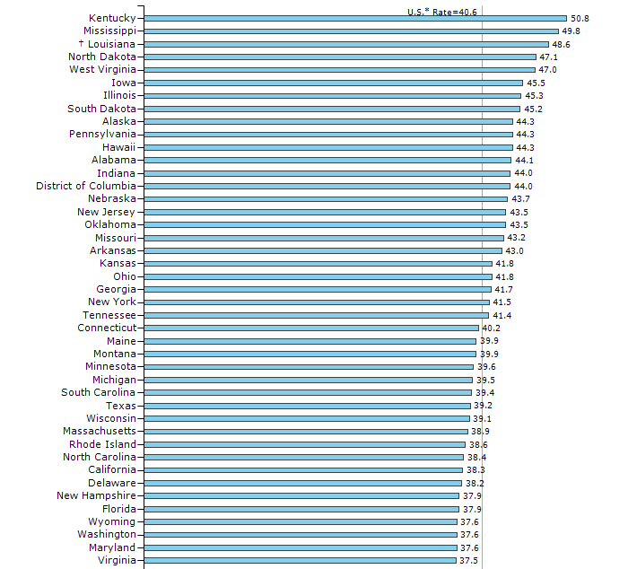
Both Genders, Colorectal Cancer Incidence Rates Ranked by State (2009 – 2013)
Source: CDC/USCS Website
Accessed July 20, 2016

Slide 87
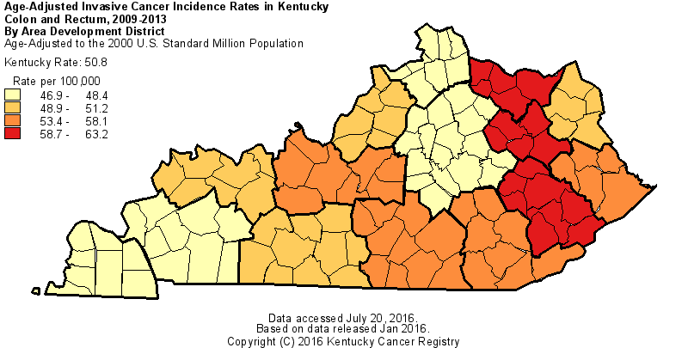

Slide 88
Source: http://cdc.gov/brfss, Accessed June 2016

Slide 89
P<.05
Source: http://www.kcr.uky.edu, Accessed June 2016

Slide 101
Late-Stage Colon and Rectum Cancer Incidence

Slide 113
Colon and Rectum Cancer Mortality

Slide 114
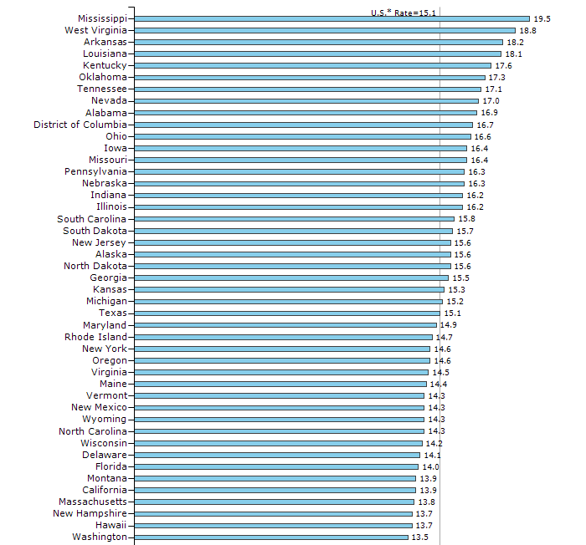
Both Genders, Colorectal Cancer Mortality Rates Ranked by State (2008 – 2012)
5th
Source: CDC/USCS Website
Accessed July 20, 2016

Slide 115
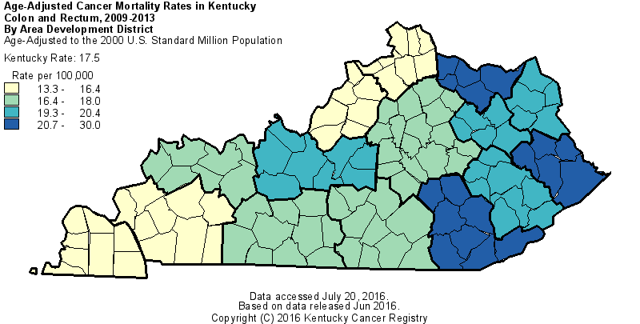

Slide 116
P<.05
Source: http://www.kcr.uky.edu, Accessed June 2016

Slide 129
An Index of the Colorectal Cancer Burden In Kentucky By Area Development District

Slide 131
Colonoscopy Rate (2012) vs. Late Stage Colorectal Cancer Incidence (2009-2013)
● Colonoscopy Rate (2012) vs. Late Stage Colorectal Cancer Incidence (2009-2013)
Linear (Colonoscopy Rate vs. Late Stage Colorectal Cancer Incidence)

Slide 132
Colon Cancer by Area Development District in KY, 2009-2013
Area Development District | High School Education, 2009-2013 |  | Colonoscopy Rate, 2012 |  | Late Stage Incidence (%) |  | Overall Rank
 | Percent | Rank | Percent | Rank | Percent | Rank
Cumberland Valley | 68.8 | 2 | 60.3 | 5 | 58.0 | 1 | 8
Big Sandy | 70.03 | 3 | 59.5 | 3 | 53.6 | 7 | 13
Gateway | 74.28 | 5 | 54.1 | 1 | 52.6 | 9 | 15
Barren River | 79.19 | 8 | 61.4 | 6 | 56.8 | 2 | 16
Kentucky River | 66.72 | 1 | 57.3 | 2 | 48.4 | 13 | 16
Buffalo Trace | 74.88 | 6 | 64.5 | 8 | 56.3 | 4 | 18
Lake Cumberland | 72.48 | 4 | 60.1 | 4 | 47.1 | 14 | 22
Northern Kentucky | 87.14 | 15 | 62.3 | 7 | 56.6 | 3 | 25
Fivco | 79.18 | 7 | 69.4 | 12 | 52.9 | 8 | 27
Pennyrile | 80.8 | 9 | 66.8 | 9 | 52.6 | 10 | 28
Lincoln Trail | 83.24 | 10 | 71.9 | 14 | 54.4 | 5 | 29
Green River | 83.78 | 12 | 72.7 | 15 | 53.9 | 6 | 33
Kipda | 87.01 | 14 | 68.2 | 10 | 51.4 | 11 | 35
Bluegrass | 84.93 | 13 | 68.2 | 11 | 49.2 | 12 | 36
Purchase | 83.67 | 11 | 70.8 | 13 | 41.9 | 15 | 39

Slide 133
Colorectal Cancer Summary
Screening for colorectal cancer has increased significantly.
At the same time, both the colorectal cancer incidence and mortality rates have declined dramatically.
The colorectal cancer incidence, late stage disease and mortality rates are declining more rapidly among African American women and men compared to Caucasian women and men.
The highest colorectal cancer incidence and mortality rates are in the Appalachian region of the state.
The colorectal cancer incidence and mortality rates in Appalachian Kentucky are declining much more slowly compared to the non-Appalachian area of the state.

Slide 134
Questions?

Slide 135
Cervical Cancer Incidence

Slide 136
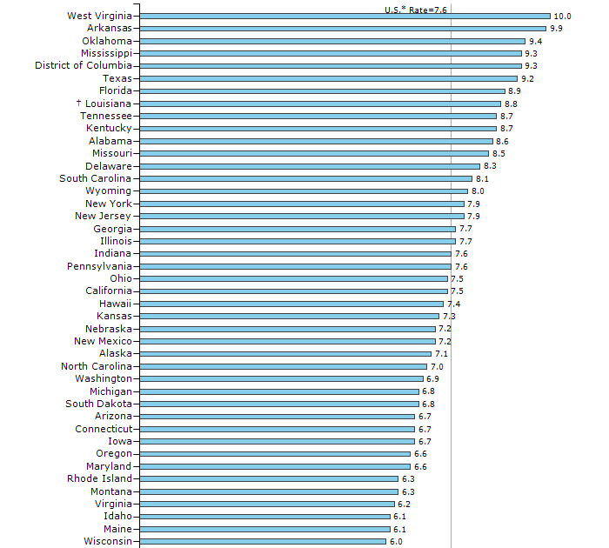
Cervical Cancer Incidence Rates Ranked by State (2009 – 2013)
10th
Source: CDC/USCS Website
Accessed July 20, 2016

Slide 137
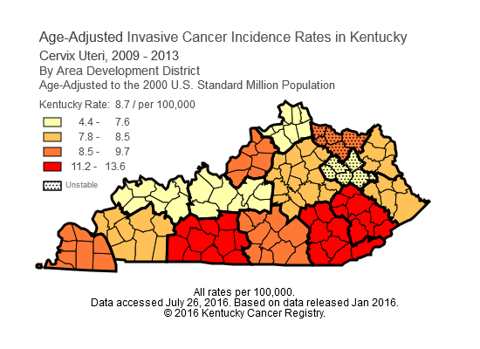

Slide 142
Cervical Cancer Mortality

Slide 143
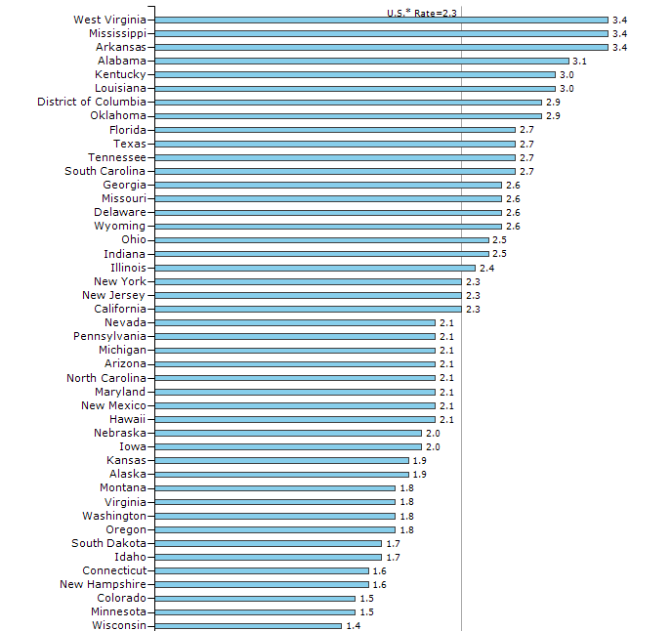
Cervical Cancer Mortality Rates Ranked by State (2009 – 2013)
5th
Source: CDC/USCS Website
Accessed July 20, 2016

Slide 144
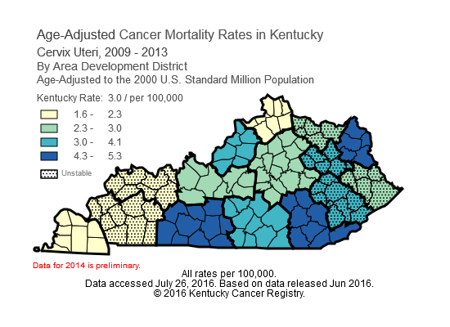

Slide 149
An Index of the Cervical Cancer Burden In Kentucky By Area Development District

Slide 152
Cervical Cancer by Area Development District in KY, 2009-2013
Area Development District | High School Education, 2009-2013 |  | Pap Rate (%) 2012 |  | Age-Adjusted Incidence |  | Overall Rank
 | Percent | Rank | Percent | Rank | Rate | Rank
Kentucky River | 66.7 | 1 | 69.1 | 2 | 13.6 | 1 | 4
Cumberland Valley | 68.8 | 2 | 72.1 | 4 | 11.9 | 2 | 8
Barren River | 79.2 | 8 | 65.1 | 1 | 11.2 | 3 | 12
Big Sandy | 70.0 | 3 | 72.0 | 3 | 8 | 9 | 15
Lake Cumberland | 72.5 | 4 | 73.6 | 6 | 8.5 | 8 | 18
Fivco | 79.2 | 7 | 72.2 | 5 | 8.5 | 7 | 19
Buffalo Trace | 74.9 | 6 | 81.3 | 12 | 9.5 | 5 | 23
Pennyrile | 80.8 | 9 | 77.4 | 9 | 8 | 9 | 27
Gateway | 74.3 | 5 | 76.0 | 8 | 4.4 | 15 | 28
Purchase | 83.7 | 11 | 82.1 | 14 | 9.7 | 4 | 29
Kipda | 87.0 | 14 | 78.6 | 10 | 9.1 | 6 | 30
Northern Kentucky | 87.1 | 15 | 74.0 | 7 | 7.6 | 12 | 34
Bluegrass | 84.9 | 13 | 79.3 | 11 | 7.8 | 11 | 35
Lincoln Trail | 83.2 | 10 | 81.6 | 13 | 7 | 13 | 36
Green River | 83.8 | 12 | 83.7 | 15 | 6.5 | 14 | 41

Slide 153
Questions?

Slide 154
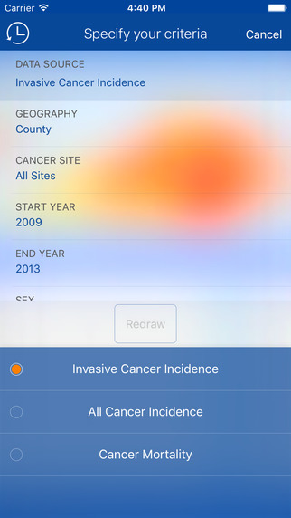
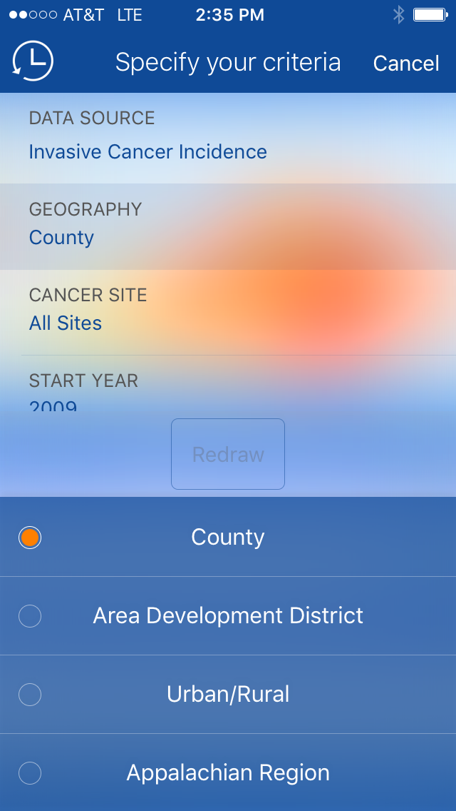
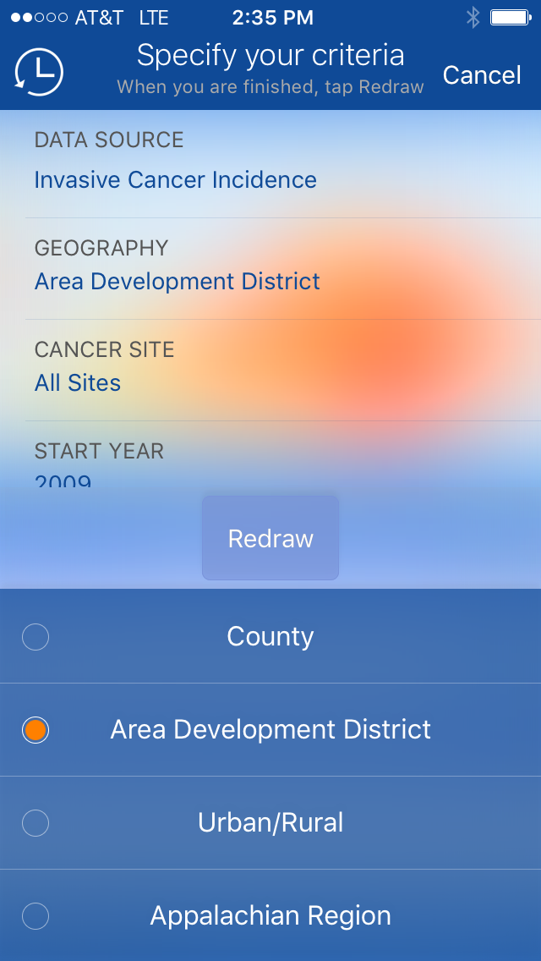
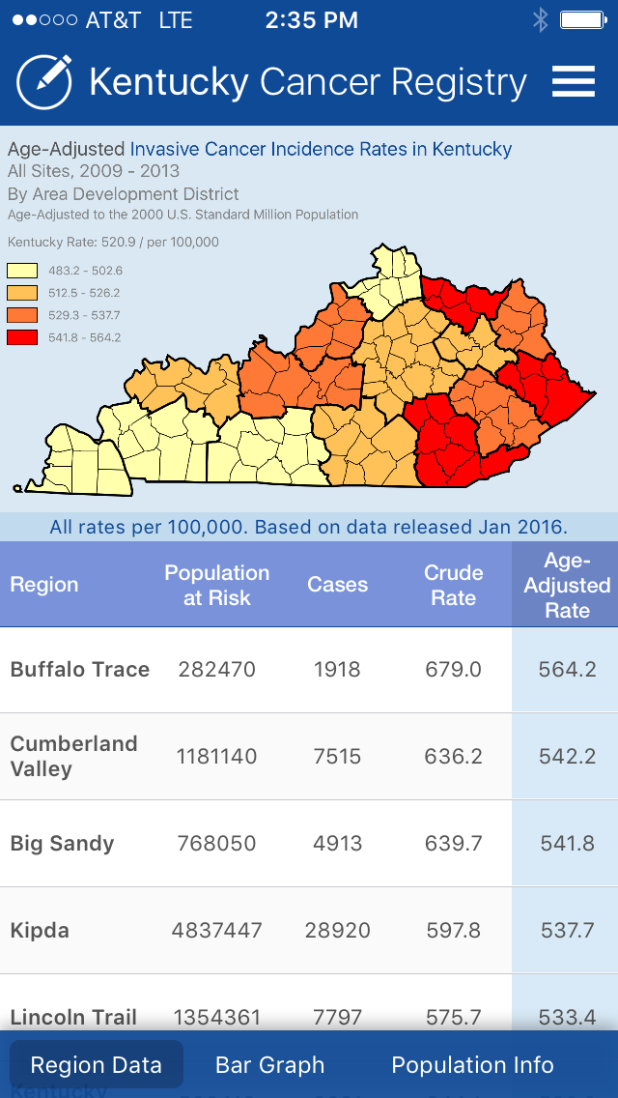
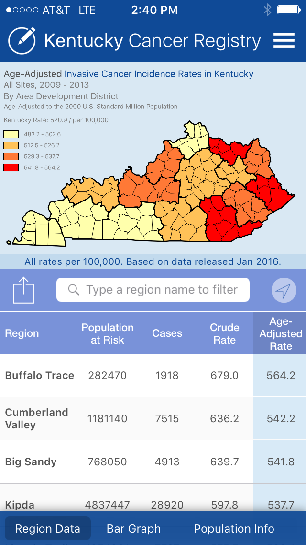
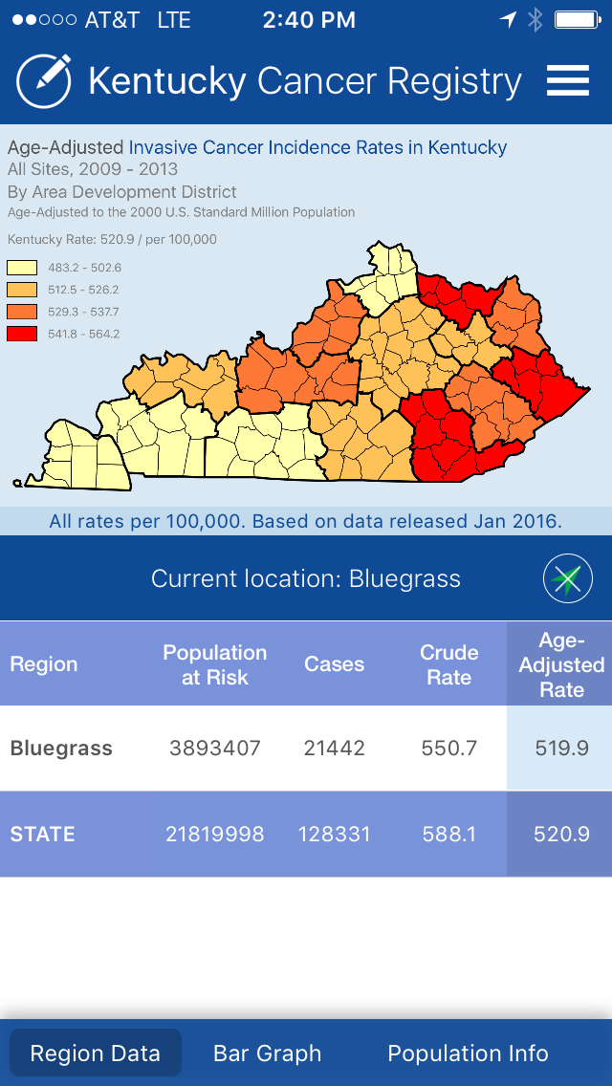
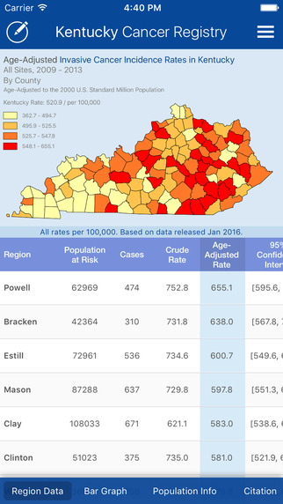
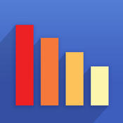
Free Kentucky Cancer Registry APP
iPhone
This app is designed for both iPhone and iPad
Free: Go to the APP Store & search “Cancer Rates”
Description
Cancer Rates is a powerful data visualization tool that provides access to population-based cancer incidence and mortality data in an intuitive, easy-to-use iOS app. Features - Browse cancer rates by cancer site, sex, race, and diagnosis or death year range. - Interactive heat maps allow you to tap or drag your finger across them to quickly view regional data. - View county-level data or data for other geographic units such as Area Development Districts in Kentucky. - Visualize rates and trends with exportable graphs. - View cancer rates by early stage and late stage*. - Rates by breast cancer molecular subtype*. - And much more.

Slide 155
Free Kentucky Cancer Registry APP
iPhone
This app is designed for both iPhone and iPad
Free: Go to the APP Store & search “Cancer Rates”
Released: Jun 10, 2016
Version: 1.0
Size: 5.4 MB
Language: English
© 2016 Kentucky Cancer Registry
Rated 12+
Compatibility: Requires iOS 8.0 or later.
Compatible with iPhone, iPad, and iPod touch

Slide 156
Thank You!
Questions?

Slide 157
Contact Information
Thomas C. Tucker, PhD, MPH
Director Kentucky Cancer Registry
tct@kcr.uky.edu
Jaclyn Nee, DrPH
Epidemiologist and Research Coordinator KCR
jnee@kcr.uky.edu

