Slide 1

Colon Cancer in Kentucky
{Date} 2015
Presented by:
{Community Partner’s Name,
Organization,
Contact Email}

Slide 2

How to Use This PowerPoint
You can use all or some sections of this PowerPoint for educational purposes. Update the title slide with your organization’s name/contact information.
Please show the data sources found on the References Pages at the end of the slide show.
This PowerPoint was developed by the Kentucky Cancer Consortium and the Kentucky Cancer Program with help from our partners.

Slide 3
Overview
Section | Content | Slide Numbers
Cancer & Colon Cancer Basics | Basics, Risk Factors, Signs & Symptoms, Average vs. High Risk, Screening Tests, & Talking to Insurance Companies | 4-22
Colon Cancer Data | Incidence, Mortality/Death, Screening, Disparities | 23-36
What You Can Do | Get Screened, Educate, & Advocate | 37-40
Looking Toward Our Future: Where are We Going | Kentucky’s Cancer Action Plan | 41-44
Kentucky Colon Cancer Screening Program (KCCSP) | Background Information | 45-50
End Slides | Conclusion, References | 51-54

Slide 4
Cancer Basics
What is Cancer?
    A group of 100 different diseases
    The uncontrolled, abnormal growth of cells
How does Cancer start?
    Cancer cells are abnormal cells that don’t die, but continue to grow new, abnormal cells
    Can invade other tissues
Notes:
Cancer is the general name for a group of more than 100 diseases. Although there are many kinds of cancer, all cancers start because abnormal cells grow out of control. Untreated cancers can cause serious illness and death.
Cancer cell growth is different from normal cell growth. Instead of dying, cancer cells continue to grow and form new, abnormal cells. Cancer cells can also invade (grow into) other tissues, something that normal cells can’t do.
Source: American Cancer Society, http://www.cancer.org/cancer/colonandrectumcancer/detailedguide/colorectal-cancer-what-is-cancer

Slide 5
Cancer Basics
    Metastasis (muh-tas-tuh-sis):
    Process of cancer spreading to other parts of the body
How does Cancer spread?
  Cancer cells can form a tumor
  Replace normal cells
  May invade nearby tissues
  May spread to other body sites via blood or lymph vessels
Notes:
In most cases, the cancer cells form a tumor. Over time, the tumors can replace normal tissue, crowd it, or push it aside.
Another way that cancer can spread is when the cancer cells get into the body’s bloodstream or lymph vessels. The process of cancer spreading is called metastasis.
No matter where a cancer may spread, it’s always named based on the place where it started. For example, colon cancer that has spread to the liver is called metastatic colon cancer, not liver cancer. In this case, cancer cells taken from the liver would be the same as those in the colon. They would be treated in the same ways too.

Slide 6
Colon Cancer
Also called “Colorectal cancer”
Uncontrolled, abnormal cell growth which starts in the colon or rectum
These abnormal cells can form a mass of tissue
Usually begins as a
noncancerous polyp,
that can, over time,
become a cancerous
tumor.
    Polyp:
A polyp is a growth that shouldn’t be there. Most colon polyps are harmless. But over time, some colon polyps can develop into colon cancer, which could be fatal if it is found in a late stage.
Notes:
Colorectal cancer is a term used for cancer that starts in the colon or the rectum. These cancers can also be referred to separately as colon cancer or rectal cancer, depending on where they start.

Slide 7
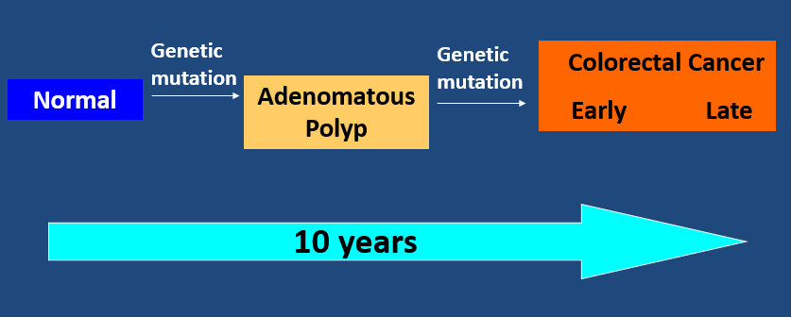
Polyp Growth to Cancer:
An Opportunity for Intervention
Notes:
It is important to remember that the majority of polyps take a long time to develop (approximately 10 years), allowing us an opportunity to find them early through screening. Most polyps remain benign (noncancerous) and are often termed hyperplastic polyps. The likelihood that hyperplastic polyps will become cancer is very low. Other benign polyps are sometimes referred to as pre-cancerous. These polyps are not malignant, themselves, but have a chance of becoming cancerous if not removed.
Adenomas are polyps that usually grow on a stalk, resembling small mushrooms. They tend to grow slowly over a decade or more. The risk of an adenoma developing into cancer increases as the size increases and with the amount of time it has been growing in the colon. Adenomas that are malignant are called adenocarcinomas. In the very early stages, abnormal cells are contained inside the polyp and can be easily removed by colonoscopy before they develop into invasive cancer. However, as cancer cells grow and divide within the polyp, they can eventually invade nearby colon tissue and grow into and beyond the wall of the colon or rectum. If the cancer becomes advanced, the tumors will grow though all of the tissue layers of the colon rectum, and may metastasize, shedding cells into the circulatory system, spreading the cancer to other organs such as the liver and lungs.

Slide 8
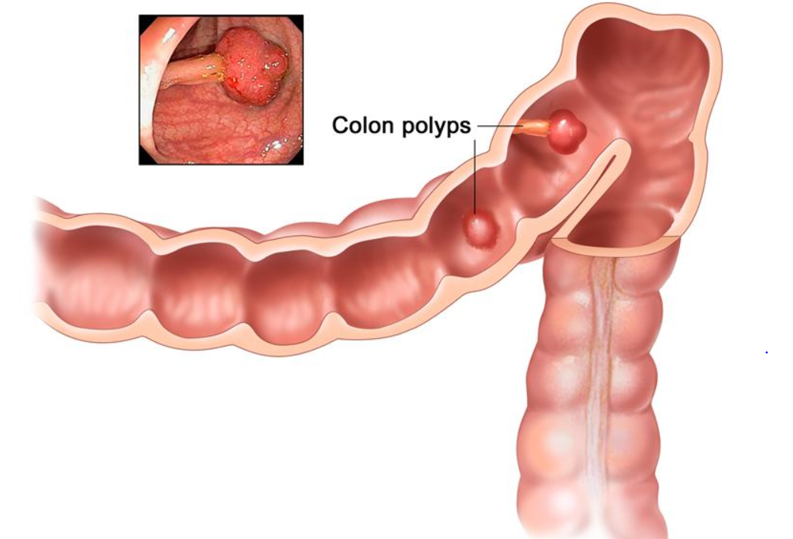
Polyps in the Colon
Image Source: National Cancer Institute
Notes:
Here is a picture of colon polyps. Some polyps have a stalk and others do not. Inset shows a photo of a polyp with a stalk. These polyps would be removed during a colonoscopy by the health care provider and tested to see if they are cancerous.

Slide 9
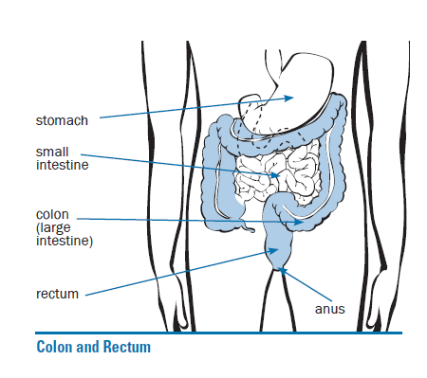
Where is the Colon and Rectum & What Do They Do?
Digestive System
Image Source: CDC, Screen for Life
Notes:
Let’s take a moment to discuss what the colon and rectum do for us. The colon and rectum are parts of the digestive system, which is also called the gastrointestinal (GI) system (see illustration). The first part of the digestive system (the stomach and small intestine) processes food for energy.
After the food that we eat enters the colon, nutrients and water are absorbed leaving waste matter which is called feces or stool. It then goes into the rectum, the final 6 inches of the digestive system, where it is stored until it passes out of the body through the anus.

Slide 10
Risk Factors for Colon Cancer
Different cancers have different risk factors
Having a risk factor(s) does not mean you will get cancer
Certain risk factors increase a person’s chance of developing a polyp(s) or colorectal cancer
    Risk Factor:
    Anything that affects your chance of getting a disease such as cancer.
Notes:
A risk factor is anything that affects your chance of getting a disease such as cancer. Different cancers have different risk factors.
But risk factors don't tell us everything. Having a risk factor, or even several risk factors, does not mean that you will get the disease. And some people who get the disease may not have any known risk factors. Even if a person with colorectal cancer has a risk factor, it is often hard to know how much that risk factor might have contributed to the cancer.
Researchers have found several risk factors that may increase a person's chance of developing colorectal polyps or colorectal cancer.

Slide 11
Risk Factors for Colon Cancer: Lifestyle Factors
Diet
  High in red meats (beef, pork,
  lamb, or liver) and processed
  meats
  Cooking meats at high temperatures
  (frying, broiling, or grilling)
Physical inactivity
Obesity (Being very overweight)
Smoking
Heavy alcohol use
Increases Risk for
Colon
Cancer
Notes:
Lifestyle-related factors
Several lifestyle-related factors have been linked to colorectal cancer. In fact, the links between diet, weight, exercise and colorectal cancer risk are some of the strongest for any type of cancer.
Certain types of diets
A diet that is high in red meats (such as beef, pork, lamb, or liver) and processed meats (hot dogs and some luncheon meats) can increase colorectal cancer risk. Cooking meats at very high temperatures (frying, broiling, or grilling) creates chemicals that might increase cancer risks.
Diets high in vegetables, fruits, and whole grains have been linked with a decreased risk of colorectal cancer, but fiber supplements do not seem to help. It's not clear if other dietary factors (for example, certain types of fats) affect colorectal cancer risk.
Physical inactivity
If you are not physically active, you have a greater chance of developing colorectal cancer. Increasing activity may help reduce your risk.
Obesity
If you are very overweight, your risk of developing and dying from colorectal cancer is increased. Obesity raises the risk of colon cancer in both men and women, but the link seems to be stronger in men.
Smoking
Long-term smokers are more likely than non-smokers to develop and die from colorectal cancer. Smoking is a well-known cause of lung cancer, but it is also linked to other cancers, like colorectal. There are resources in Kentucky for those interested in stopping smoking. Contact the Kentucky Cancer Program in your area to find out more about these programs or you can call the Quit Now Kentucky Line at 1-800-QUIT-NOW
Heavy alcohol use
Colorectal cancer has also been linked to the heavy use of alcohol. Alcohol use should be limited to no more than 2 drinks a day for men and 1 drink a day for women.

Slide 12
Other Risk Factors for Colon Cancer:
Age (over 50)
Personal history of colorectal cancer
    or polyps
Personal history of Inflammatory
Bowel Disease (IBD)
Family history of colorectal
cancer or polyps
Inherited syndromes
Racial & Ethnic Backgrounds:
  African-Americans & Jewish persons of
  Eastern European descent
Type 2 Diabetes
Increases Risk for
Colon
Cancer
Notes:
Inflammatory bowel diseases include Crohn’s Disease and Ulcerative colitis.
Certain inherited conditions such as Lynch disease (non hereditary Polyposis) increase your risk of colon cancer and other cancers.

Slide 13
Signs & Symptoms of Colon Cancer
Early colon cancer may have NO symptoms.
If symptoms are present, they may include:
A change in bowel habits
A feeling of needing a bowel movement
Rectal bleeding
Blood in the stool which may make it look dark
Cramping or abdominal (belly) pain
Weakness & fatigue
Unintended weight loss
Schedule an appointment to talk to your health care provider if you
have any of these symptoms.
Notes:
Colorectal cancer may cause one or more of these symptoms. If you have any of the following you should see your doctor:
A change in bowel habits, such as diarrhea, constipation, or narrowing of the stool, that lasts for more than a few days
A feeling that you need to have a bowel movement that is not relieved by doing so
Rectal bleeding
Blood in the stool which may make it look dark
Cramping or abdominal (belly) pain
Weakness and fatigue
Unintended weight loss
Colorectal cancers can bleed. While sometimes the blood can be seen or cause the stool to become darker, often the stool looks normal. The blood loss can build up over time, though, and lead to low red blood cell counts (anemia). Sometimes the first sign of colorectal cancer is a blood test showing a low red blood cell count.
Most of these problems are often caused by conditions other than colorectal cancer, such as infection, hemorrhoids, irritable bowel syndrome, or inflammatory bowel disease. Still, if you have any of these problems, it's important to see your doctor right away so the cause can be found and treated, if needed.

Slide 14
Importance of Screening for Colon Cancer
Colon cancer is PREVENTABLE!
Early diagnosis means a better chance at successful treatment.
Prevent colon cancer or find it in its early stage when it is more treatable
Find any polyps or abnormal growths early & remove them
Obtain regular colon cancer screenings
Notes:
Since early colon or rectal cancer may have no symptoms, it is important to obtain regular screenings before symptoms develop.
Colorectal cancer is often found after symptoms appear, but most people with early colon or rectal cancer don't have symptoms of the disease. Symptoms usually only appear with more advanced disease. This is why getting the recommended screening tests before any symptoms develop is so important.
Regular screening can often find colorectal cancer early, when it is most likely to be curable. In many people, screening can also prevent colorectal cancer altogether. This is because some polyps, or growths, can be found and removed before they have the chance to turn into cancer.

Slide 15
Who should be screened?
People at High Risk
People at
Average Risk
Have one or more risk factors for developing colon cancer
Must be screened more often & regularly
This includes persons with a personal or family history of polyps or colon/rectal cancer
ALL people ages 50-75 who are “average risk”
After age 75, discuss with your doctor if screening needs to be continued
Includes men and women
The American College of Gastroenterology, a professional medical organization, recommends African-Americans begin colon cancer screening at age 45.
Notes:
People at average risk
The American Cancer Society believes that preventing colorectal cancer (and not just finding it early) should be a major reason for getting tested. Having their polyps found and removed keeps some people from getting colorectal cancer. Tests that have the best chance of finding both polyps and cancer are preferred if these tests are available to you and you are willing to have them.
Beginning at age 50, both men and women at average risk for developing colorectal cancer should be screened.
People at increased or high risk
If you are at an increased or high risk of colorectal cancer, you should begin colorectal cancer screening before age 50 and/or be screened more often. The following conditions make your risk higher than average:
A personal history of colorectal cancer or adenomatous polyps
A personal history of inflammatory bowel disease (ulcerative colitis or Crohn's disease)
A strong family history of colorectal cancer
A known family history of a hereditary colorectal cancer syndrome such as familial adenomatous polyposis (FAP) ( a condition in which thousands of polyps may develop or hereditary non-polyposis colon cancer (HNPCC) (a condition which is not cancer, but in which a small number of polyps develop that puts you at greater risk for getting colon cancer.

Slide 16
Which Screening Test Should You Get?
It depends on your RISK FACTORS. Be sure to talk with your health care provider about your risk factors and the risks for each colon cancer screening test.
Common Colon Cancer Screening Tests which are often covered by Private Health Insurance, Medicare, & Medicaid
Fecal Immunochemical Test (FIT) or Guaiac Fecal Occult Blood Testing (gFOBT)
Colonoscopy
Some insurance companies may also cover the fecal DNA test (includes Cologuard-is covered by Medicare & Aetna) or other screening tests for colon cancer. Be sure to talk to your insurance company about which test(s) they cover for your individual risk factors.

Slide 17
Types of Colon Cancer Screening Tests | Description of the Test | Screening Schedule for AVERAGE RISK PERSONS
Fecal/Stool blood tests (FIT, FOBT, or gFOBT) | Samples of stool are checked for blood | Every year
Stool DNA Test (Includes Cologuard) | Samples of stool are checked for blood as well as DNA changes | Every 3 years
Colonoscopy | A flexible, lighted tube is used to look at the entire colon & rectum | Every 10 years
Sigmoidoscopy | A flexible, lighted tube is used to look at the rectum & lower colon | Every 5 years, with FIT or FOBT testing every 3 years
Schedule an appointment to talk to your health care provider about which test is right for you & how often you should be screened.
Notes:
These are common screening tests for average risk persons. Again, it is important to know if you are average risk or at high risk based on your personal and family history. If you are HIGH RISK, you will need to go straight to a Colonoscopy screening test to make sure polyps, or abnormal growths in the colon, are removed. This can prevent cancer as well as catch it in its early stages.
It’s important to note that the FDA approved the use of Cologuard in August 2014 and Medicare (Centers for Medicare & Medicaid) decided in October 2014 to make it a covered service. Cologuard, a DNA stool test, detects colon cancer cells in the stool of persons who are “average risk”. No special diet or bowel preparation (no laxatives or enemas) are required for the stool DNA test.
The FIT test is a type of FOBT test that doesn’t require a special diet or the avoidance of medications and usually requires only one or two samples. The test should be done every year.
If either a fecal/stool test or a stool DNA test comes back “positive” or indicating there is blood in the stool, a person will need to have a colonoscopy to determine if they have pre-cancerous polyps or cancer.
If polyps or abnormal cells are removed during a colonoscopy, a person will need to be tested more often than every 10 years.

Slide 18
Colon Cancer Screening and Insurance Coverage
It’s important to know what your insurance covers for colon cancer screening.
Coverage of colon cancer screening tests is required by the Affordable Care Act (ACA).
It is important to know if your health plan was a “grandfathered plan”.
Contact your health insurance company to find out exactly what they will cover for your colon cancer screening as well as any costs that you will have to pay.
Notes:
Grandfathered Plans are not required to cover some cancer screening tests that are mandated by the Affordable Care Act. The Kentucky Cancer Consortium and the Kentucky Cancer Program have developed a fact sheet and work sheet to help individuals estimate the costs of colon cancer screening. These sheets can be found on the KCP and the KCCC websites.

Slide 19
Colonoscopy Screening and Insurance Coverage
It is important to find out from your insurance company if the cost of a colonoscopy will change if a biopsy is done or if a polyp is removed.
Ask your insurance representative what costs you will be responsible for:
  A “Screening Colonoscopy”
  A “Diagnostic Colonoscopy”
Notes:
A “Screening Colonoscopy” is when an individual has a colonoscopy in which the health care provider looks at the colon. If the health care provider sees anything abnormal, they will perform a biopsy where they remove tissue from the colon or they may remove a polyp. When a health care provider removes tissue or a polyp, the screening becomes “diagnostic” and there may be additional charges to you.

Slide 20
Colonoscopy Screening and Insurance Coverage: Update
In the past, some people have had additional out-of-pocket costs when:
  They had a positive: FIT, DNA test (including Cologuard) or FOBT test that required a colonoscopy
  They had a “screening colonoscopy” (meaning they had no symptoms) which was later coded as a “diagnostic colonoscopy” if a polyp was removed
Notes:
Having a “positive” colon cancer screening test means something abnormal was found such as blood in the stool which could possibly indicate colon cancer.

Slide 21
Colonoscopy Screening and Insurance Coverage: Update
In March 2015, the Kentucky General Assembly passed legislation which has been signed by Governor Beshear that will require that all “screening colonoscopies” be covered without a co-pay or deductible.
Health benefit plans that are renewed on or after January 1, 2016 will no longer be able to impose a deductible or co-pay for patients who have a “screening colonoscopy” that results in a polyp removal or have a positive FIT/Fecal DNA (including Cologuard)/FOBT test that requires a follow-up colonoscopy.

Slide 22
Which Screening Test Should You Get?
It depends on your RISK FACTORS. Be sure to talk with your health care provider about your risk factors and the risks for each colon cancer screening test.
There is a Screening Test for You!
Common Colon Cancer Screening Tests which are often covered by Private Health Insurance, Medicare, & Medicaid
Fecal Immunochemical Test (FIT) or Guaiac Fecal Occult Blood Testing (gFOBT)
Colonoscopy
Some insurance companies may also cover the fecal DNA test (Cologuard-is covered by Medicare & Aetna) or other screening tests for colon cancer. Be sure to talk to your insurance company about which test they cover for your individual risk factors.
Notes:
The important thing to remember is there is a colon cancer screening test for you! Talk to your doctor about which test is best for you according your individual risk factors and talk to your insurance about any charges that you will be responsible for when getting a colon cancer screening test.

Slide 23
Colon Cancer 101 Facts
Colorectal cancer is the second leading cause of death from cancer in the United States.
  The majority of these cancers and deaths could be prevented by increasing awareness and screening according to recommended guidelines.

Slide 24
Colon cancer accounts for 1 out of every 10 cancer deaths
every year.
Notes:
Colon cancer accounts for nearly 10% of cancer deaths in the United States, or one out of every 10 cancer deaths.

Slide 25
Colon Cancer Incidence Rate: Kentucky vs. U.S. (2007-2011)
*Per 100,000 People
Notes:
Incidence Rate means the number of new cases of colon cancer per a population at risk in a given time period. So, for the population of Kentucky at risk for colon cancer, 52.7 persons per 100,000 were at risk during the time period of 2007-2011. This is the latest time for which we have data. This figure includes cancer of the colon & rectum, all races, both sexes, and all ages. This rate is for Invasive Cancer Incidence for colon cancer.

Slide 26
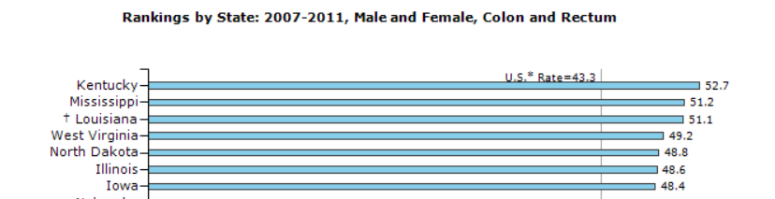
Colon Cancer Incidence Rate:
How Kentucky Ranks (2007-2011)
Kentucky has the highest colorectal cancer incidence rate in the United States, compared to all other states.

Slide 27
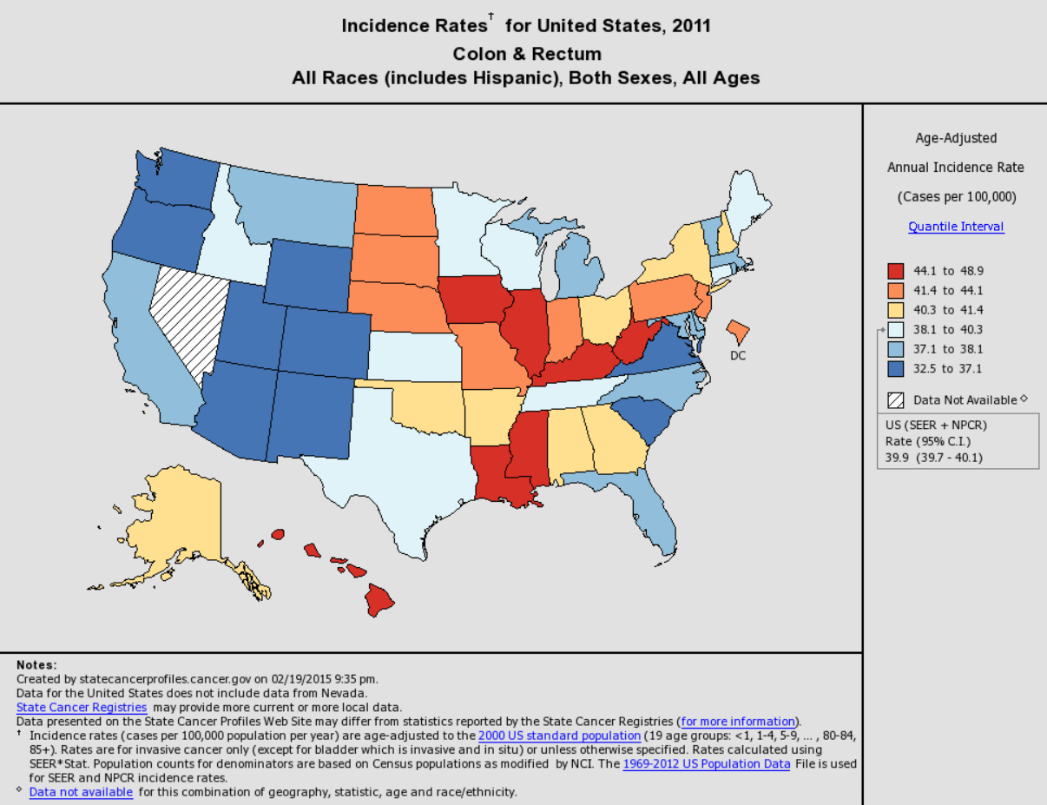
Notes:
This map shows the incidence rates for the United States in 2011. In 2011, Kentucky’s incidence rates was 48.9 per 100,000 population, the highest in the nation.

Slide 28
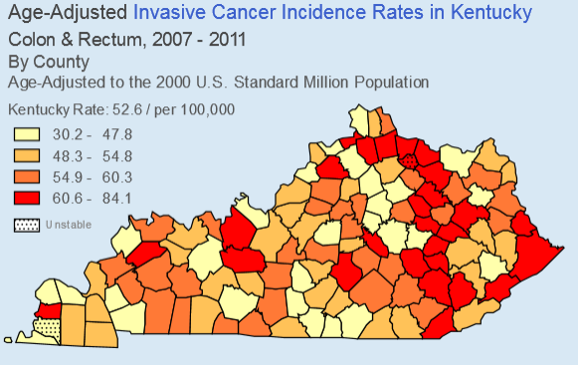
Notes:
There are areas of Kentucky which have very high invasive colorectal cancer incidence rates, particularly in eastern Kentucky. For the years 2007-2011, there were 12,429 new cases of invasive colon cancer in Kentucky.

Slide 29
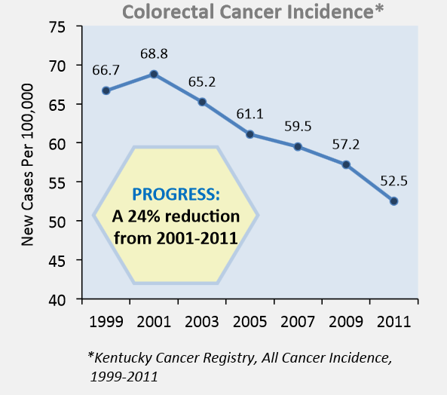
Notes:
Since 2001-2002, Kentucky had made significant progress in decreasing the new cases or the incidence rate for colorectal cancer. We’ve had a 24% reduction in new cases from the years 2001-2011.

Slide 30
Colon Cancer Death Rate:
Kentucky vs. U.S. (2007-2011)
*Per 100,000 People
Notes:
Mortality means death. Mortality or death rates are the number of deaths in a given period of time, from a particular cause. In Kentucky for the years 2007-2011, approximately 19 people per 100,000 died from colon cancer or 4,343 people during this time period.

Slide 31
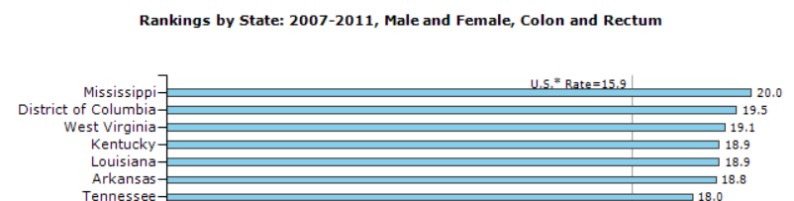
Colon Cancer Death Rate:
How Kentucky Ranks (2007-2011)
Kentucky is tied for the fourth highest colorectal death/mortality rate in the United States, compared to all other states.

Slide 32
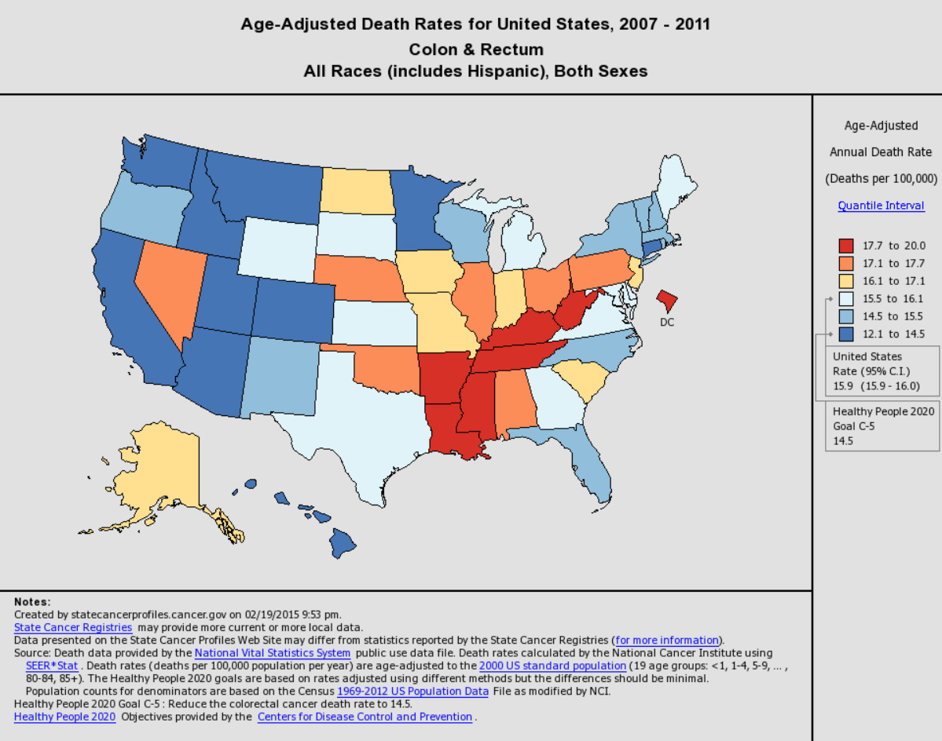
Notes:
This map shows the mortality/death rates for the United States for 2007-2011. During this time, Kentucky’s mortality/death rates from colorectal cancer was 18.9 per 100,000 population, the fourth highest in the nation.

Slide 33
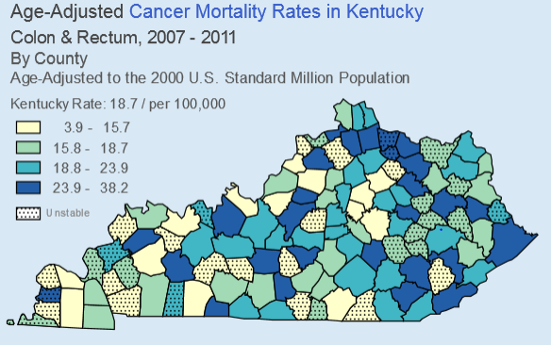
Notes:
Again, there are parts of Kentucky which have very high mortality/death from colon cancer, particularly in eastern Kentucky but also throughout the state. Between 2007-2011, 4,343 people died from colon cancer in Kentucky, a preventable death.

Slide 34
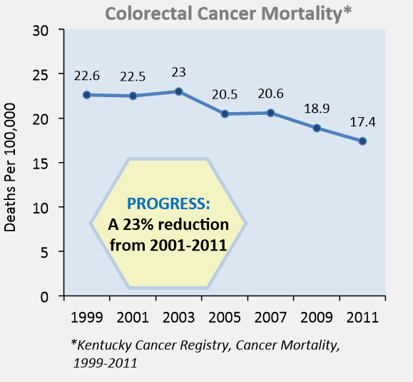
Notes:
Since 2001-2002, Kentucky has made significant progress in decreasing the deaths or the mortality rate from colorectal cancer. We’ve had a 23% reduction in deaths from the years 2001-2011.

Slide 35
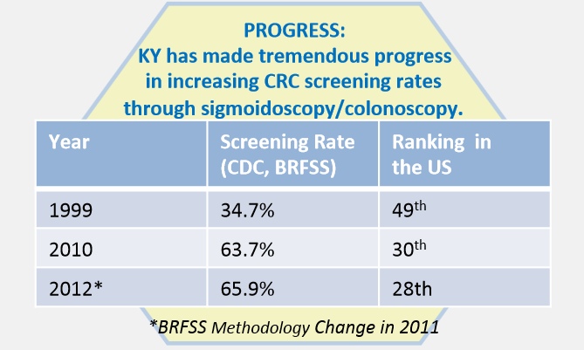
Colon Cancer Screening:
How Kentucky Ranks
Source: Kentucky Behavioral Risk Factor Surveillance System (BRFSS)
Notes:
SCREENING for colorectal cancer saves lives and effective screening methods are available. By getting screened, a person increases their
chances of preventing colorectal cancer or catching it at an earlier stage when the cancer is easier to treat, leading to better health outcomes.

Slide 36
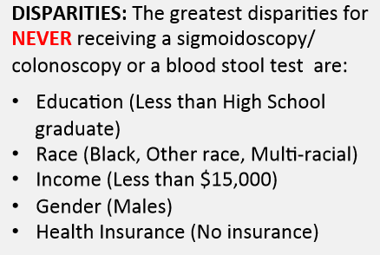
Colon Cancer Disparities
Notes:
EDUCATION LEVEL: The data shows us that individuals without a high school diploma or GED are the least likely to receive a colorectal cancer screening
(blood stool test or sigmoidoscopy/colonoscopy). Therefore, education regarding the need for colorectal cancer screening as well as outreach with
screening options and resources are crucial to populations with low educational attainment.

Slide 37
What can YOU do to help reduce the Risk for Colon Cancer in Kentucky?
  Get Screened!
  Educate!
  Advocate!
Notes:
Get Screened: Get screened for colon cancer and encourage others (your family, friends, co-workers) to get screened as well.
Educate: share what you have learned about colon cancer and screening tests. Educate family & friends with facts.
Advocate: advocate to your employer or insurance company to cover all types of colon cancer screenings.

Slide 38
Tools You Can Use to EDUCATE
Set an example by getting screened for colon cancer
Educate others about the importance of being screened
    -Your family and your friends
    -Your business, church and school
    -Your hospital and health department
    -Your physicians, nurses and allied health
    -Your Chamber of Commerce
    -Your media outlets (TV, radio, print, institutional)
    -Your local, state and nationally elected officials
Notes:
Help spread the word about the importance of colon cancer screening. All people 50 and older should be screened. It is recommended that African Americans start screening earlier, at age 45. People with a family or personal history of colon cancer, polyps, Crohn’s Disease, ulcerative colitis, or uterine and ovarian cancers may need to be screened even earlier. Colon cancer often strikes without any warning signs or symptoms.
Tools:
Educate your friends, family, and colleagues about the Kentucky Colon Cancer Screening Program and the need for the state to allocate funding to spread this life-saving message and provide screening to those Kentuckians who do not have access.

Slide 39



Tools You Can Use to EDUCATE
Kentucky colon cancer screening campaign materials.
Contact your local KCP
office.

Slide 40
Tools You Can Use to EDUCATE
Kentucky’s Colon Cancer Prevention Project materials, at http://www.ColonCancerPreventionProject.org
ACS’s video about colon cancer screening http://www.cancer.org/Healthy/ToolsandCalculators/Videos/get-tested-for-colon-cancer-english
CDC’s Screen for Life national campaign materials, at http://www.cdc.gov/cancer/colorectal/sfl

Slide 41
Looking Towards our Future…
Where are we going?

Slide 42

Where are WE Going…
Kentucky has an objective of increasing colon cancer screening for eligible adults to 80% by 2018.
The Kentucky Cancer Consortium works with numerous partner organizations throughout the state to implement
the Cancer Action Plan (or CAP),
Kentucky’s blueprint for cancer
prevention and control.

Slide 43
80% by 2018 Initiative
Informational video provided by the American Cancer Society (9 minutes)- provides an overview of national data, screening modalities, and prevention.
http://goanimate.com/videos/0QR0Nbl8B3TI?utm_source=linkshare&utm_medium=linkshare&utm_campaign=usercontent

Slide 44
Colon Cancer Partners in Kentucky
American Cancer Society
Colon Cancer Prevention Project
Kentucky Cancer Program
Kentucky Colon Cancer Screening Program
Kentucky Cancer Consortium

Slide 45
Kentucky Colon Cancer Screening Program Information

Slide 46
What is the KY Colon Cancer Screening Program (KCCSP)?
State-wide colon cancer screening program for the uninsured, income eligible population
  Provides funding and administration to sites
  Includes an outreach/awareness campaign
  KCCSP Advisory Committee
KCCSP enacted into law (KRS 214) in 2008 by the KY General Assembly
Relies on partnerships

Slide 47
KCCSP: Background
Funded for 2012-2014 & 2014-2016
Housed at the Kentucky Dept. for Public Health, Chronic Disease Prevention Branch
Reason for KCCSP’s creation (Increase Colon Cancer Screening!):
  Colon cancer is common
  Colon cancer is costly
  Colon cancer is highly preventable
Notes:
Thanks to Governor Beshear…for continued funding

Slide 48
KCCSP Funded Sites for 2014-2016
Barren River District Health Dept.
Boyle County Health Dept.
Christian County Health Dept.
Floyd County Health Dept.
Jessamine County Health Dept.
KY River District Health Dept.
Knox County Health Dept.
Lake Cumberland District Health Dept.
Lexington-Fayette County Health Dept.
Lawrence County Health Dept.
Louisville Metro Dept. for Public Health & Wellness
Laurel County Health Dept.
Montgomery County Health Dept.
Purchase District Health Dept.
Wedco District Health Dept.

Slide 49
KCCSP & Screening Disparities
Kentuckians (adults aged 50+)having:
  Less than a high school education (50.5%)
  Household income of <$15,000 (48.5%)
  Reported NEVER having a colon cancer screen (2010 BRFSS)

Slide 50
How can you get Involved?
Partner with a funded site
Refer uninsured patients to the KCCSP: If you know of someone who is uninsured and needs a colorectal cancer screening from the Kentucky Colon Cancer Screening Program, please call 1-800-633-8100.
Educate & encourage your patients/family members/neighbors to get their colon cancer screenings.

Slide 51
Thank you and be sure to Get Screened for Colon Cancer!

Slide 52
Additional Notes
These slides were created by the Kentucky Cancer Consortium and the Kentucky Cancer Program with help from our partners at the American Cancer Society, Kentucky Cancer Registry, Kentucky BRFS program & the Colon Cancer Prevention Project.
To view and/or download slides from this presentation, visit the Kentucky Cancer Consortium’s website at: http://www.kycancerc.org/ or the Kentucky Cancer Program’s website at: http://www.kycancerc.org/
Please show the references and accompanying web pages at the end of the PowerPoint.

Slide 53
References
Mayo Clinic, http://www.mayoclinic.org/diseases-conditions/colon-polyps/basics/definition/con-20031957
John Hopkins Colon Cancer Center, http://www.hopkinscoloncancercenter.org/CMS/CMS_Page.aspx?CurrentUDV=59&CMS_Page_ID=0B34E9BE-5DE6-4CB4-B387-4158CC924084
American Cancer Society
  http://www.cancer.org/cancer/colonandrectumcancer/detailedguide/colorectal-cancer-what-is-cancer
  http://www.cancer.org/cancer/colonandrectumcancer/detailedguide/colorectal-cancer-risk-factors
  http://www.cancer.org/cancer/colonandrectumcancer/detailedguide/colorectal-cancer-signs-and-symptoms
  http://www.cancer.org/cancer/colonandrectumcancer/detailedguide/colorectal-cancer-diagnosed
  http://www.cancer.org/cancer/colonandrectumcancer/detailedguide/colorectal-cancer-detection
  http://www.cancer.org/cancer/colonandrectumcancer/moreinformation/colonandrectumcancerearlydetection/colorectal-cancer-early-detection-screening-coverage-laws
National Cancer Institute
  http://www.cancer.gov/cancertopics/pdq/treatment/colon/Patient/page1#figure_213_e
  http://www.cancer.gov/cancertopics/pdq/screening/colorectal/Patient/page2

Slide 54
References, cont.
State Cancer Profiles, http://statecancerprofiles.cancer.gov/quick-profiles/index.php?statename=kentucky
CDC-National Program of Cancer Registries
  http://apps.nccd.cdc.gov/uscs/cancersrankedbystate.aspx
  http://www.cdc.gov/cancer/colorectal/sfl/publications/fact_sheets.htm
State Cancer Profiles, http://statecancerprofiles.cancer.gov/map/map.withimage.php?00&001&020&00&0&01&0&1&6&0#results
Kentucky Cancer Registry, http://cancer-rates.info/ky/index.php
“Colorectal Cancer in Kentucky-A Snapshot” on the Kentucky Cancer Consortium’s website: http://www.kycancerc.org/canceractionplan/Colon-fact-sheet.pdf

