Slide 1



Opportunities:
Local Smoke-free Laws
Ellen J. Hahn, PhD, RN, FAAN
Kentucky Center for Smoke-free Policy
BREATHE
University of Kentucky
College of Nursing

Slide 2
Two-thirds of Kentuckians breathe toxic secondhand smoke at work every day, putting them at grave health risk and costing taxpayers billions every year in healthcare costs and productivity losses.

Slide 3
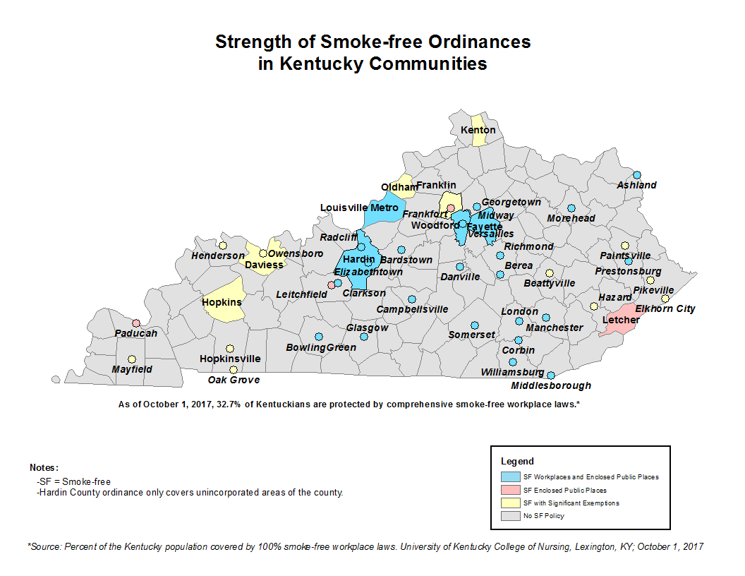

Notes:
SOLUTION

Slide 4
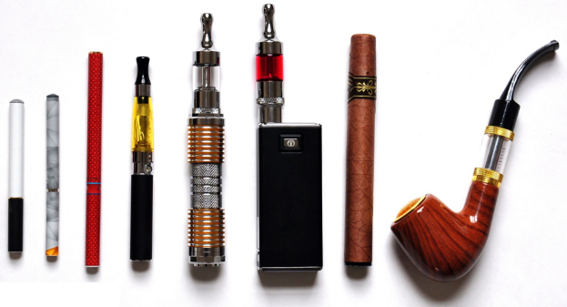

E-cigarettes Included in Kentucky Ordinances
  1. Berea
  2. Bardstown
  3. Danville
  4. Glasgow
  5. Lexington-Fayette
  6. Manchester
  7. Morehead
  8. Richmond
  9. Versailles
  10. Woodford County
  11. Ashland
  12. Pikeville
  13. Hazard
  14. Prestonsburg
  15. Leitchfield
  16. Clarkson
  17. Henderson
  18. Louisville Metro
Notes:
Also Leitchfield

Slide 5

Why Focus on Local Laws?
Create a climate where local communities can consider spending their political capital on 100% effective smoke-free workplace laws.
Passing smoke-free laws one community at a time bolsters support for a Smoke-free Kentucky (only 1/3 of Kentuckians covered currently)
Popularity in rural communities
Better to focus on strong local laws rather than accept a state law with no population health benefits
Notes:
Discuss explicit or implicit

Slide 6
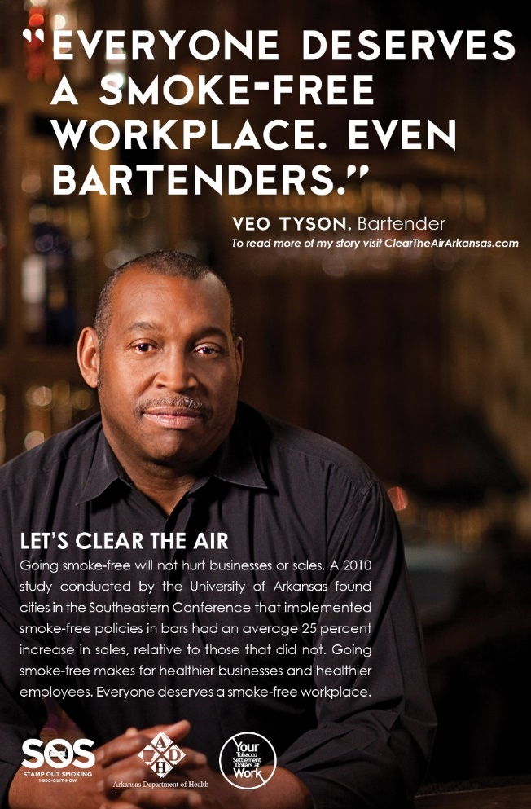
Partial Laws Don’t Work
  Leave many unprotected
  Create health disparities
  Do not improve population health
  Cause confusion
  They ‘stick’ and are rarely strengthened
Notes:
The goal is to protect everyone from SHS
Better to have no law than a partial one that is nearly impossible to strengthen later

Slide 7

Smoke-free laws improve health and lower costs, but only if they are comprehensive, or 100%.
Notes:
3-legged horse analogy
Expired medicine

Slide 8


Now is the Time to Act Local

Slide 9
Building Capacity
Get the Right People to the Table
Keep Them Engaged
Translating & Disseminating Science
Make Data Talk
Local Data
Building Demand
Create a Tipping Point
Media Advocacy
Notes:
KCSP developed & tested this model with rural Kentucky communities
Found it effective in helping communities pass comprehensive smoke-free policies.
It is your road map for running a successful smoke-free campaign.
Focus is on educating and informing
Depending on the Phase of readiness, we use all 3 elements of our policy advocacy approach as per the slide: (see phases document handout)
Building awareness: to build demand for smoke-free workplaces by documenting the problem
Building momentum: to build capacity by identifying, educating, and mobilizing your “friends”
Building a case for legislative action: to create a tipping point such that the community is asking for smoke free air and policymakers are listening
Building a Smoke-free Ordinance: enactment
Building Implementation of a Smoke-free Community: create smooth transition from enactment ot implementation and enforcement
Building community commitment to smoke-free: to maintain the integrity of the law and/or strengthen it

Slide 10
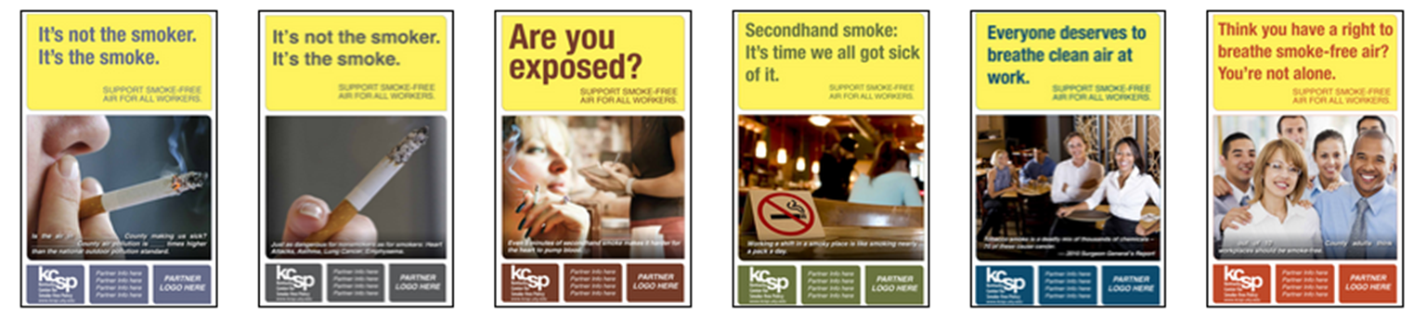
KCSP: A value-added resource
Share resources, tools, and strategies that work
  County level data
  Print media templates
  Legal resources
  Community trainings & presentations
Suggest tailored strategies based on your stage of readiness for smoke-free policy
Serve as your ‘sounding board’
Notes:
KCSP is:
Research and community engagement center
Assist communities with the development and implementation of smoke-free community policies and tobacco-free campus policies
Working with local communities in Kentucky for nearly 15 years

Slide 11
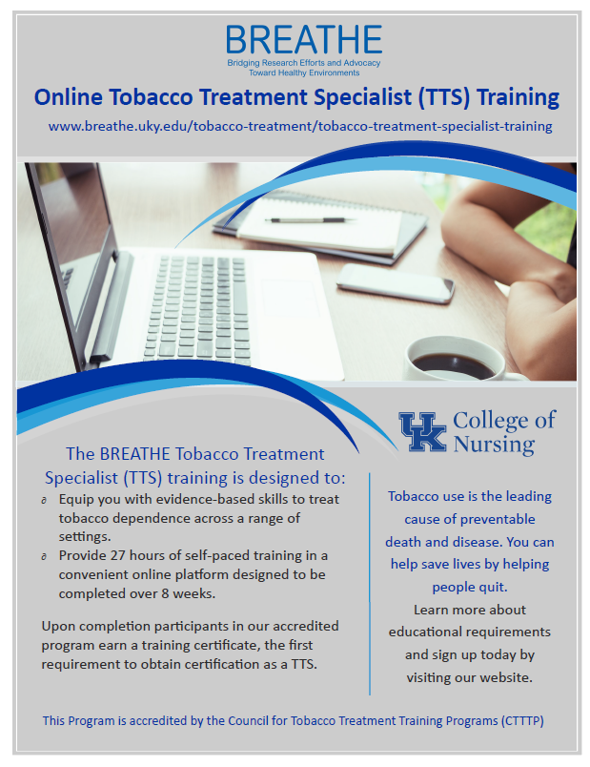
BREATHE Tobacco Treatment Specialist Training Program
ATTUD-accredited online training program
27 hours of instruction time designed to be completed over 8 weeks
Contact Audrey Darville audrey.darville@uky.edu for more information
http://www.uky.edu/breathe/tobacco-treatment/tobacco-treatment-specialist-training

Slide 12



Ask Us!
Kentucky Center for Smoke-free Policy
BREATHE
www.breathe.uky.edu
kcsp00@lsv.uky.edu
(859) 323-9958
@kysmokefree

