Slide 1
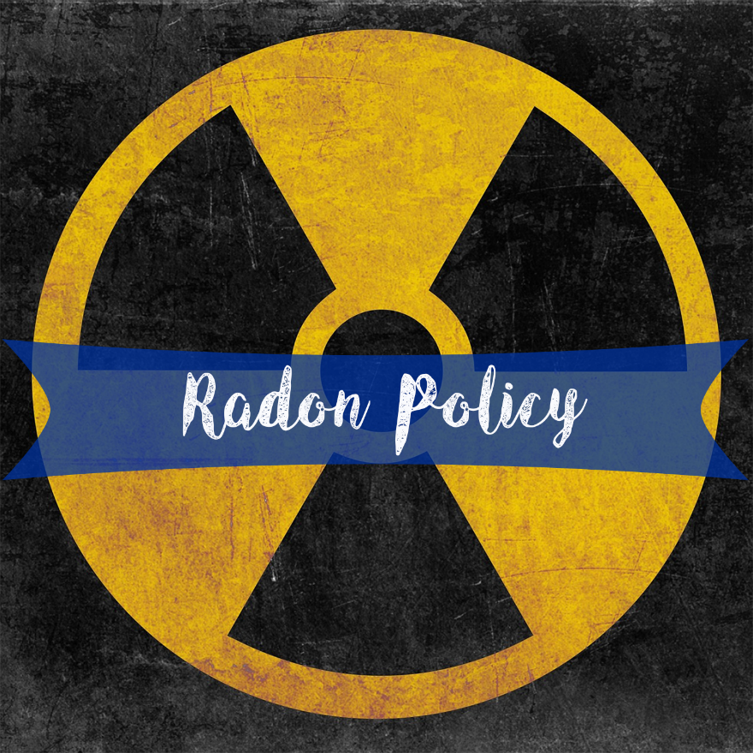


Ellen J. Hahn, PhD, RN, FAAN
Professor & Director, BREATHE
ejhahn00@email.uky.edu
(859) 257-2358

Slide 2


Who We Are
Vision: All people will have access to clean air and live in healthy environments.
Mission: To promote lung health and healthy environments to achieve health equity through:
research
community outreach and empowerment
advocacy and policy development
access to health services

Slide 3

Tobacco Smoke and Radon
Cause Lung Cancer
Smoking and exposure to secondhand smoke are the #1 cause of lung cancer.
Radon is the 2nd leading cause of lung cancer.
Notes:
There are two known causes of lung cancer, exposure to tobacco smoke and radon.
That means if we could eliminate exposure to both, we could theoretically eliminate lung cancer.
At the very least, if we could reduce exposure to tobacco smoke and radon, we could reduce the prevalence of lung cancer, along with its significant morbidity and mortality and related health care costs.

Slide 4

Surgeon General Call to Action to
Promote Healthy Homes, 2009
Common Hazards:
Fires & falls
Secondhand smoke
Radon gas
Carbon monoxide
Pesticides
Firearms
Notes:
A little bit about why we do what we do:
The 2009 SG’s Call to Action to Promote Health Homes listed SHS and radon as common hazards, and described the steps people can take to protect themselves from disease, disability and injury that may result from health hazards in their houses.
These steps have been scientifically proven to reduce health problems that cause or contribute to disease and injuries.
And, improving literacy about healthy homes and teaching people about the steps they can take to change unhealthy and unsafe behaviors at home will lead to better health for all Americans.
This Call to Action also outlines the next steps of a society-wide, comprehensive and coordinated approach to healthy homes that will result in the greatest possible public health impact and reduce disparities in the availability of healthy, safe, affordable, accessible, and environmentally friendly homes.

Slide 5

Radon Policy to Reduce Exposure to Radon
Certification of Radon Professionals
Radon in Real Estate Transactions
Radon in Rental Dwellings
Radon in New Construction
Radon in Childcare Centers
Radon in Schools
https://www.eli.org/buildings/publications-topic#radon

Slide 6
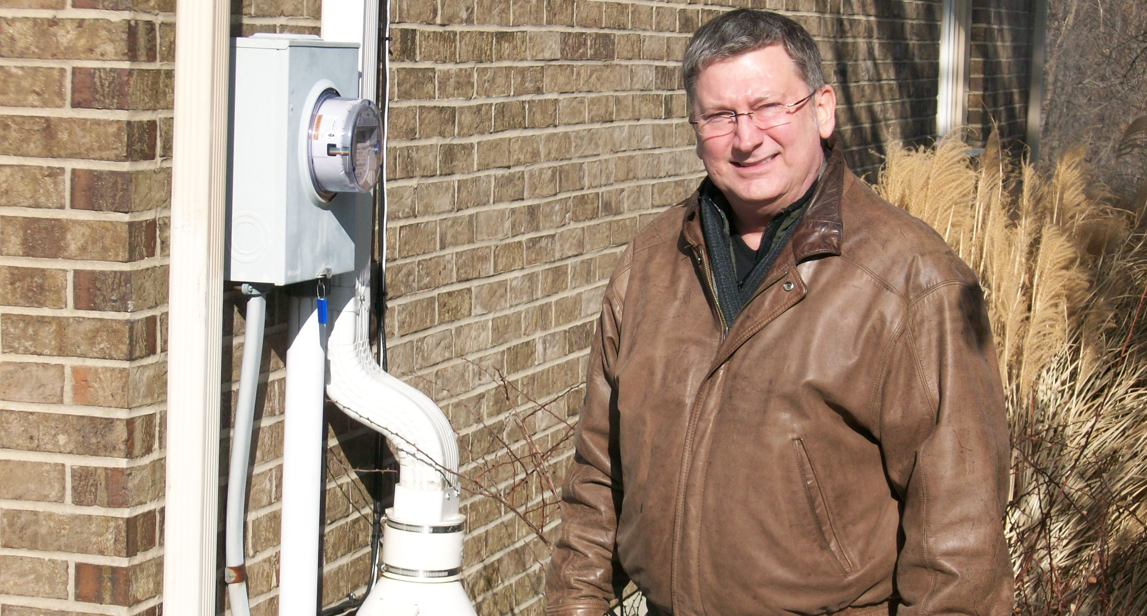
Certification of Radon Professionals
Notes:
Setting minimum standards for the radon profession will give the public greater confidence in taking action to test or mitigate their homes and will ensure that radon work is carried out according to accepted industry practices.

Slide 7
State Certification Programs
13 state laws: FL, IL, IN, IA, KS, KY, ME, NE, NJ, OH, PA, RI and WV
  All require certification
  All require training and certification exam
  Several require continuing education
  Nearly all require testing and mitigation standards/protocols
Notes:
13 states have laws that establish a state certification program, including minimum-qualifications and standards of practice. Those states include, Florida, Illinois, Indiana, Iowa, Kansas, Kentucky, Maine, Nebraska, New Jersey, Ohio, Pennsylvania, Rhode Island, and West Virginia.
All policies require certification for those performing radon measurement and mitigation.
All states require individuals to complete a state-approved training course and pass a state-approved exam in order to be certified. Several require continuing education in order to be re-certified.
All but one (WV) require standards/protocols that require certified radon testers to comply with federal and/or state testing protocols. Most of these states reference EPA guidance documents, while states such as Illinois and Ohio have established their own detailed testing protocols. Most of these states require pre- and post-mitigation testing, and some prohibit the same person from doing both testing and mitigation on a project.
Nearly all of the states require certified professionals to establish quality assurance/quality control plans, and some states establish detailed plan requirements.
A majority of states also require adoption of health and safety plans to protect those performing the radon work.
Nearly all require that certified professionals report to the state on a regular basis information about their testing and mitigation activities. State regulations typically specify the information that must be reported, and most require address of the test/mitigation, results of test, type of mitigation system. Several states require more specific information about testing (ex: type and location of the device).
All of the laws and regulations include a wide range of enforcement authorities for addressing violations:
Inspection of records, businesses, and/or work of certified professionals
Suspension or revocation of certification under specified circumstances
Administrative, civil and/or criminal penalties
All of the laws require payment of fees for certification and re-certification. Most specify that the fees collected under the program are to be deposited in a designated account or fund to support program activities.

Slide 8
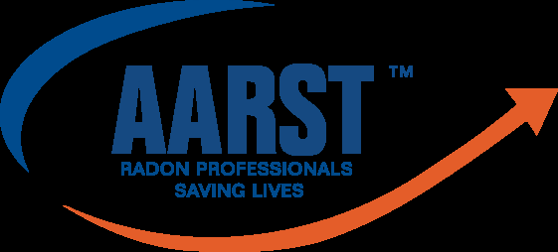
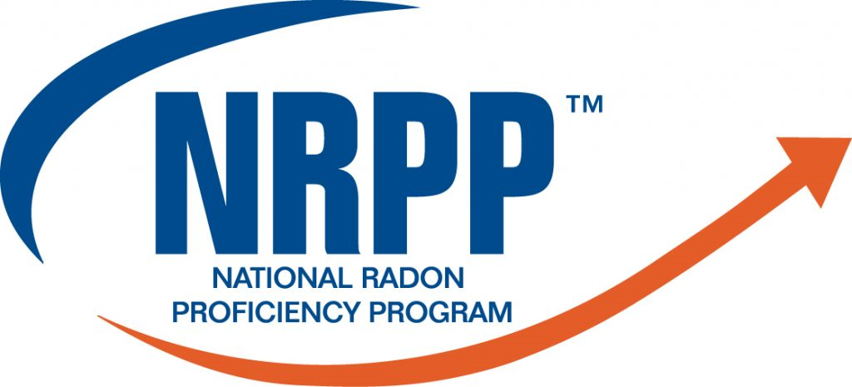
Certified Radon Professional
National Radon Proficiency Program (NRPP) is the credentialing and certification division of the American Association of Radon Scientists and Technologist (AARST)
  Only certification recommended by the U.S. EPA
Currently, NRPP has over 2,800 certified professionals qualified in radon measurement and mitigation,
ANSI-AARST Standard Protocols for:
  Conducting Measurements of Radon in Homes
  Soil Gas Mitigation Standards for Existing Homes NRPP Certified Radon Mitigation Professional.

Slide 9
Kentucky
Radon Contractor Certification Program
  KRS 211.9101-211.9135 (June 8, 2011)
Required certification of radon measurement and mitigation professionals and professional labs that analyze radon tests
Created the Kentucky Radon Program Advisory Committee
Named the Cabinet for Health and Family Services (CHFS) as the “regulatory agency for the control of radon in the Commonwealth of Kentucky.”
Notes:
Certification: Previous regulations required verification of a completion of an AARST-NRPP or NRSP course and exam. Amendent 902 KAR 95:041: A radon training course shall be cabinet-approved is issued by the: AARST, ABIH, AIHA, ANSI, ASTM, NRPP or WHO. These organizations do not have existing radon certification programs.
Quality assurance: AARST is the only organization with ANSI-ASTM approved standard operating procedures for quality control programs. Amendment: Cabinet will approve standard operating procedures issued by AARST, ABIH, AIHA, ANSI, ASTM, NRPP or WHO. These additional groups DO NOT HAVE radon standard operating procedures. Replaced requirement to mitigate a home below 4.0 picocuries per liter to as low as reasonably achievable (ALARA). This requirement is subjective and can be interpreted differently by different parties. This action level is the industry standard. Failure to set an action level is problematic for real estate transactions and could interfere with the purchase transaction. It could create a potential public health issue, as radon mitigation contractors are not held accountable for reducing indoor radon concentrations to below any type of benchmark.
Reporting to state: Previous regulations required radon testing and mitigation quarterly. Details about testing and mitigation (ex: methods for testing, conditions under which tests were conducted, location of test in building, type of mitigation system installed, location of mitigation system, post mitigation measurement, floor plan of the structure, diagnostic and communication testing). Amendment: Reduced to semi-annually and most details about testing and mitigation eliminated. Only reporting requirements are result of the test, date tested and type of structure mitigated. Requirements to calibrate equipment to assure accurate readings were removed. Over time, if calibration is not done on machines, the readings fluctuate greatly.

Slide 10
Radon Certification Regulations
902 KAR 95:040 (promulgated 9/17/14; start date scheduled for 7/1/15)
  2011-2013 regulations developed with input from CHFS, businesses, and other interested parties
  Approved by the KY Administrative Regulation Review Subcommittee
  http://www.lrc.ky.gov/kar/902/095/040.htm
InterNACHI (International Association of Certified Home Inspectors) filed a lawsuit against the Commonwealth of Kentucky. Injunction filed 6/25/15 – present.
Regulations amended by CHFS: 5/12/17
Notes:
The injunction was filed on 6/25/15 in Franklin Circuit Court, Division II, Case No: 15-01-687: https://www.nachi.org/documents2012/InterNACHI%20et.%20al.%20vs.%20Com.%20of%20Kentucky%20et%20al.pdf but we didn’t hear about it until 6/30/15
Petitioners included Air Source Technology (Bruce Ferguson), Advanced Radon Services (Edwin Huff/Randy Watson), IPM Services (Dennis Brewer/Linda Vittitoe), Inspector USA (D. Michael Green), Central KY Home Inspections (David McLean), AccuCheck Home Inspections and Radon Services (J.B. Langford), B4UCLOSE (Erby Crofutt), and Radon Solutions of KY (Kenny McLaughlin) NOTE: All these are INC (incorporated businesses).
This was a petition for declaration of rights and temporary and permanent injunctive relief. Audrey Tayse Haynes, Secretary for CHFS was listed as to be served on behalf of herself, the cabinet, and the KY Radon Program Advisory Board. Jack Conway, then Attorney General, was also named.
Main arguments were that:
• The regs would prohibit them from both measuring and mitigation radon
• AARST would be the only established/recognized radon certification body and, thus, would create a monopoly (NOTE: NRPP and NRSB actually certify – not AARST)
• Contractors would have to pay to access AARST standards and would increase cost of professional radon services substantially
• The regs increase costs of becoming certified radon measurement, testing, and remediator by raising cost of liability insurance premiums due to required liability insurance coverage limits required.
• The regs contradict the statute by imposing license and permit fees not required by the statute
• The regs provide unfair advantage to AARST and certain contractors
• The regs increase economic burden on plaintiff companies (smaller companies)
They asked the court to determine the regs unconstitutional, unenforceable, and to grant a temporary AND permanent injunction against the regs.
They asked for early hearing to obtain injunction and also asked that their attorney fees be granted.
The state immediately granted injunction prior to a hearing being set.
The injunction remains in place today.
However, during the time from June 25, 2015 to August 8, 2017, the Cabinet worked with attorneys of the plaintiffs to amend the regulations. These amendments were filed approved by the Cabinet and filed with LRC with no knowledge of or input from the Kentucky Radon Program Advisory Committee. The Committee was told in late August 2017 that the Cabinet’s attorney had represented the Committee as well.

Slide 11
Proposed Amendments to Radon Certification Regulations (5/12/17)
  Allowed radon training and radon SOPs by organizations with no existing radon certification programs or SOPs.
  Replaced requirement to mitigate a home below 4.0 picocuries per liter to as low as reasonably achievable.
  Removed requirements to calibrate equipment, jeopardizing assurance of accurate readings.
  Most details about testing and mitigation eliminated from required reporting.
Notes:
Filed with LRC 8/14/17
Health advocate organizations provided oral and written public comment about the proposed amendments to the regulations

Slide 12
Update 2017
Oral and written public comment by health groups and proponents of the amended regulations (6/17).
KY Administrative Regulation Review Subcommittee deferred amended (revised) regulations for one month (9/17)
Kentucky Radon Program Advisory Committee reviewed amended regulations and provided comment.
CHFS in process of revising amended regulations to address business concerns and to assure what is safe for the public and best practices for business owners.
Notes:
CFHS revised the amended regulations and filed on 8/14/17 with few changes to the amendments.
This set of revised/amended regulations went before the Kentucky Administrative Regulation Review Subcommittee at their September 2017 meeting. The regulations were deferred. The Cabinet agreed to defer them through October 2017. In September and early October 2017, the Kentucky Radon Program Advisory Committee reviewed the regulations as amended and provided comment back to the cabinet. The Cabinet is in the process of revising the regulations as amended to address concerns and to assure that regulations consider what is safe for the public and assures safety and best practices for business owners who are testing and mitigating radon.
The Cabinet will bring the revised regulations before the Administrative Regulation Review Committee at their November 2017 meeting.

Slide 13
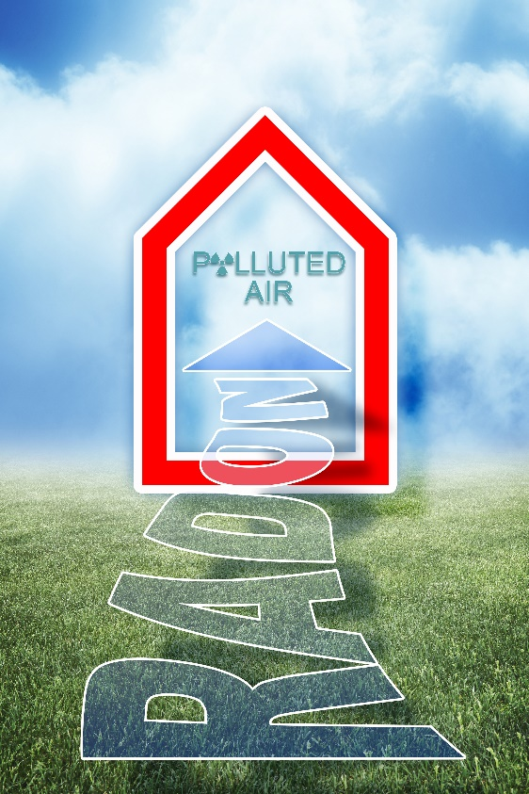
Next Steps
Implementation & enforcement of the regulations
Increase access to affordable, adequate, accessible certified radon professionals
Notes:
Current state radon certification laws provide an important legal framework for protecting consumers, reducing radon risk, and improving the states’ understanding of radon testing and mitigation activities.
The following are key issues that states should consider in developing radon certification policies.
State Certification: Require state certification of radon professionals and laboratories
Training and Examination: Require completion of a state-approved training course and examination
Work Practices: Require compliance with testing and mitigation protocols, as well as quality assurance and worker health/safety plans
Reporting Requirements: Require reporting of testing and mitigation activities and facilitate data analysis
Enforcement: Establish clear and comprehensive enforcement provisions

Slide 14

Radon in Real Estate Transactions
Notes:
For the past two decades, the real estate transaction has been a central focus of efforts to increase testing for and mitigation of elevated radon levels in existing homes. The purchase and sale of a home is a key opportunity for testing and mitigation, as the parties are already negotiating various aspects of the transaction that involve repairs and improvements to the property.
While federal policy does not play a role in this area, state law does address various aspects of the real estate transaction.

Slide 15
Real Estate Transaction Laws
32 state laws: AK, CA, CO, CT, DE, FL, IL, IN, IA, KS, KY, ME, MD, MI, MS, MT, NE, NH, NJ, NY, NC, OH, OK, OR, PA, RI, SC, SD, TN, TX, WA, WI
No laws require radon testing
Typically require disclosure of conditions the seller is aware of
About half require disclosure of results
Few require disclosure of radon mitigation systems on property
Eight require seller to provide general radon info
Notes:
32 states have laws requiring radon disclosure during the real estate transaction.
There are no laws requiring radon testing on the part of the buyer or seller.
The laws typically require disclosure of conditions of which the seller is “aware” or has “knowledge.” The laws DO NOT require the seller to TEST THE HOME FOR RADON to determine if radon is present. It is impossible to know if radon exists without testing.
About half of the state laws require disclosure (or copies) of the results of any radon tests performed on the property. A few require disclosure of radon mitigation systems on the property.
At least eight states have laws that require sellers to provide buyers with general information about radon.

Slide 16
Kentucky
KRS 324.360
  201 KY Adm. Code 11:350
Requires specific disclosure:
  “Aware of any testing for radon gas?...Results, if tested.”
  Test results
Required general radon information:
  No

Slide 17

Considerations for Future Policy Development
Require radon information to warn sellers and buyers
Require seller and buyer to sign to affirm disclosures
Require sellers to test and disclose results
Notes:
Two important aspects of an effective radon disclosure requirement are content and format. The more specific the content (ex: test results for the property), the more likely it will prompt action. Moreover, the way in which the information is conveyed can help make it more likely that the parties will pay attention to radon. The following are elements to consider in developing a robust radon disclosure policy.
Transactions Covered: Require disclosure in existing and new home transactions.
Nature of Disclosure: Require disclosure of known property-specific radon information.
Radon Warning: Require provision of general radon information.
Acknowledgement: Require seller and buyer signatures to affirm distribution and receipt of required radon disclosures.
Required Testing: Require sellers to test for radon and disclose the test results.

Slide 18

Radon in Rental Dwellings
Notes:
More than one-third of the nation’s housing units are occupied by renters. Many states have laws and regulations establishing minimum conditions in rental housing, including requirements for addressing indoor air quality conditions such as lead-based paint and carbon monoxide. Few of these state policies address radon.

Slide 19
Radon in Rental Dwellings
3 state laws: FL, IL, ME
Landlords must disclose radon information to tenants
Requires landlords to test and mitigate for elevated levels (ME only)
Notes:
Only three states have adopted laws or regulations addressing radon in rental dwellings.
They have done this in two ways: by requiring landlords to disclose radon information to tenants, and by requiring landlords to test for and mitigate elevated radon levels. At least two states have enacted laws that require landlords to disclose radon information to tenants (FL and IL). Maine is the only state that has enacted legislation or regulations requiring testing and/or mitigation in rental dwellings.
There are no laws in Kentucky regarding radon in rental dwellings.

Slide 20
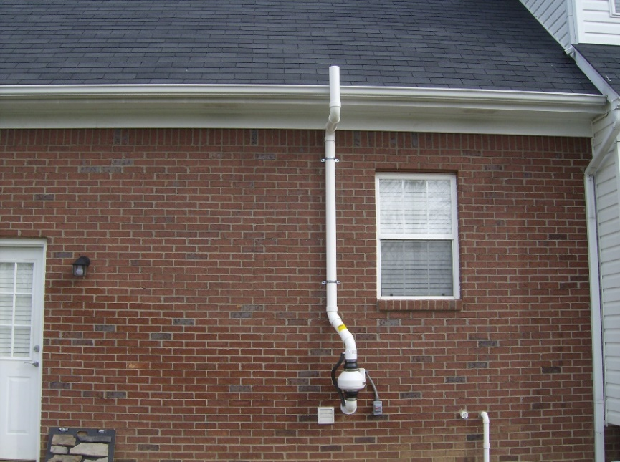
Considerations for Future Policy Development
Require landlords to test & mitigate for radon, if high
Require services by certified professionals
Require reporting to tenants and the state
Radon-related requirements in connection with affordable housing funding programs.
Notes:
Tenants face significant constraints in addressing radon problems, given their lack of authority to undertake building repairs and the challenges they face in pursuing the legal remedies that may be available to them.
Testing and Mitigation: Require landlords to test for an mitigate elevated radon levels.
Professional Services: Require that testing and mitigation of rental property be carried out by certified professionals.
Reporting: Require reporting of testing and mitigation activities to tenants and to the state.

Slide 21

Radon in New Home Construction
Notes:
A vital component of a state radon risk-reduction strategy is ensuring that new homes are built to minimize radon entry. New home construction techniques for controlling radon are well established, and the cost is considerably lower than the cost to install a radon mitigation system. Stronger RRNC action is needed to keep pace with new construction and reduce the number of homes in the U.S. with elevated radon levels.
Most states that have both statewide building codes and significant radon potential still DO NOT address radon control in their building codes.

Slide 22
Radon Resistant New Construction (RRNC)
8 state laws: IL, MA MD, MI, MN, NJ, OR, WA
Mandatory RRNC integrated into residential building codes
Five adopted model building code (IRC)
None require radon testing following construction
Two require RRNC throughout state
Voluntary ‘Gold Standard’ (MN DOH)
Notes:
Eight states in the U.S. – Illinois, Massachusetts, Maryland, Michigan, Minnesota, New Jersey, Oregon and Washington – have adopted mandatory RRNC measures as part of their state-wide, residential building codes.
Five of the eight have adopted the radon control standard of the International residential Code (IRC) – a model building code developed by the International Code Council that contains a radon control standard, which calls for a passive (no fan) sub-slab or sub-membrane depressurization system to be installed in homes located in Zone 1 areas. The state of NJ has developed its own radon standard, which includes elements similar to IRC. In Maine, homeowners or builders who choose to incorporate radon control techniques into new home construction must do so in accordance with the ASTM standard. Nebraska enacted a law establishing a RRNC Task Force to develop recommended minimum standards for radon resistant new construction by April 2018.
None of the states require radon testing following construction or provision of test kits to the owner.
Minnesota and Illinois require RRNC for all new construction throughout the state. The other five state policies apply to specific localities based on average radon potential.
The Minnesota Department of Health has developed a voluntary “Gold Standard” for radon resistant new construction, which goes beyond the state building code to incorporate active (fan powered) radon control standards. The Department also provides information on builders and contractors who use the Gold Standard.

Slide 23
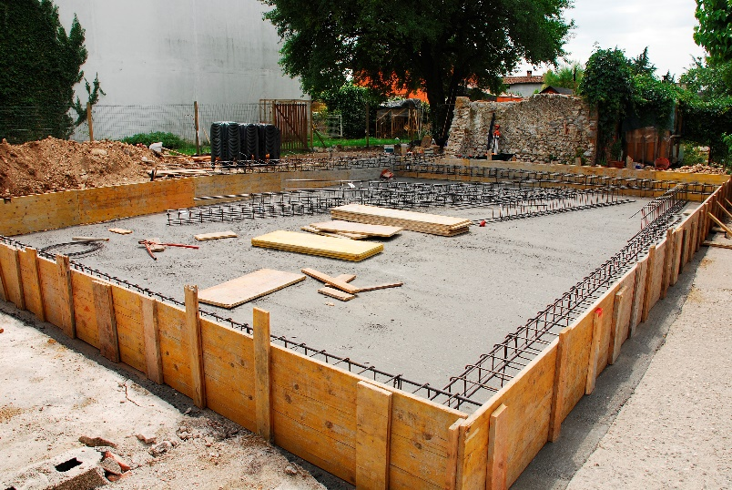
Considerations for Future Policy Development
Revise Residential Buildings Codes to include RRNC
Geographic Scope (mod-high radon potential)
Active vs. passive (+ testing)
Require builders to provide new homeowners with radon information
Notes:
One important policy opportunity for protecting public health is to include radon control requirements in residential building codes— both local building codes and statewide building codes that are mandatory at the local level. Here are some options policymakers can consider for strengthening existing policies and adopting new RRNC requirements to reduce exposure.
Geographic Scope: Apply RRNC requirements to residential construction in high and moderate radon potential areas.
Radon Control Standard: As an alternative to requiring a passive RRNC system, require an active RRNC system or a passive system combined with testing.
Residential Buildings Covered: Apply RRNC requirements to all types of new residential construction.
Local Implementation: Incorporate technical assistance and capacity building for local code officials who enforce RRNC requirements.
Disclosure: Require that builders provide new homeowners with radon information.

Slide 24
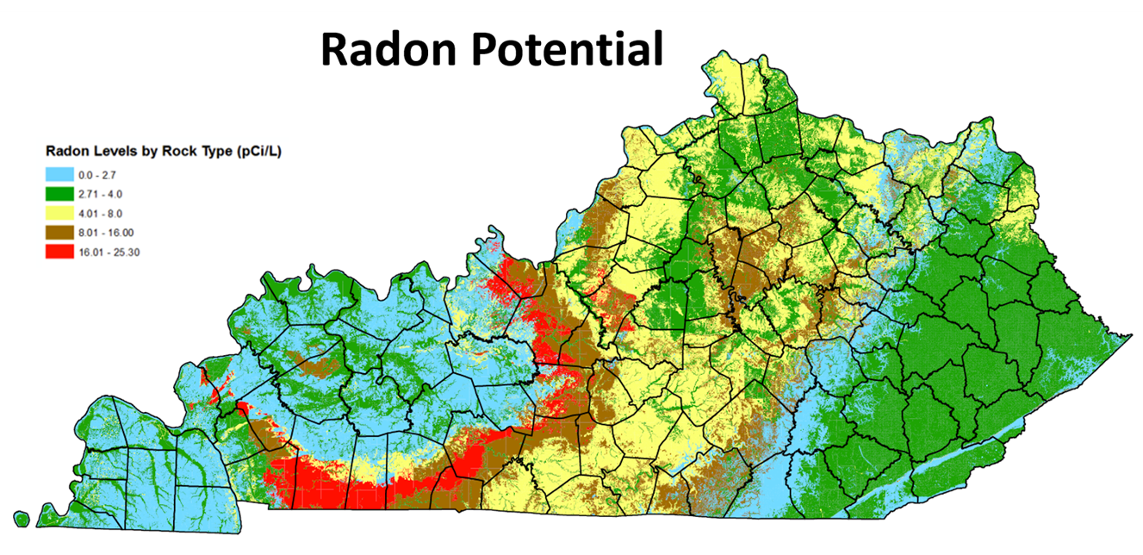

Slide 25

Radon in Childcare Centers
Notes:
The child care environment is vitally important to the health and development of millions of young children who receive care outside their homes.

Slide 26
Radon in Childcare Centers
8 state laws: CT, FL, IL, IA, MI, NH, NJ, RI
All require radon testing
Most specify testing procedures
Most require radon reporting:
  State
  License renewal
  Health Department
  Parent/Guardian (CT, NJ, IL posting, copies)
Notes:
Eight states have established radon testing and/or mitigation requirements for existing child care facilities.
All require radon testing in one or more types of licensed child care facilities.
Most of the states that require radon testing also set forth testing procedures for carrying out the testing. By specifying testing practices and procedures, state policies can help ensure consistency with best practices and reliability of radon testing results. A number of states require re-testing at periodic intervals, through the timeline varies from to two years (the EPA recommendation) to five.
Reporting of radon test results is important not only for making parents/guardians aware of facility conditions, but also for facilitating state oversight of testing requirements and giving state agencies a better understanding of the scope of the radon problem within the state. Several of the states require radon test results to be reported to the state, a few require reporting when renewing licensing, a couple require reporting to the health department and some require results to be available to parents. Connecticut requires posting of results next to the child care facility license, while New Jersey requires posting at a location visible to parent/guardian. Illinois requires copies given to parents/guardian upon request.

Slide 27
Radon in Childcare Centers
Some limit by location of facility
Most states require mitigation of elevated radon levels > 4.0 pCi/L
Some establish protocols for mitigation (IA plan approved by DPH)
Notes:
Some states limit their radon testing requirement to facilities or structures they believe present the greatest potential for elevated radon based on location (ex: centers that use lower levels of buildings, parts of the state with higher potential for radon).
Most of the states reviewed here (CT, IA, MI, NH and RI) require mitigation for elevated radon levels and establish a mitigation action level of 4.0 pCi/L.
Some states also establish protocols for conducting the mitigation. Some states require certification or licensure of radon mitigation professionals. Iowa requires the development of a mitigation plan that is approved by the Department of Public Health.

Slide 28

Non-Regulatory Initiatives
Voluntary recognition programs
Outreach
Technical and financial assistance
Notes:
Some states that do not require licensed child care providers to address radon risks nonetheless have established formal agency initiatives to encourage radon testing and mitigation in child care facilities. These activities, include voluntary recognition programs, outreach, and technical and financial assistance.

Slide 29

Radon in Schools
Notes:
To give children the best chance for educational success, school facilities need to be free of environmental problems that impact health and impede learning. Many schools have already taken action to test for and mitigate elevated radon levels. Radon control techniques are also available for new construction.

Slide 30
Radon in Schools
Several require testing but few require mitigation (RI requires mitigation >4.0 pCi//L)
Most do not set a standard mitigation level
The majority require reporting after testing
Some require RRNC in new schools, but some only in high radon potential areas (CT, RI)
Notes:
Several policies require schools to test, but few require mitigation if levels are elevated. Of those that include mitigation, most do not set a standard level of when to mitigation. Rhode Island does require mitigation above the EPA’s action level of 4.0 pCi/L. Several states require or encourage schools or school districts to develop their own radon testing and mitigation plan.
The majority require reporting requirements, including a variety of the following methods:
Maintained on file and available for review
Provided at school board meeting
Posted on school and/or district website
Reported to Health Department or Bureau for Public Health
Reported to Board of Education
Some require new schools to be built with RRNC, but some only require in areas with high to moderate radon potential. Connecticut prohibits approval of school building plans in areas with high to moderate radon potential, unless plans include RRNC. Rhode Island requires any new construction or school renovations over $500,000 to incorporate radon mitigation if located in an area with high to moderate radon potential.

Slide 31
Best Practice Public Policy Actions to Consider
Amend KRS 324.360 to Require Radon Testing in All Real Estate Transactions
Require landlords to test, mitigate, and provide information to tenants
Revise state residential building codes to require RRNC with no geographic limits
Require radon testing and mitigation in all childcare centers
Require radon testing and mitigation in all schools

Slide 32
Policy Implementation, Voluntary Policy, and Community Outreach
Promote Radon Certification Training (March 5-9, 2018, Lexington)
Include Radon Testing and Mitigation in Health Savings Accounts
Integrate Radon Mitigation in Affordable Housing Funding Programs
Create Safety Net Alliances
  Step Up to Reduce Radon (Northeast Kentucky AHEC)

Slide 33

FREE Radon Continuing Education
Convenient, online platform
3 CE hours
Lung cancer risks
Laws and policies to reduce risk
Communicating health risks
Answering FAQs
Strategies to increase testing
Notes:
If you want to learn more about laws and policies to reduce radon risk, I encourage you to complete our free radon continuing education course. This self paced course and can be accessed from our website – breathe.uky.edu.
The course goes into detail about why exposure to radon increases lung cancer risk, especially with tobacco smoke. It also covers how to discuss the basics of radon exposure, testing and mitigation; and includes information about laws and policies designed to reduce radon risk.
The program also covers how to effectively communicate about radon health risks and answer frequently asked questions. It addresses strategies and information that can increase radon testing and mitigation when necessary.
I have some fliers with more detail about this continuing education opportunity that you can take with you.

Slide 34
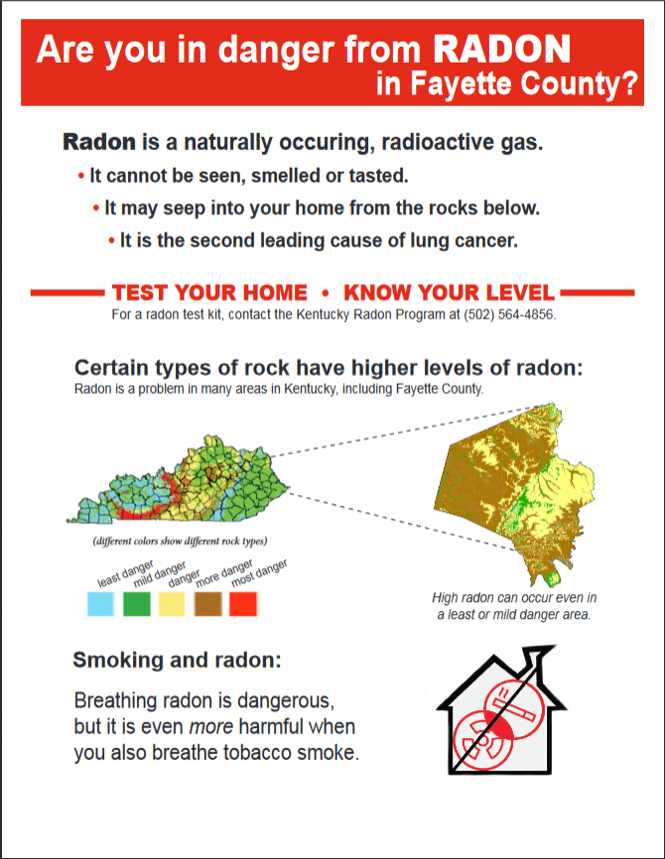
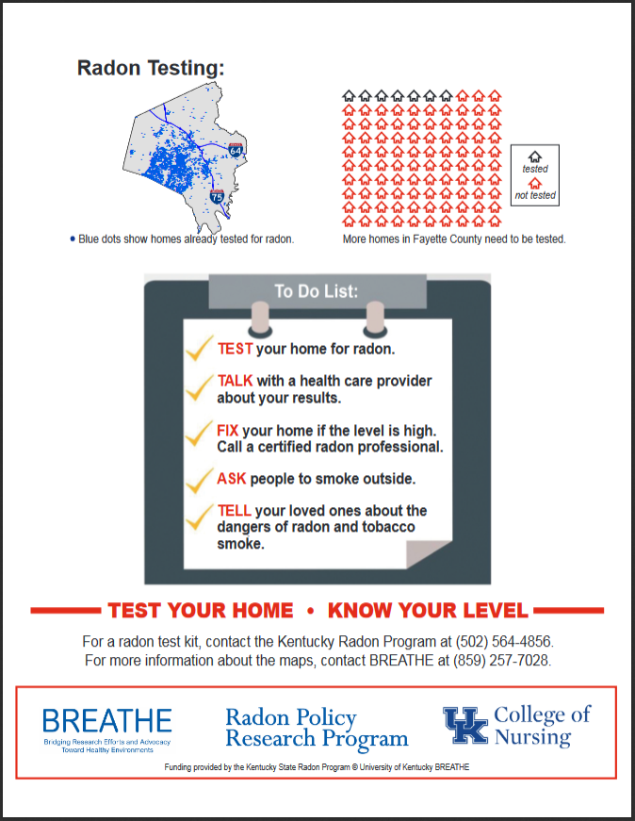

120 county-based infographics for the general public
www.breathe.uky.edu

Slide 35
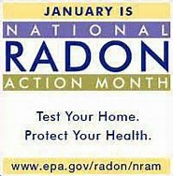


Slide 36

Questions?
Ellen Hahn, PhD, RN, FAAN
Professor & Director, BREATHE
ejhahn00@email.uky.edu
(859) 257-2358
www.breathe.uky.edu

